Slide 1
DIGITAL LITERACY
BEING SMART IN THE 21ST CENTURY

Slide 2
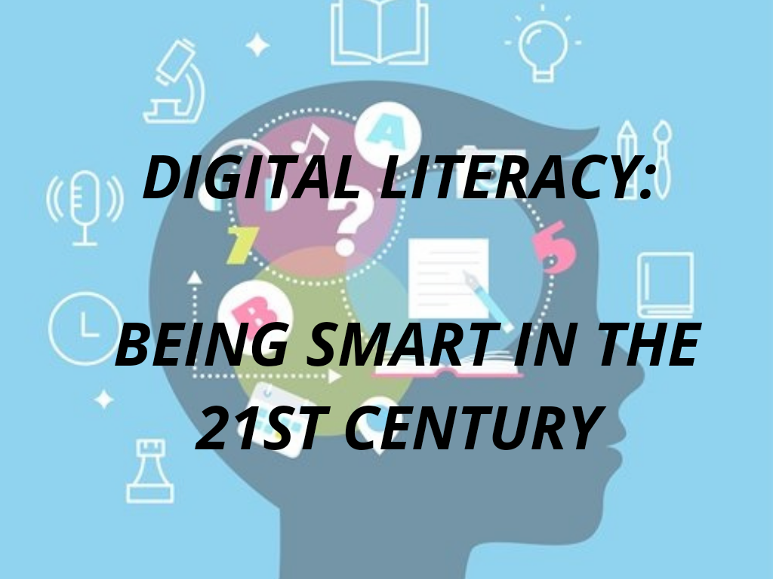

Slide 3
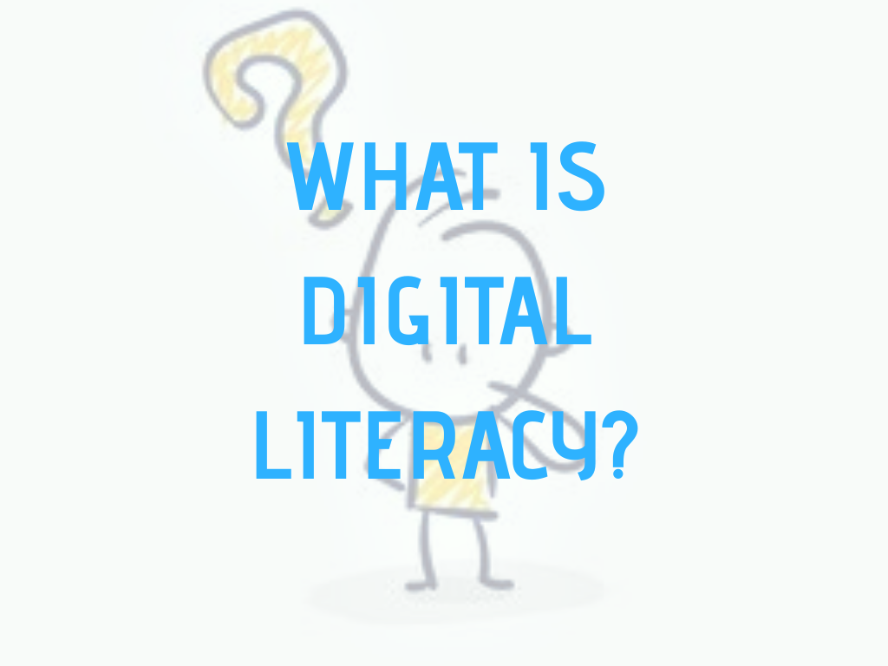

Slide 5
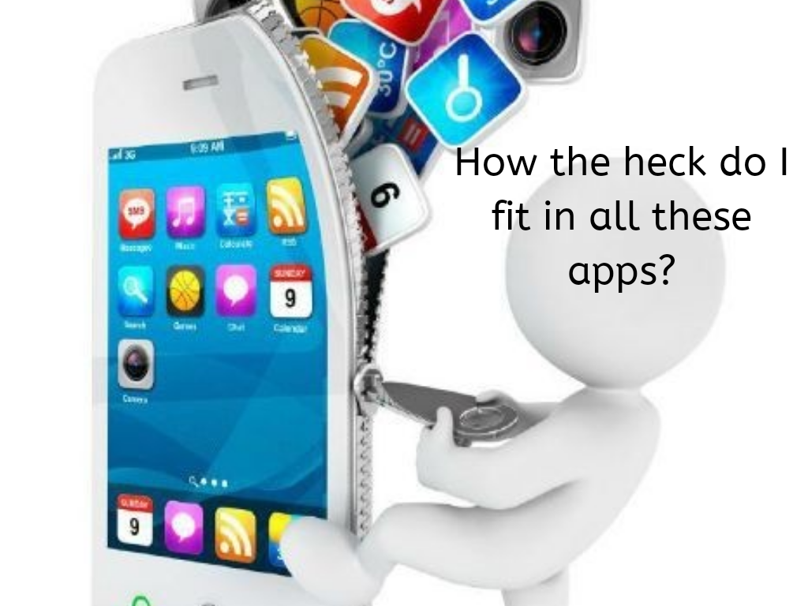

Slide 7
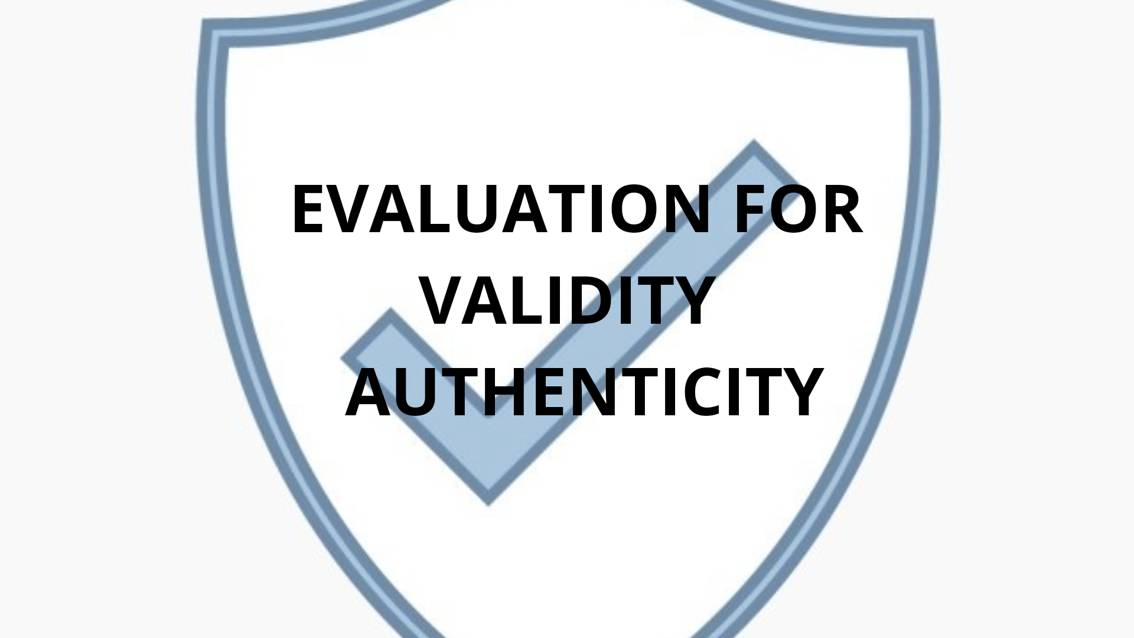

Slide 9
