Slide 1


MANRS
March 2018
Improving global routing security and resilience
  Michuki Mwangi
    mwangi@isoc.org

Slide 2

Internet Routing – what is the problem?
Internet routing infrastructure is vulnerable
  Traffic can be hijacked, blackholed or detoured
  Traffic can be spoofed
  Fat-fingers and malicious attacks
BGP is based on trust
  No built-in validation of the legitimacy
  of updates

Slide 3
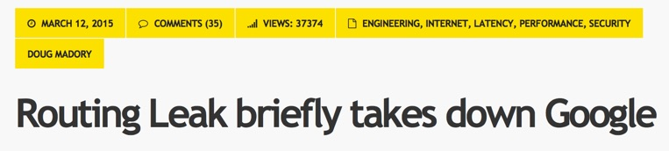
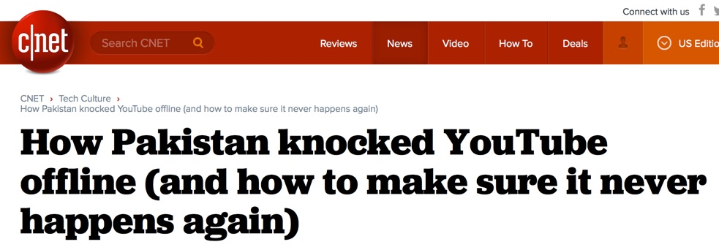


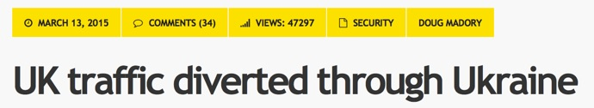
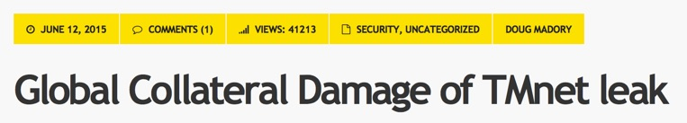
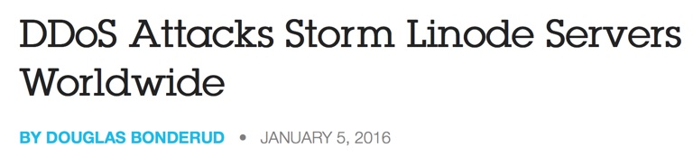
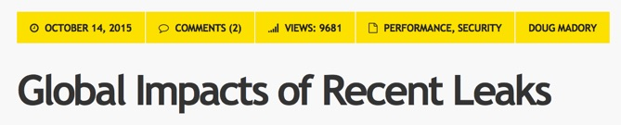

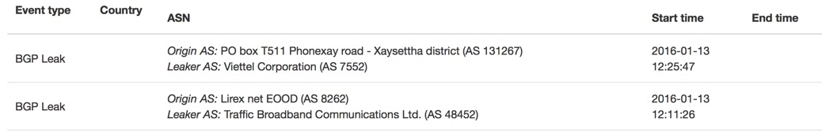
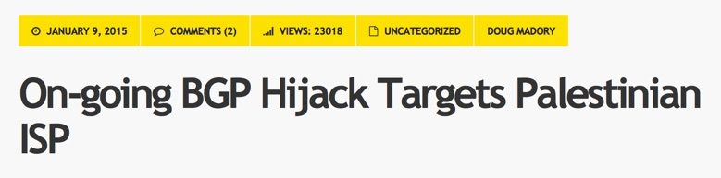

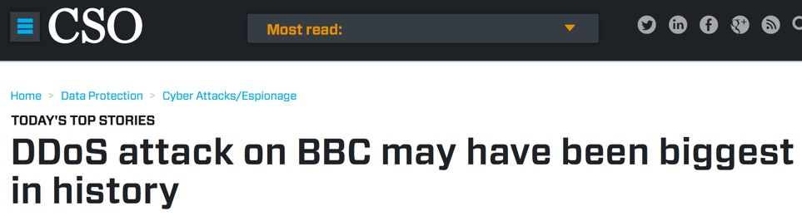
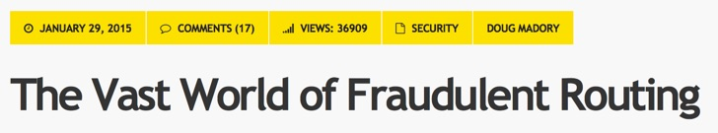
https://bgpstream.com/
Notes:
Plenty of evidence

Slide 4
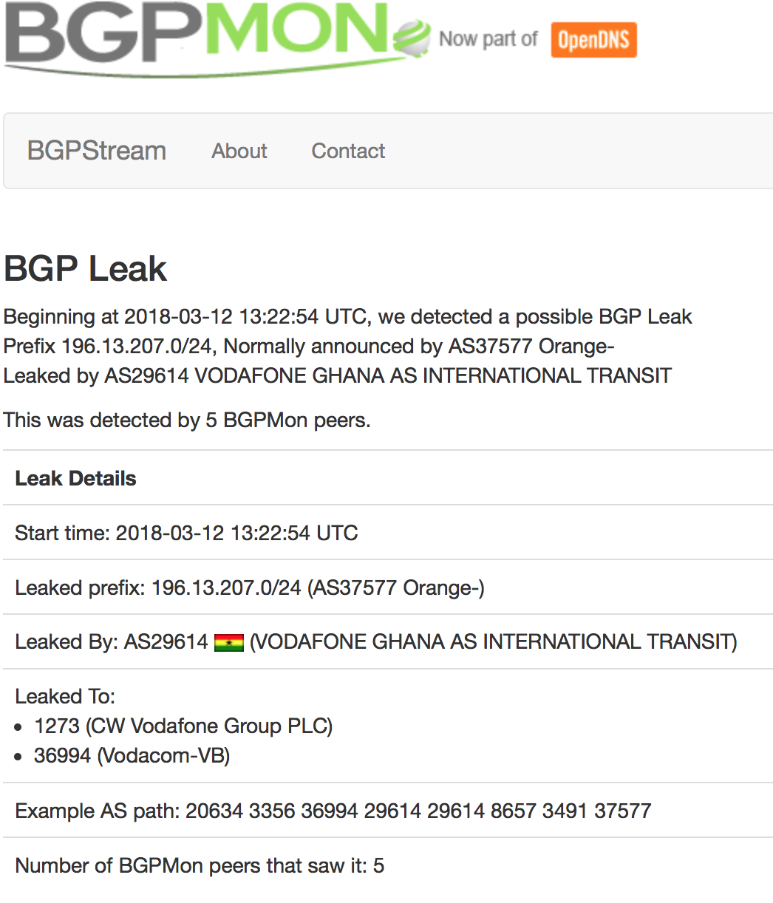
Not a day without an incident data source: http://bgpstream.com/
388 Incidents [December 2017 – January 2018]
BGP Leaks: 226
BGP Hijacks (possible): 162

Slide 5

What’s behind these incidents?
IP prefix hijack
  AS announces prefix it doesn’t originate
  AS announces more specific prefix than what may be announced by originating AS
  Packets end-up being forwarded to a wrong part of Internet
  Denial-of-Service, traffic interception, or impersonating network or service
Route leaks
  Similar to prefix hijacking
  Usually not malicious and due to misconfigurations
  But may also aid traffic inspection and reconnaissance
IP address spoofing
  Creation of IP packets with false source address
  The root cause of reflection DDoS attacks

Slide 6

Are there solutions?
Yes!
  Prefix and AS-PATH filtering, RPKI …
  BGPSEC under development at the IETF
  Whois, Routing Registries and Peering databases
But…
  Lack of deployment
  Lack of reliable data

Slide 7
Mutually Agreed Norms for Routing Security (MANRS)
MANRS defines four concrete actions that network operators should implement
    Technology-neutral baseline for global adoption
MANRS builds a visible community of security-minded operators
    Promotes culture of collaborative responsibility

Slide 8

Good MANRS
Filtering – Prevent propagation of incorrect routing information
  Own announcements and the customer cone
Anti-spoofing – Prevent traffic with spoofed source IP addresses
  Single-homed stub customers and own infra
Coordination – Facilitate global operational communication and coordination between network operators
  Up-to-date and responsive public contacts
Global Validation – Facilitate validation of routing information on a global scale
  Publish your data, so others can validate
Notes:
Limited scope:
MANRS use case: the network and topology
e.g. ensures correctness of their own announcements and announcements from their customers to adjacent networks with prefix and AS-path granularity
e.g. enables source address validation for at least single-homed stub customer networks, their own end-users and infrastructure
e.g. maintain globally accessible up-to-date contact information.

Slide 9
Growth so far…
MANRS members by # of AS

Slide 10
Increasing gravity by making MANRS a platform for related activities
Developing better guidance
  MANRS Best Current Operational Practices (BCOP) document: http://www.routingmanifesto.org/bcop/
Training/certification programme
  Based on BCOP document and an online module http://www.manrs.org/tutorials/
Bringing new types of members on board
  IXPs

Slide 11
Resource Statistics

Slide 13
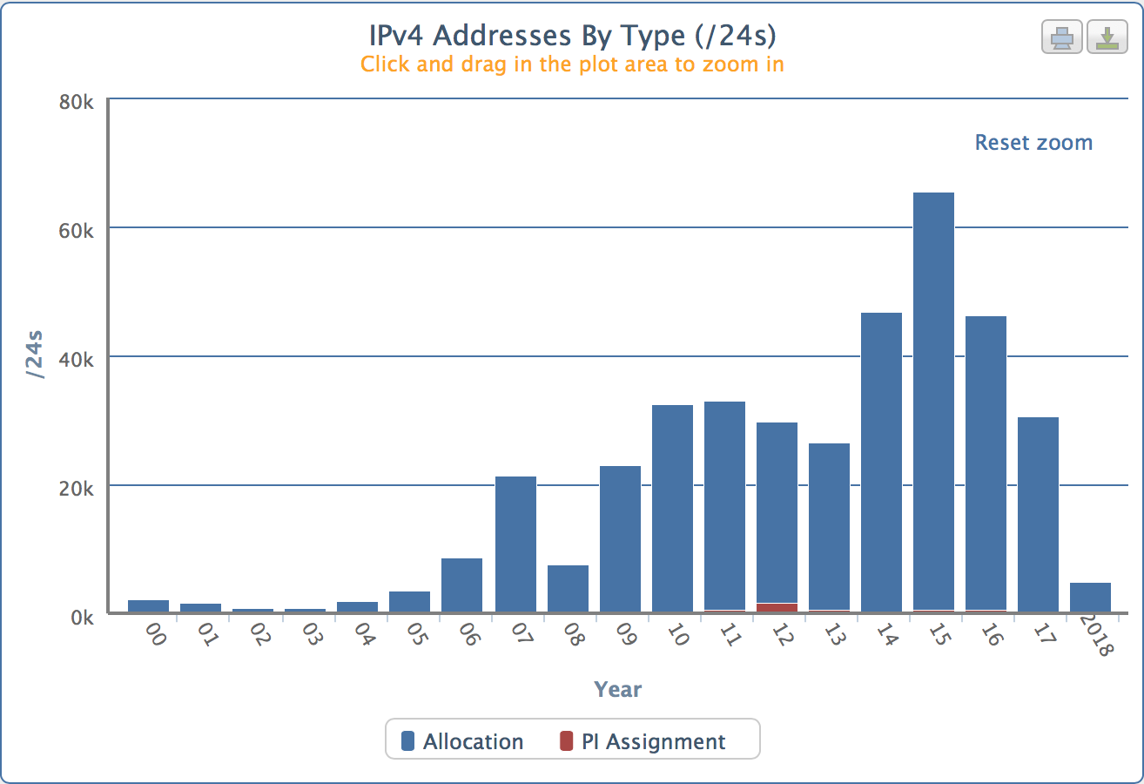
AfriNIC IPv4 Allocations (from 2000 onwards)

Slide 14
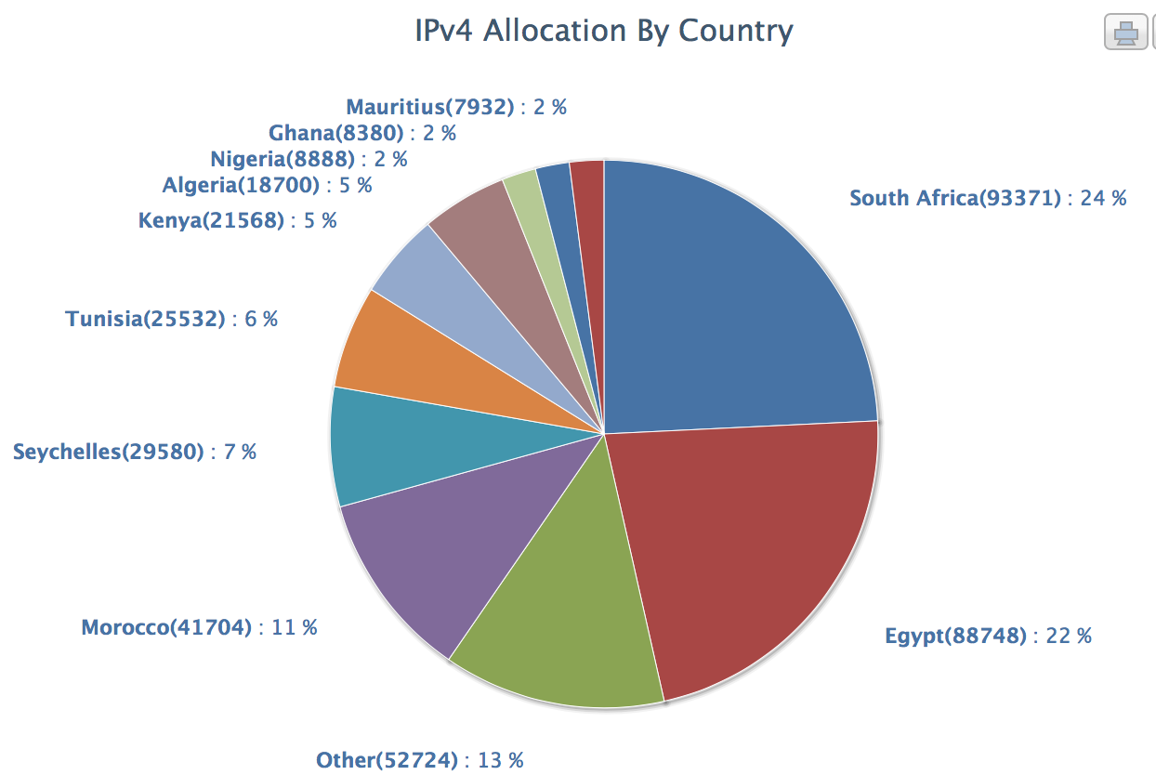
Total Prefixes as at Dec 2017
IPv4 (/24) : 415,746
Pv6 (/32) : 729
ASN : 1,534

Slide 15
AfriNIC Region Analysis Summary – March 2018
Prefixes being announced by AfriNIC Region ASes: 18476
Total AfriNIC prefixes after maximum aggregation: 4005
AfriNIC Deaggregation factor: 4.61
Prefixes being announced from the AfriNIC address blocks: 20777
Unique aggregates announced from the AfriNIC address blocks: 7466
AfriNIC Region origin ASes present in the Internet Routing Table: 1123
AfriNIC Prefixes per ASN: 18.50
AfriNIC Region origin ASes announcing only one prefix: 365
AfriNIC Region transit ASes present in the Internet Routing Table: 227
Average AfriNIC Region AS path length visible: 4.6
Max AfriNIC Region AS path length visible: 21
Number of AfriNIC region 32-bit ASNs visible in the Routing Table: 398
Number of AfriNIC addresses announced to Internet: 95974144
Equivalent to 5 /8s, 184 /16s and 115 /24s
AfriNIC AS Blocks 36864-37887, 327680-328703 & ERX transfers
AfriNIC Address Blocks 41/8, 102/8, 105/8, 154/8, 196/8, 197/8,

Slide 16
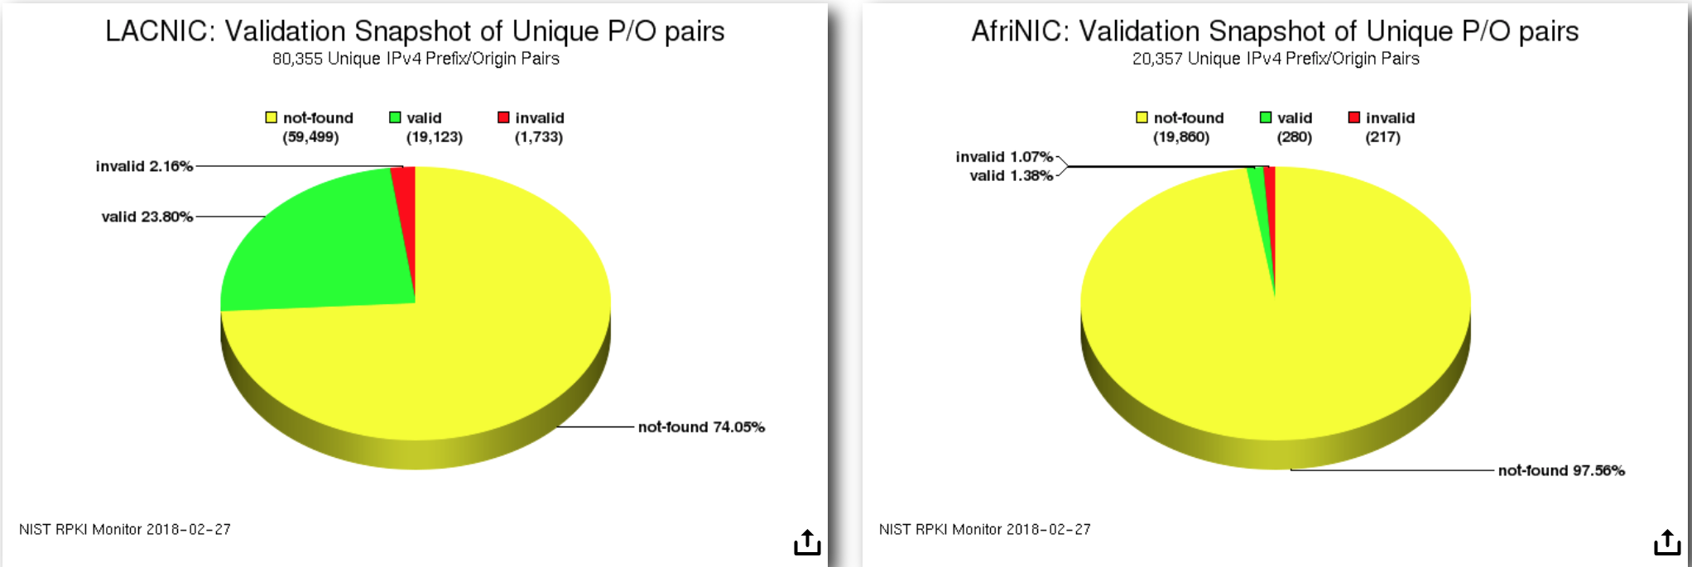
RPKI Validation Comparison

Slide 17
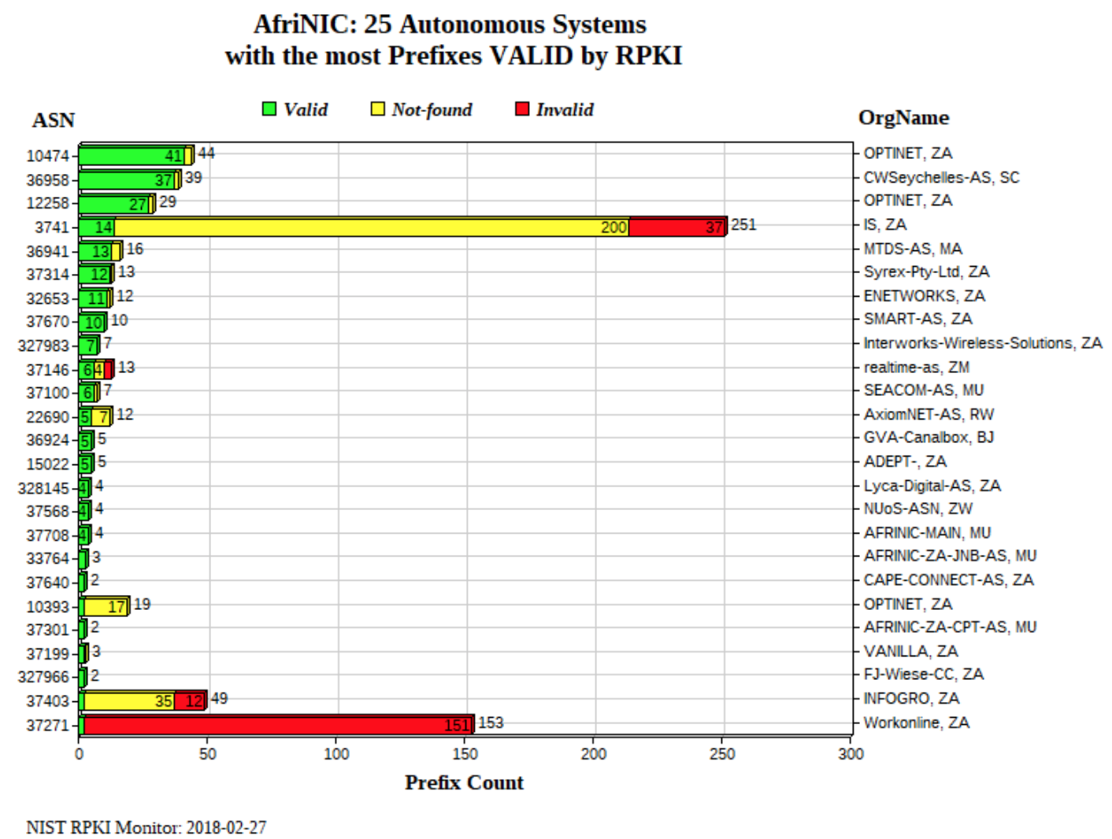

Slide 18
Bogus Prefixes/ASN from Africa

Slide 19
Possible Bogus Prefixes
Prefix | Origin AS | AS Description | Unallocated block
14.128.14.0/23 | AS10247 | NETLINE, ZA | 14.128.12.0 - 14.128.15.255
14.192.50.0/23 | AS10247 | NETLINE, ZA | 14.192.48.0 - 14.192.51.255
14.192.58.0/23 | AS10247 | NETLINE, ZA | 14.192.56.0 - 14.192.59.255
27.100.7.0/24 | AS56096 |  | 27.100.4.0 - 27.100.7.255
36.255.250.0/23 | AS10247 | NETLINE, ZA | 36.255.248.0 - 36.255.251.255
Possible Bogus ASNs
AS36886 | Announced by | AS9129 | KE-NET2000, ZA
AS36886 | Announced by | AS37061 | Safaricom, KE
AS37265 | Announced by | AS37179 | AFRICAINX, ZA
AS37330 | Announced by | AS37061 | Safaricom, KE
AS37500 | Announced by | AS37451 | CongoTelecom, CG

Slide 20
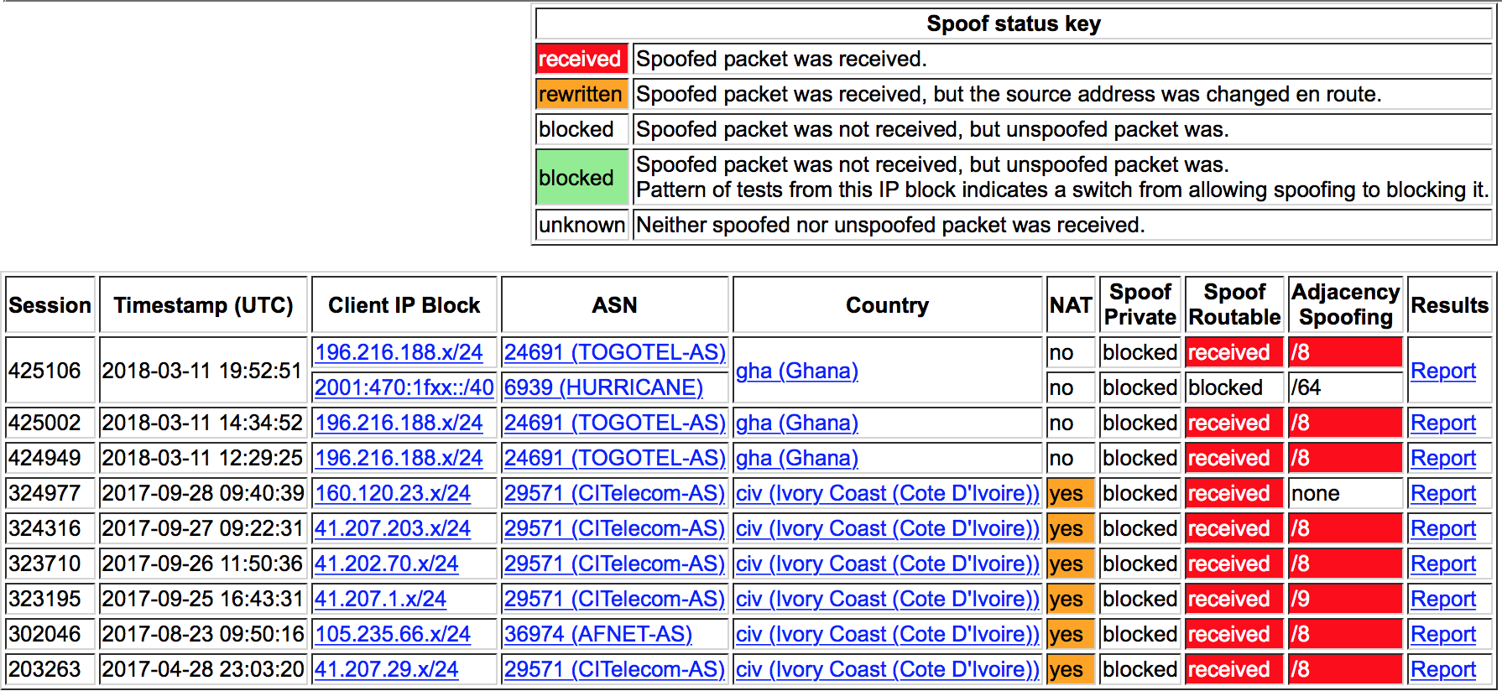
Spoofer Results for Ghana and Cote d’Ivoire
https://spoofer.caida.org/recent_tests.php?sid=425560&as_include=&country_include=gha%2Cciv&no_block=1

Slide 21
Conclusion

Slide 22
Please join us to make routing more secure
Go to https://www.manrs.org/signup/
Provide requested information
Please provide as much detail on how Actions are implemented as possible
We may ask questions and ask you to run a few tests
Routing “background check”
Spoofer https://www.caida.org/projects/spoofer/
Your answer to “Why did you decide to join?” may be displayed in the testimonials
Download the logo and use it
Become an active MANRS participant

Slide 23
Questions?
Feel free to contact us if you are interested and want to learn more
  http://www.routingmanifesto.org/contact/
  Mail: routingmanifesto@isoc.org
Looking forward to your sign-ups:
  http://www.routingmanifesto.org/signup/

