Slide 1
Valorization of Open Data Archive and Documentation of the University of Ibadan Research Metadata Platform (UI-NADA)
http://nada.ui.edu.ng/
Olawale Olayide, Abdulazeez Adelopo & Rising Osazuwa
University of Ibadan, Nigeria
waleolayide@yahoo.com, oe.olayide@ui.edu.ng
WACREN-Hackfest 2016, Lagos, Nigeria

Slide 2
Outline
Scientific problem
Architecture of the use case
Objectives and milestones
Achievements so far
Plans till the end of Hackfest
Post-Hackfest activities and milestones

Slide 3
Scientific Problem and Rationale
Products of researches are expected to be public goods and services
Un-FAIR data are inimical to societal progress
Use case is solving the problem of closed or un-FAIR research data by making research metadata FAIR (Findable, Accessible, Interoperable, and Reusable) on OAR
Enabling re-use, re-analysis & referencing/citation of metadata on existing platform
Using the web creates the advantages of cloud and distributed computing. It enhances visibility and impact in scientific community, policy sphere and the society
Ensuring linkages & sustainability of the platform

Slide 4
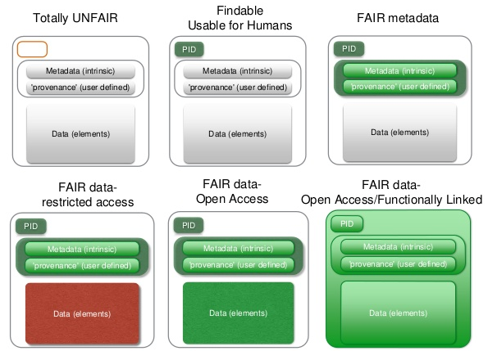
Data as Increasingly FAIR Digital Objects

Slide 5
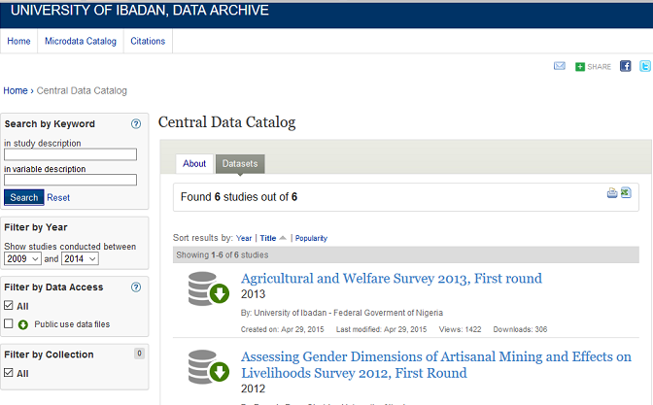
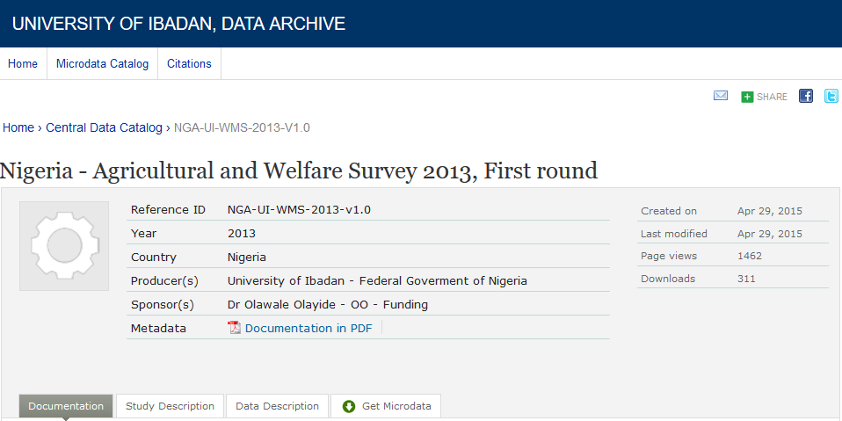
Architecture of the Use Case - http://nesstar.com/

Slide 6
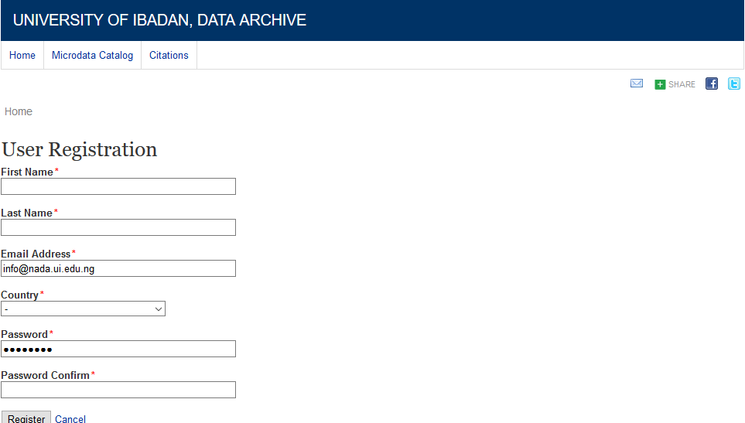

Slide 7
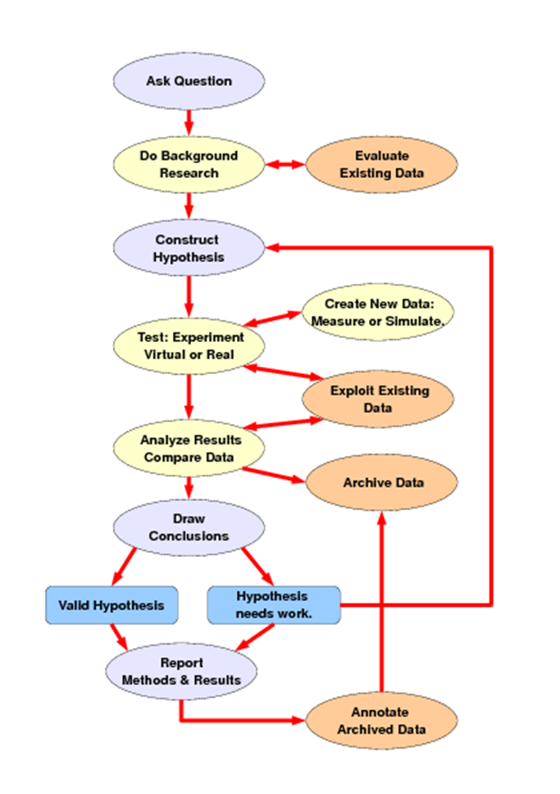
Schema of Research

Slide 8
Objectives and Milestones
Linking UI-NADA to Open Access Repository platforms
Creation of Digital Object Identifiers (DOIs) for UI-NADA metadata on sub-category of Sci-GaIA
Linking UI-NADA to Federated authentication platforms
Data analysis with R, STATA, SPSS, MYSQL
Cloning of OAR on NADA

Slide 9
What has been Achieved
UI-NADA successfully replicated on Open Access Repository platforms
A sub-category of UI-NADA (suffix UINADA) has been created on sci-gaia.eu
Presentations: (https://oar.sci-gaia.eu/collection/PRESENTATIONS%20UINADA?ln=en)
Datasets: (https://oar.sci-gaia.eu/collection/DATASETS%20%20UINADA?ln=en)

Slide 10
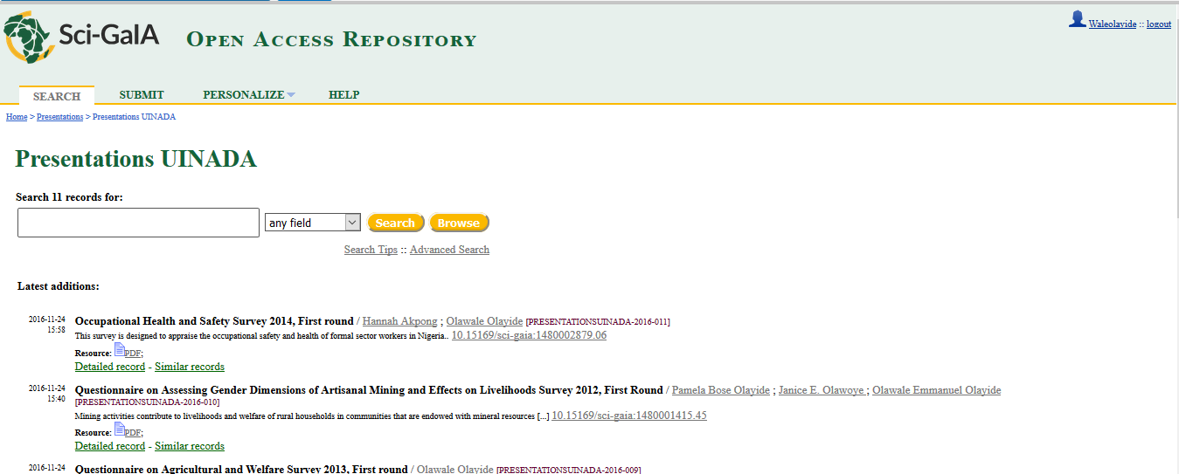
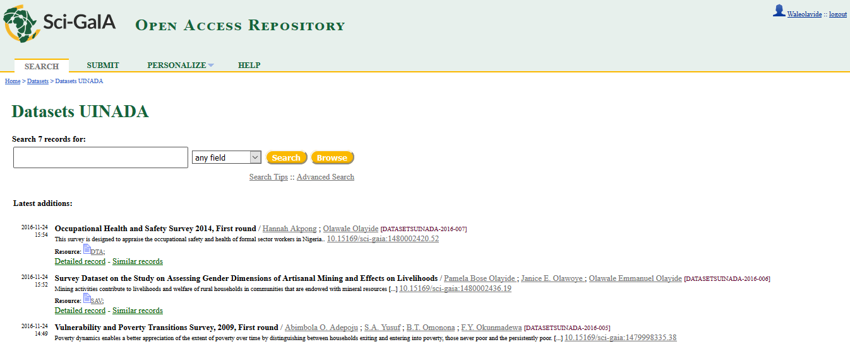

Slide 11
Creation of Digital Object Identifiers (DOIs) for UI-NADA
The process of creation of Digital Object Identifiers (DOIs) for UI-NADA has commenced
Registration of ORCID
Reservation of DOI on the created OAR sub-category on Sci-GaIA
Approval and processing of DOIs by WACREN/Eko-KONNECT

Slide 12
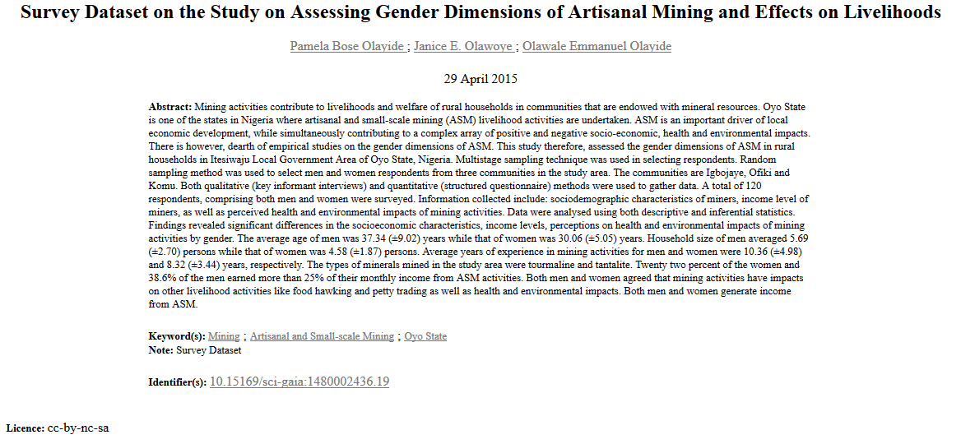

Slide 13
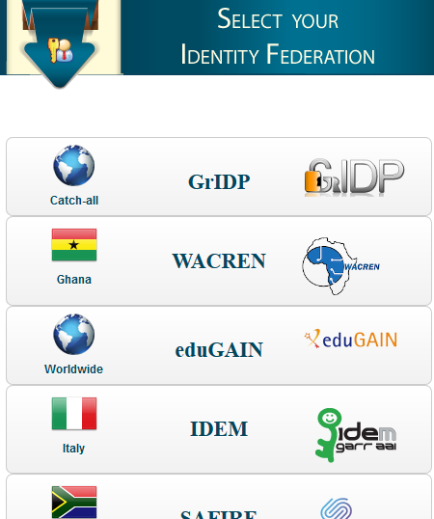
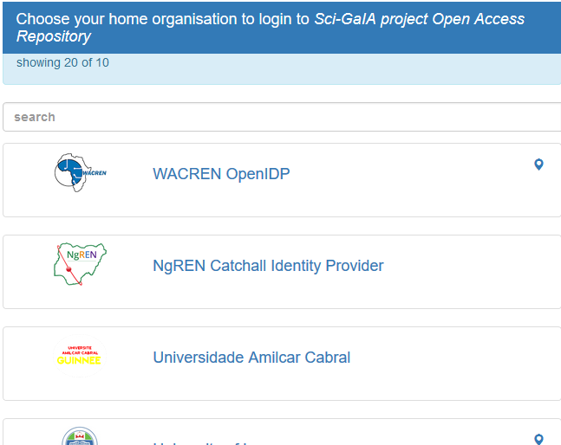
Linking UI-NADA to Federated Authentication Platforms

Slide 14
Problems Encountered

Slide 15
Problems Encountered

Slide 16
Problems Resolved

Slide 17
Progress Made

Slide 18
Purpose Achieved

Slide 19
Plans Till the End of Hackfest
Upload additional documents and data on the repository
Link the publications and DOIs to ORCID (somewhat automatically?)
Collaborate with other participants

Slide 20
Post-Hackfest Activities and Milestones
Phase 1 (1-2 months):
Upload all NADA data and other resources to the UINADA sub-categories in the Sci-GaIA OAR, allocate DOIs and connect to ORCID IDs
Create a NADA website that exposes the datasets through the Invenio REST API
Organise workshop on ORCID for academic staff and PhD candidates
Phase 2 (1-2 months):
Deploy a clone of the Sci-GaIA OAR (uioar.sci-gaia.eu) at Ibadan University (oar.ui.edu.ng)
Move the NADA data to the new OAR
Link the NADA website to the new OAR
Organise workshop on research data and publications documentations

Slide 21
The Valorization Procedure and Architecture
Opendata.ui.edu.ng
Federated log-in
Publications
Datasets
Registration
Metadata

Slide 22
Acknowledgements
Sci-gaia
WACREN
Eko-Konnect
OECD/PARIS21
University of Ibadan
Team members

Slide 23
Thank you!
waleolayide@yahoo.com, oe.olayide@ui.edu.ng
+2348035973449

