Slide 1
Valorization of Open Data Archive and Documentation of the University of Ibadan Research Metadata Platform (UI-NADA)
http://nada.ui.edu.ng/
Olawale Olayide, Abdulazeez Adelopo & Rising Osazuwa
University of Ibadan, Nigeria
waleolayide@yahoo.com, oe.olayide@ui.edu.ng
WACREN-Hackfest 2016, Lagos, Nigeria

Slide 2
Outline
Scientific problem area
Starting point
Where we are
Computational and data model
Implementation strategy
Where we want to be

Slide 3
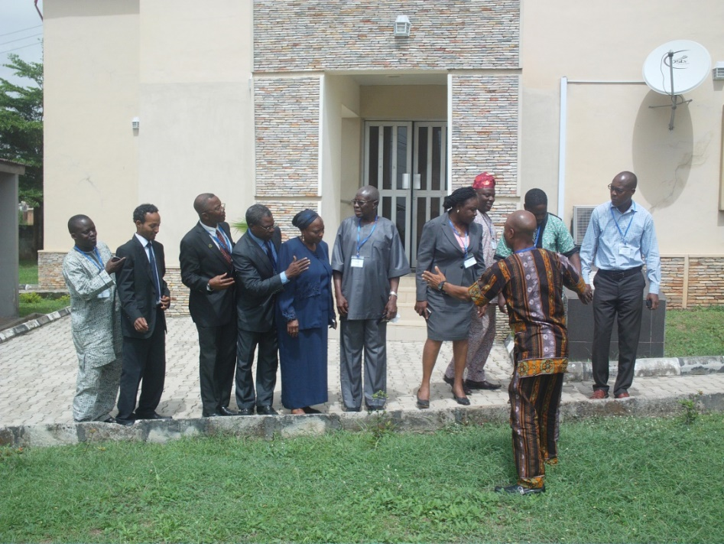
Starting Point
- Proposal development
- Coordination
- Collaboration
- Networking

Slide 4
Scientific problem and overview of use case
This is a meta data open access and open science platform
It is solving the problem of closed research data
It proposes re-use, re-analysis & referencing/citation tracking of existing platform
Using the web creates the advantages of cloud and distributed computing. It will create further visibility and impact in scientific community, policy sphere and the social media
To promote more collaboration
To ensure sustainability of the platform

Slide 5
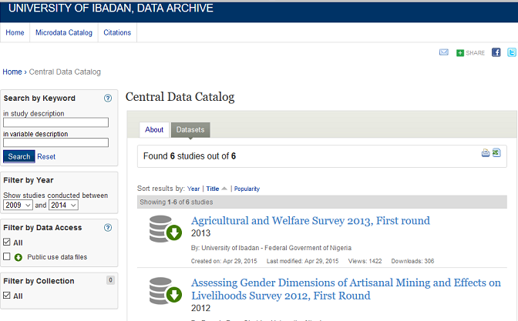
Where we are

Slide 6
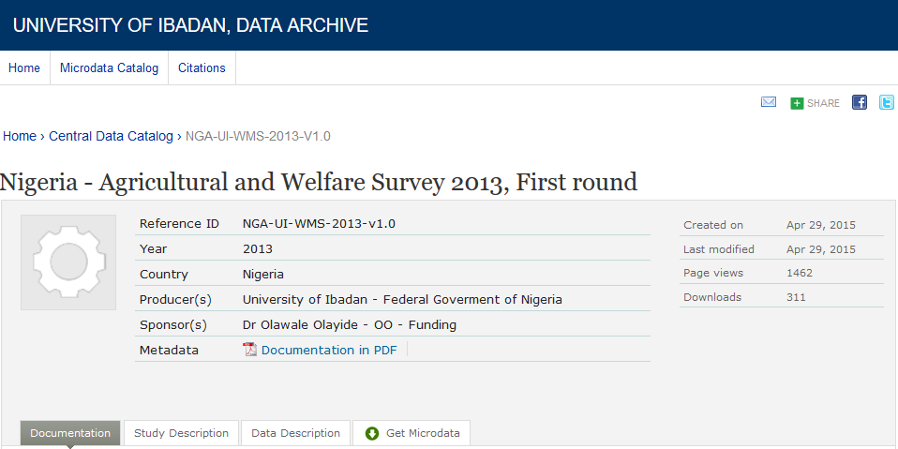

Slide 7
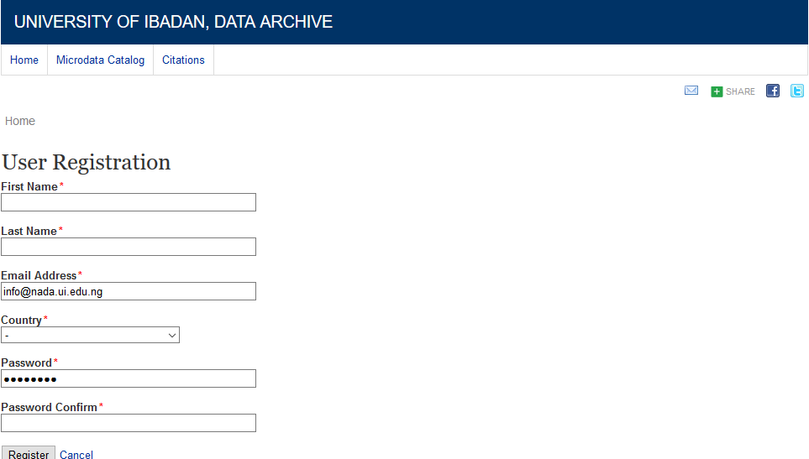

Slide 9
Where we want to be – Sustainably FAIR, Friendly & Functional
Repeatability
The closeness of agreement between independent results obtained with the same method on identical test material, under the same conditions (same operator, same apparatus, same laboratory and after short intervals of time)
Affected by random errors
Reproducibility
The closeness of agreement between independent results obtained with the same method on identical test material but under different conditions (different operators, different apparatus, different laboratories and/or after different intervals of time)
Affected by systematic errors

Slide 10
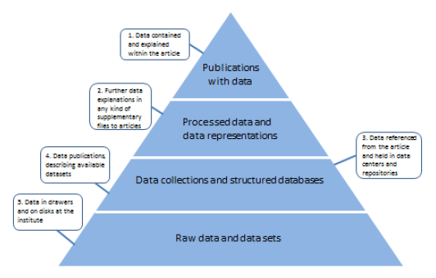
Source: Reilly, S. et al. (2011), Report on Integration of Data and Publications, ODE, Opportunities for Data Exchange

Slide 11
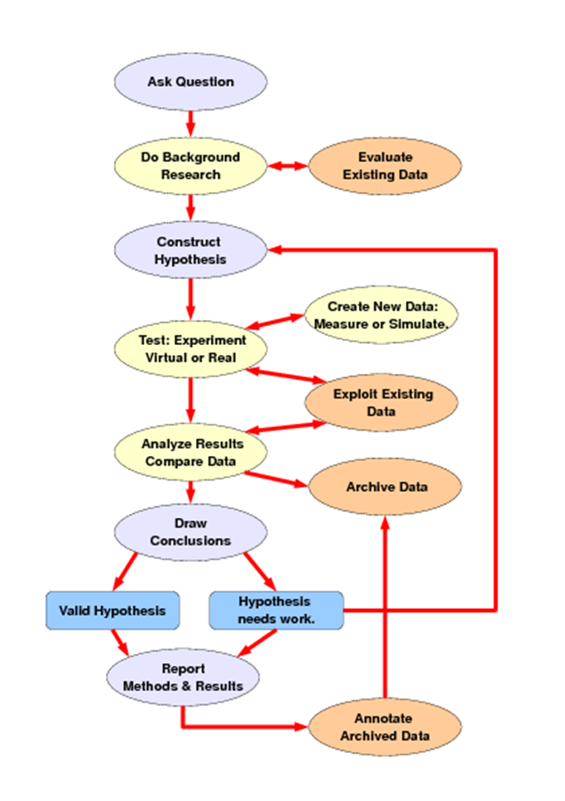
Workflow/schema

Slide 12
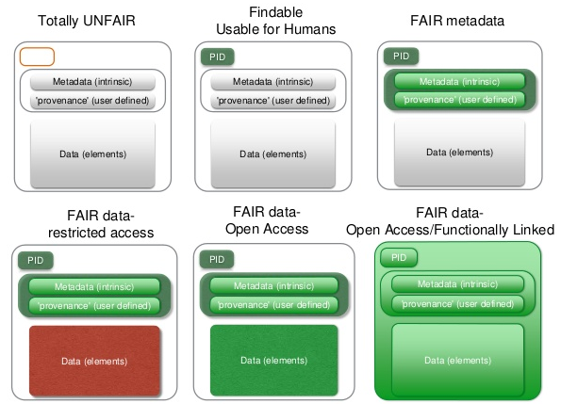
Data as increasingly FAIR Digital Objects

Slide 13
Identified Gaps
(FAIR Data, Friendly & Functionally Linked)
Re-use
Boosting multiple uses at scale (aggregation and disaggregation)
Re-analysis
Further analysis of datasets with illustrations
Referencing/citation tracking
Linking to DOI and OAR platforms, including social media platforms
Mobile Platforms

Slide 14
Data model
The various workflows that users of the application will undertake –
Researchers are given privileges to upload
Research documentation (by researchers)
Anonymous users (allowed to download upon registration)
Data origins – Research data from researchers and lecturers
Ingestion, management – Administrator assign privileges
Where are you getting data from? – Data from researchers
Where should it be moved to? – Archive/repository!!!
Where should it finally be stored? – Server/cloud
REST API?

Slide 15
Computing model
Which of these models apply to you ?
High throughput computing (grid/cloud/p2p) Yes
High-performance computing (grid/HPC) No
On-demand computing cloud computing (commercial cloud) No
Persistent cloud computing (commercial/private cloud) No
Ubiquitous computing (#GIFEE) Yes
Mobile computing (Android/iOS apps, Messaging) Yes

Slide 16
Implementation strategy
Project plan – to be done with GitHub issues and with milestones
Creation of DOIs and linking of metadata to OAR platforms
Two milestones :
Mid-hack checkpoint – creation of DOIs for metadata
End-of hack checkpoint – linking of metadata to OAR platforms
We require features of DOIs and OAR platforms
Names and dates of your milestones
Mid-hack checkpoint – 26 November 2016
End-of hack checkpoint – 30 December 2016

Slide 17
Risks and unknowns
What could get on the way/obstacles
Time (other official workloads, etc)
Resources (internet, server, electricity, etc)
Strike actions or lack of commitment by team members

Slide 18
Summary (Expected Outcomes)
Include Federated log-in (Research networks, e.g., WACREN, NgREN, etc)
Create DOI for documentation and data
Link to social media platforms (Twitter & Facebook)
Include compatible graphical analysis tools?

Slide 19
Acknowledgements
Sci-gaia
WACREN
Eko-Konnect
OECD/PARIS21
University of Ibadan
Team members

Slide 20
Thank you!
waleolayide@yahoo.com, oe.olayide@ui.edu.ng
+2348035973449

