Slide 1
IBIS, A Framework For the Interoperability Of Bio-repository Information System In Africa - Final report
Abayomi Mosaku and Boladele Akanle - Covenant University, CUBRe - Nigeria
WACREN e-Research Hackfest – Lagos (Nigeria)

Slide 2
Outline
Scientific problem
Work done during the hackfest
Results achieved so far
Future plans
Summary and conclusions

Slide 3
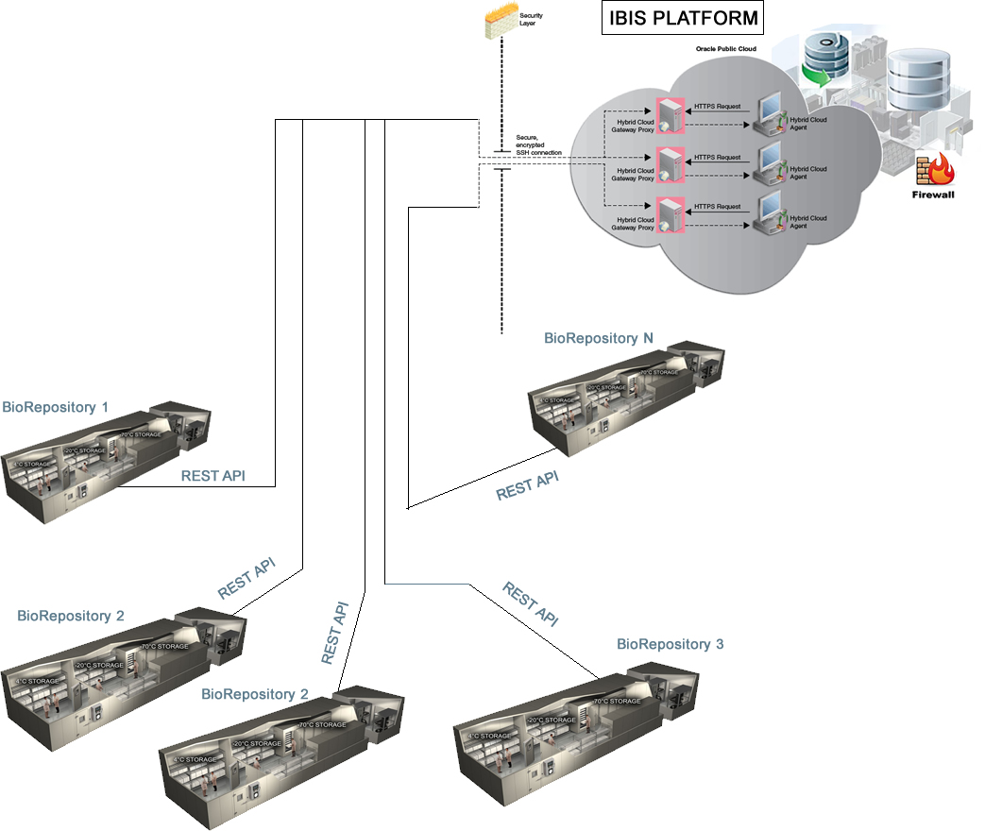
Scientific Problem
"Interoperability is the ability of multiple systems with different hardware and software platforms, data structures, and interfaces to exchange data with minimal loss of content and functionality" [NISO, 2004].

Slide 4
Scientific Problem
Bio-repositories have been developed for specific projects in local institutions, but most of such bio-repositories are often not interoperable.
This inadequacy makes it difficult for researchers to share data conveniently from a common centre (Kim, 2010).
The absence of Interoperable bio-repository information system in Nigeria/Africa has made it difficult for researchers to obtain needed data for their research into diseases .
Accessibility to repositories through such search tools as Specimen Resource Locator, and tissue Expediter among several others has provided indication that further improvement can be made through research efforts.
Observations (Krestyaninova, 2010; Tupasela, 2009) have shown that most database systems rely on database administrators to design and maintain database architecture and this process imposes constraints on database users when non-standardized input formats and parameters are set.
This inconsistency is generally a problem in addition to the loss of flexibility and control by individual databases to a central authority. These are obvious problems to which interoperability of biorepository systems could be a viable solution.

Slide 5
Other Problems We Are Solving
Inter-operability Problems
Schema Inter-operability Problems
Semantic Inter-operability Problems
Linguistic Inter-operability Problems

Slide 6
Work done during the Hackfest
Started Developing Meta Database using g-Library (was formally developed in Mysql)
Implement back end using JSP, Servlet, JDBC and connected 3 test biorepositories with successful search
Adjusted the Internationalization and language handling Implementation
Implemented data mining (K means algorithm) for real time knowledge discovery from multiple databases.
Develop Java Server Pages that auto generated Attribute-Relation File Format (ARFF) to complete the KDD
We implemented Java JENA library to connect to the Ontology but we have not built the Ontology
Incorporated SPARQL Protocol and RDF Query Language
Kick started Future Gateway Implementation
Initiated the implementation of Federated Identity

Slide 7
Work done during the Hackfest
Develop User Interface and user interactivity using Hypertext Mark-up Language (HTML) and Java scripting
Style the interface using Cascading Style Sheet (CSS)
Accomplish mobile responsiveness using the CSS 3 @media Query
Develop angularjs & javascript modules to ensure input data integrity and enforcing client side user validation but more is still to be done.
Test Deployment using Amazon Cloud Service Free Package

Slide 8
Work done during the Hackfest
Started Developing Meta Database using g-Library (was formally developed in Mysql)

Slide 9
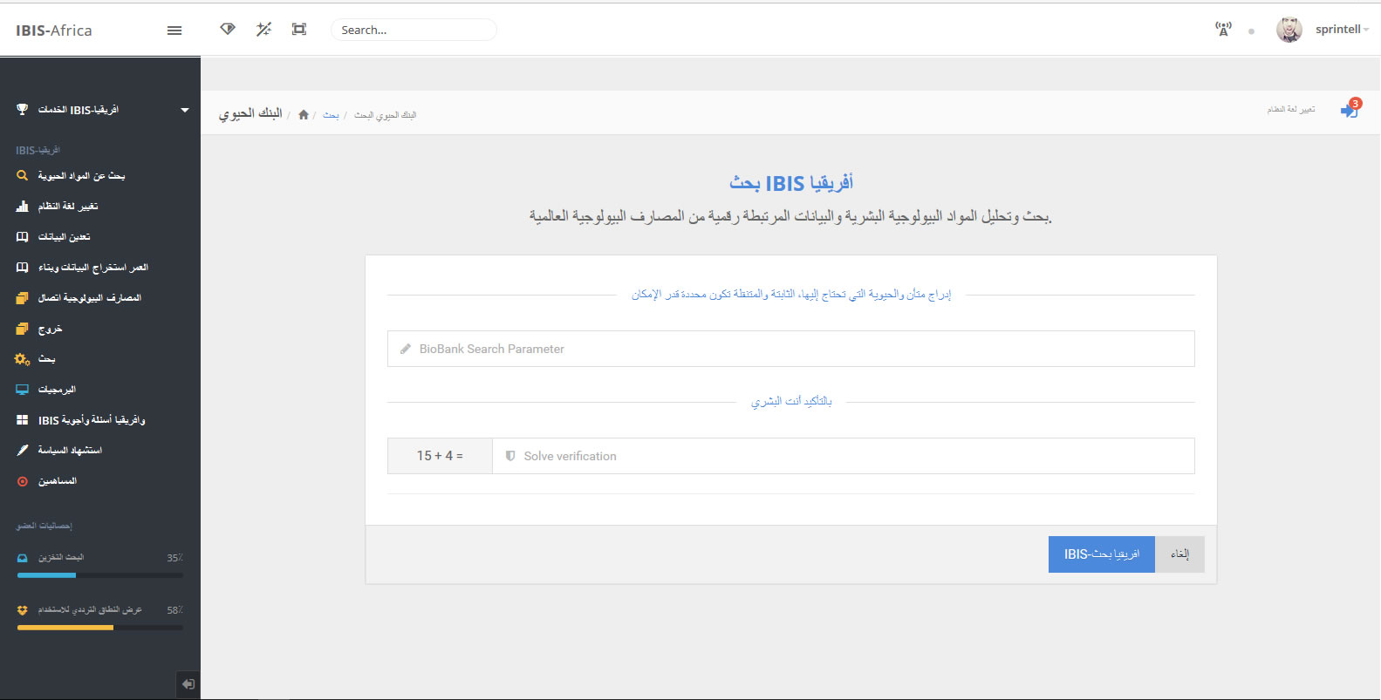
Work done during the Hackfest
Adjusted the Internationalization Implementation

Slide 10
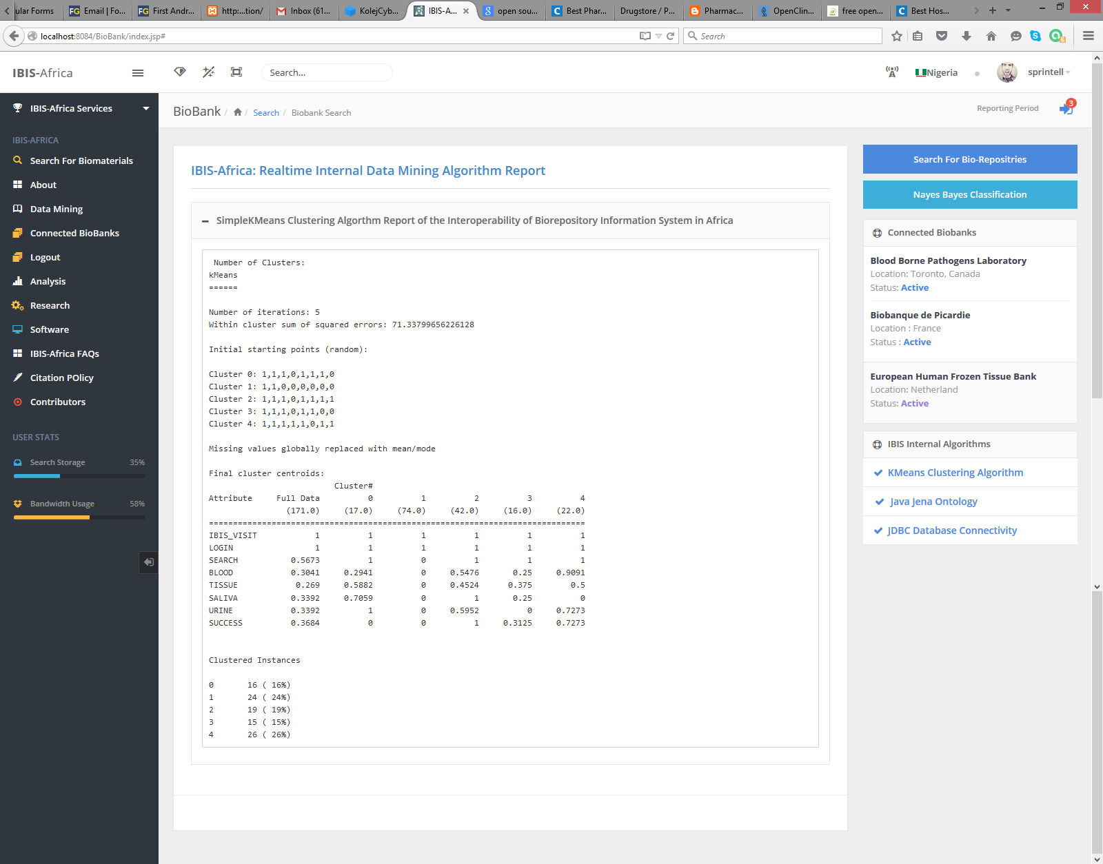
Work done during the Hackfest
Implemented data mining (K means algorithm) for real time knowledge discovery from multiple databases.

Slide 11
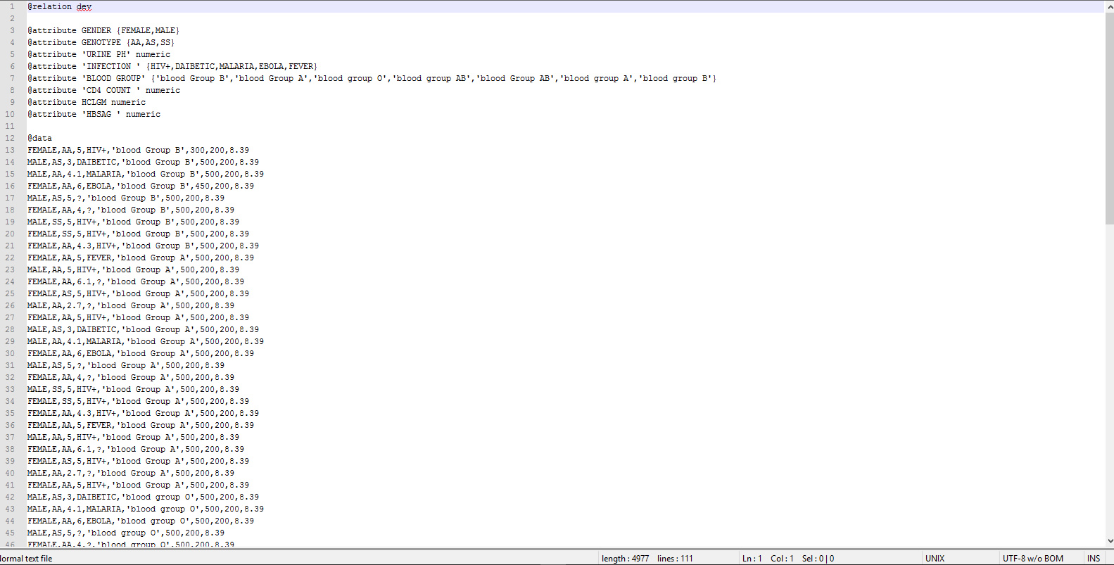
Work done during the Hackfest
Develop Java Server Pages that auto generated Attribute-Relation File Format (ARFF) to complete the KDD

Slide 12
Work done during the Hackfest
Develop Java Server Pages that auto generated Attribute-Relation File Format (ARFF) to complete the KDD

Slide 13
Work done during the Hackfest
Implemented data mining (K means algorithm) for real time knowledge discovery from multiple databases.

Slide 14
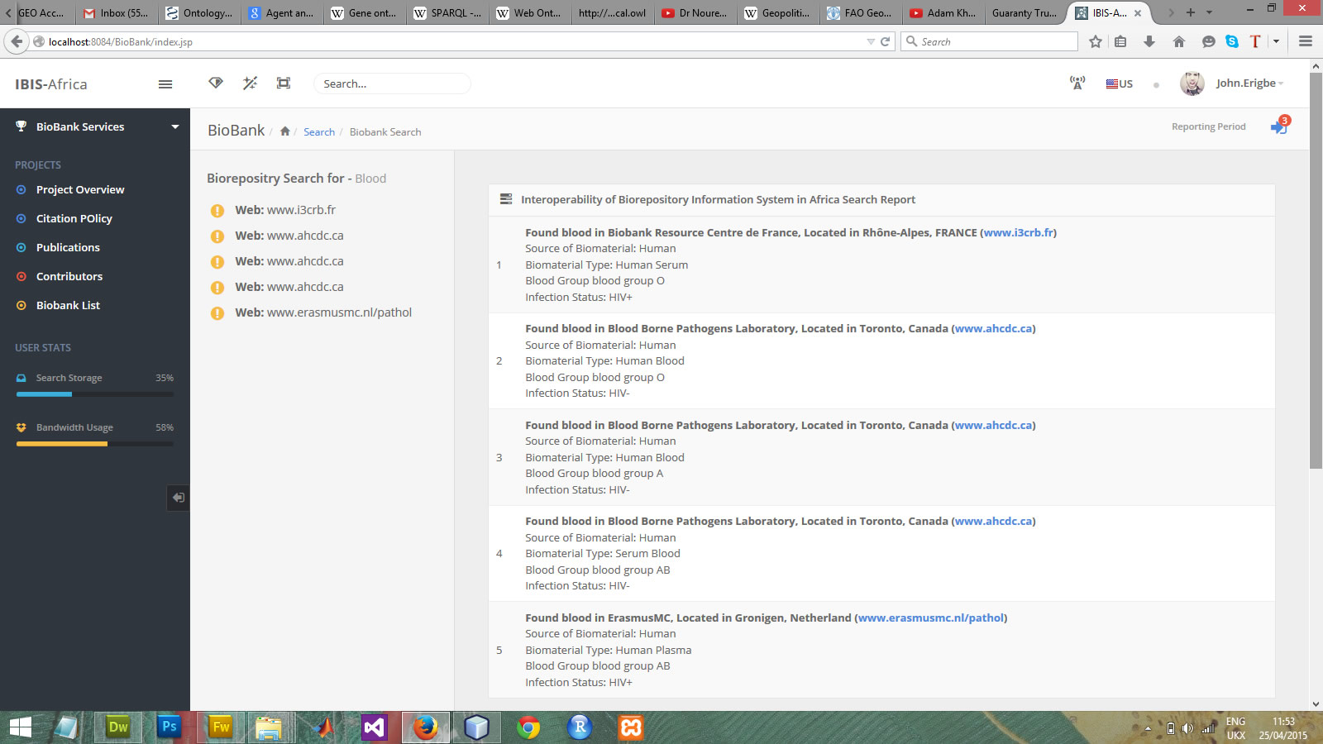
Work done during the Hackfest
Implement back end using JSP, Servlet, JDBC and connected 3 test biorepositories with successful search

Slide 15
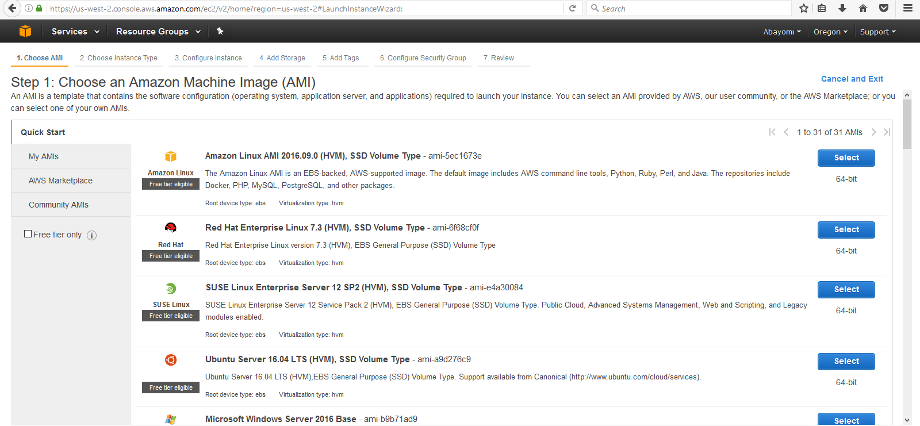
Work done during the Hackfest
Test the Front end Web App Deployment using Amazon Elastic Cloud (EC2) Service 1 year Free Package

Slide 16
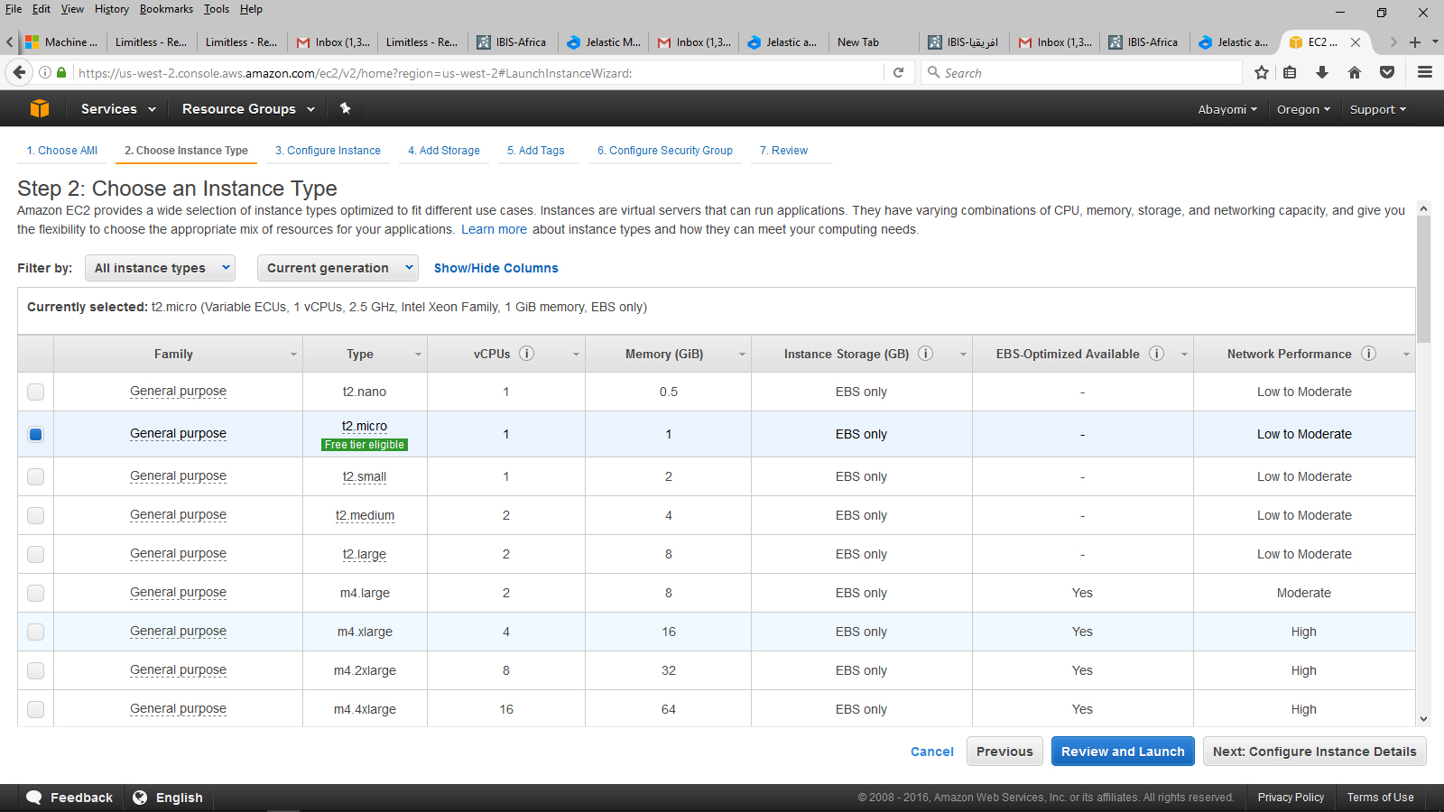
Work done during the Hackfest
Test the Front end Web App Deployment using Amazon Elastic Cloud (EC2)

Slide 17
Future plans (until the Sci-GaIA Final Event in Pretoria on March, 23-24, 2017)
Implement SAML (Security Assertion Markup Language) or OAuth for Federated Authentication, and develop Java Servlets & Java API for RESTful Web Services (JAX-RS)
Complete Meta database store using gLibrary
Develop mini-ontology using Protege and the Ontology Web Language
Incorporate more data mining algorithms aside Kmeans for real time knowledge discovery from multiple databases.
Coding D3.js (Data Driven Document) for real time visualization of data mining outputs
Develop Java API for HL7 (Health Level 7) to standardize the records before pushing to glibrary.
Develop More on the Administration End for Connecting meta databases
Perfect the Implementation of Federate Identity
Complete the Implementation of JAX Web Service to connect to gLibrary
More UI and Validation Perfection based on previous specifications
Make it available as a Portlet on the African grid science gateway

Slide 18
Summary and conclusions
Afforded us Time to implement a lot of things we had mind
Opportunity to meet Other scientist and researchers and shared from their wealth of knowledge
Privilege to have an assurance that what we develop will be globally accessible via the European science gateway
Afforded us to better utilize the Github, Slack platform for collaboration
Afforded us the opportunity to explore our HPC servers more, as for the first time I had to personally install tomcat on a live centOS server and host web application and database
Assurance that this project will be completed

Slide 19
Thank you!
sci-gaia.eu
info@sci-gaia.eu
Great thanks to:
Bruce
Mario
Prof. Aribisala and LASU
EkoConnect
Wacren
SciGaia

