Slide 1

Technology Clinic: Climate Data, AI, APIs & Rapid Prototyping
A practical guide to climate data, satellite imagery, AI, APIs, and rapid prototyping — designed for teams building solutions at the intersection of climate and human impact.
START WITH THE PROBLEM. THEN FIND THE SIMPLEST CREDIBLE TECHNOLOGY TO TEST YOUR SOLUTION.
Yazid Salahudeen Mikail

Slide 2




The Four-Layer Technology Stack
Before selecting any tool, ground your choices in what your user must actually do by the end of today's sprint. The target is one working or simulated user journey — not a complete production system.
1. Data
2. Analysis / AI
What information do we need?
How do we turn information into an insight?
3. API / Integration
4. User Interface
How does information move between systems?
How does the user access and act on the result?

Slide 3
Climate Data: What Types Exist?
A dataset is an organised collection of observations, measurements, records, or model outputs. Not all climate data are interchangeable — always check what a dataset measures, its time period, resolution, uncertainty, and permitted uses before selecting it.
Data Type | Simple Definition | Example Application
Weather observations | Measurements of conditions that occurred, such as rainfall or temperature | Monitor recent rainfall
Weather forecasts | Model-generated estimates of future weather | Provide advance warnings
Climate records & reanalysis | Historical climate estimates combining observations and modelling | Examine rainfall trends and past extremes
Climate projections | Model simulations of possible future climates under specified scenarios | Assess long-term climate risks
Earth observation (EO) | Information collected by satellites or remote-sensing instruments | Map vegetation, water, or land-cover changes
Socioeconomic & field data | Information about people, livelihoods, infrastructure, or local conditions | Understand vulnerability and adaptation capacity

Slide 4



Satellite Imagery & Earth Observation
Earth observation (EO) means collecting information about the Earth using satellites and remote-sensing instruments. EO data can help monitor vegetation, land cover, surface water, floods, fires, and other environmental conditions at scale.
Key Satellite Products
Key Platforms & Resources
Sentinel-1
Sentinel-2
Copernicus Data Space
Google Earth Engine
Radar imagery; penetrates clouds. Useful for flood extent and land-surface changes.
Optical imagery for vegetation, crop conditions, land cover, and water analysis.
Free access to Sentinel imagery and tools to view, compare, and download EO products.
Cloud platform for analysing large satellite datasets without downloading data locally.
Landsat
MODIS & GPM IMERG
USGS EarthExplorer
NASA Earthdata Search
Long-term optical and thermal observations for land-cover change and surface temperature.
Broad-area vegetation, temperature, fire indicators, and satellite precipitation estimates.
Search and download Landsat imagery and other EO datasets.
Discover and access NASA Earth science datasets and satellite observations.
Key terms: Raster, Spatial resolution, NDVI, Land-surface temperature, Revisit frequency. An indicator is not the same as the phenomenon it estimates.

Slide 5
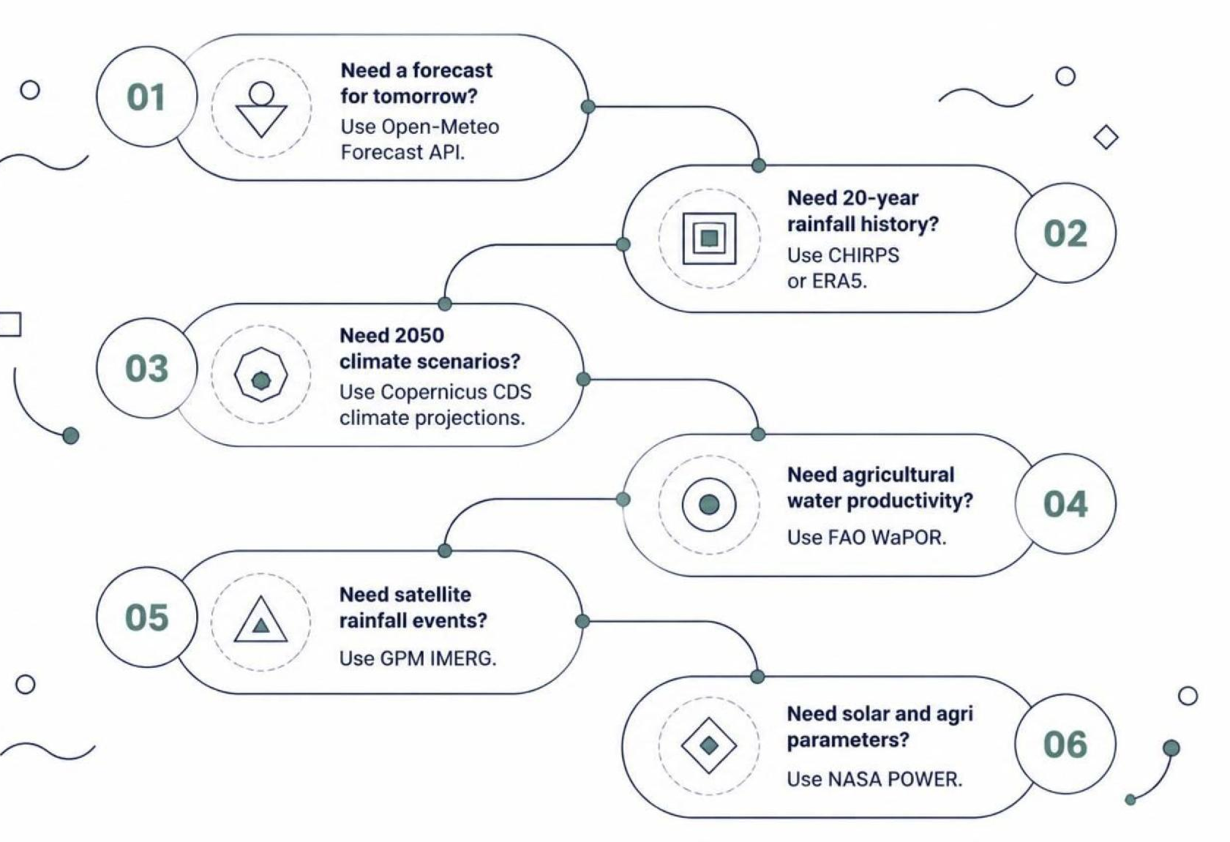
Weather, Rainfall & Climate Datasets
These sources serve different time horizons and questions. Choosing the wrong dataset for your question — for example, using a weather forecast to assess 2050 climate risk — produces unreliable results. Always check time step, geographic resolution, variables, validation, licence, and uncertainty.
01
Open-Meteo
Forecast and historical weather APIs; easiest way to connect a prototype to weather data quickly.
02
Copernicus CDS & ERA5
Portal for climate datasets, reanalysis, and long-range climate projections.
03
CHIRPS & GPM IMERG
Long-term rainfall datasets combining satellite and station data; ideal for drought and variability analysis.
04
FAO WaPOR & World Bank Portal
Remote-sensing water productivity data and country-level climate risk profiles.

Slide 6
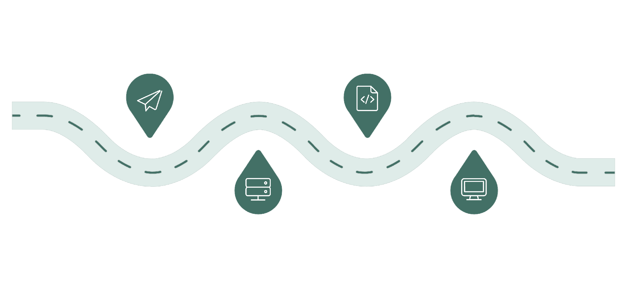
APIs: Connecting Climate Data to Your Application
An API (Application Programming Interface) is a defined way for one software system to request data or an action from another. Think of it as a service counter: your application submits a request with agreed parameters, and the service returns structured data — or an error.
Request
Response
Send location, date, and variable
Return structured JSON or CSV
API Service
User Interface
Retrieve or compute climate data
Display forecast, alert, or recommendation
Critical Checks Before Using Any API
Verify timestamps and units match your use case | Confirm location coverage and model limitations
Implement error handling for missing or failed responses | A successful API response does not prove forecast accuracy for health or agricultural decisions

Slide 7



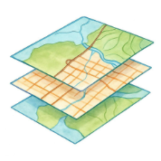
Climate AI: What Can You Actually Build?
AI is not one technology. Choose the method based on the output your user needs and the evidence available to support it. Not every climate problem needs machine learning. A well-designed rule, reliable dataset, and clear interface may be more useful than an unvalidated predictive model.
Rules-Based & Statistical Systems
Machine Learning & Computer Vision
LLMs & Retrieval-Augmented Generation (RAG)
GeoAI & Hybrid Systems
Apply predefined thresholds or expert-approved conditions. Generate an alert when rainfall crosses a defined limit. Analyse trends and weather–health associations. Often the most appropriate starting point.
Learns patterns from historical examples to predict or classify outcomes. Classify land cover from satellite imagery or estimate a defined crop-stress risk — only when appropriate training and validation data exist.
Apply AI to location-based data to map drought indicators or vulnerability. Hybrid systems combine forecasts, expert rules, statistical models, and AI to convert weather information into reviewed, user-friendly advisories.
Generate accessible explanations of climate alerts or answer farmer questions using approved extension materials. RAG grounds AI responses in a curated knowledge base, reducing hallucination risk for advisory use cases.

Slide 8
Worked Examples: Two Team Prototypes
Both teams should use real data where practical. If a component is simulated or manually entered, label it explicitly. A narrow, transparent demonstration is stronger than a complex workflow whose outputs cannot be verified.
Team 1: Clim4Health — Weather & Health Surveillance
Team 2: GeoFem-Climate — GeoAI & Agricultural Advisory
Objective: Demonstrate how weather information could support a clearly defined, expert-reviewed health information workflow.
Objective: Demonstrate how a geospatial indicator can be linked to credible, locally relevant agricultural guidance.
Retrieve weather data for a defined location using Open-Meteo
Display current conditions or forecast with source and timestamp
Apply a clearly defined rule or approved health guidance
Show the relevant message and the action a user can take
Test whether users understand the message and its limitations
Choose one location, crop, and agricultural decision
Explore suitable Sentinel imagery or an existing geospatial dataset
Display one interpretable indicator, map layer, or risk category
Connect location and context to a curated agricultural knowledge base
Show an advisory with its source, limitations, and context
A working weather dashboard does not establish the ability to predict disease outbreaks or diagnose individuals.
A satellite-derived indicator and chatbot response do not automatically constitute a validated farm-level climate-risk prediction.

Slide 9




Low-Code, No-Code & Delivery Channels
No-code means building an application using visual controls without writing code. Low-code uses visual development with some coding where needed. Start with a mobile-friendly web page, form, dashboard, or clickable prototype if it can test the user need. Build a dedicated app only when the evidence supports it.
KoboToolbox
AppSheet / Power Apps / Glide
Design surveys, collect field data, and manage submissions — supports offline workflows for farmer feedback and user testing.
Turn structured data into simple mobile or web workflows. Build internal monitoring, reporting, or advisory interfaces without heavy development.
Figma
n8n & Streamlit
Demonstrate the full user journey with a clickable prototype before building any backend. Essential for validating UX early.
Automate API-to-notification workflows with n8n. Present climate dashboards, maps, or model outputs as interactive web demos with Streamlit.

Slide 10

From Technology Choices to a Testable Prototype
Use the final part of the clinic to select one approach and define your team's first experiment. A narrow, transparent demonstration is always stronger than an ambitious workflow whose outputs cannot be verified.
The Build-Sprint Checklist
1
Define the user and task
What does the user need to accomplish, and in what situation?
Responsible AI & Data Checks
2
Choose the data
Is the data source credible, current enough, and appropriate for the intended decision?
Does the solution protect sensitive health, location, or personal information?
Identify source, variables, time period, geographic resolution, licence, and limitations.
3
Select the simplest toolchain
Can users understand the output, its source, and its uncertainty?
Has AI-generated advice been checked by an appropriate human expert?
Choose a dataset, API, rule or model, and interface. Simulate only what cannot reasonably be built during the sprint.
4
Test one complete workflow
Are language, connectivity, accessibility, and affordability considered?
Show the journey from input to output and the decision it supports.
5
Record evidence and limitations
What worked? What failed? What remains untested? What happens next?

Slide 11


