Slide 1




From Ideas to Testable Prototypes
WOMEN-IN-WACREN CLIMATE INNOVATION LAB 2026
If you had one day to show your climate innovation could work, what would you build first?
Idea
Evidence
Prototype
Product
Joshua Opoku Agyemang | IoT Network Hub Africa | 12 Oct 2026
Notes:
0:00–1:00 (1 min). Welcome participants. The goal is not to finish a product in 30 minutes; it is to learn how to decide what is worth building and testing next. ASK (pause and think): "If you had one day to show that your climate innovation could work, what would you build first?" Take one quick response. No-tech option: show of hands, then one voice. Tagline: Build to learn. Test to understand. Use evidence to decide.

Slide 2
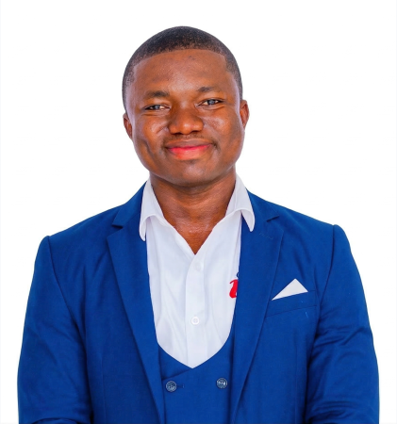





Joshua Opoku Agyemang
YOUR FACILITATOR
Technology entrepreneur · AI and IoT evangelist · STEM educator · Innovation ecosystem builder · Mentor
ROLES
PRACTICE AND EXPERTISE
HAS WORKED WITH
Co-Founder and President
IoT Network Hub – Africa
Artificial intelligence
Internet of Things (IoT)
Software development
Robotics
Digital transformation
Solution architecture
UNICEF · Google
Raspberry Pi Foundation
Mastercard Foundation
UNESCO · KOICA
Ghana Education Service
British Council · MEST Africa
President
Ghana STEM Network
“Africa’s future will be shaped not only by those who use technology, but by those who build it.”
Co-Founder and Chief Evangelist Officer
STEMAIDE Africa
President
Rethink Africa Intelligence
josh@iotnetworkhub.org
10+ YEARS building Ghana’s technology, innovation and STEM ecosystem
50,000+ members in the IoT Network Hub community across 20 African countries
RECOGNISED BBC · Forbes Africa · UNDP · African Entrepreneurship Award (Top 30)
linkedin.com/in/joshoa
Notes:
Optional facilitator introduction, about 30 seconds, taken from the opening slides; skip or shorten it if time is tight. Keep it to one or two lines: who you are, and why climate innovators should trust the "build to learn, test to understand" approach. SAY: Introduce yourself briefly, then move straight to the first question on the title slide. Contact details are on screen for follow-up after the session.

Slide 3





What you will leave with
YOUR ROADMAP
Empathise
Define
Ideate
Prototype
Test
Know who needs it
A sharp problem question
Generate, then narrow ideas
Choose what to build
Test assumptions with evidence
Keep your team challenge in mind. We move fast, and you leave with your next experiment.
Empathise
Define
Ideate
Prototype
Test
Notes:
1:00–2:00 (1 min). Build order: reveal each stage left to right as you speak. SAY: We will use one framework quickly rather than study it in depth. You should leave knowing the next experiment your team needs to run. ASK (pause and think): Keep your team challenge in mind throughout the session. No-tech option: write the challenge at the top of your paper.

Slide 4
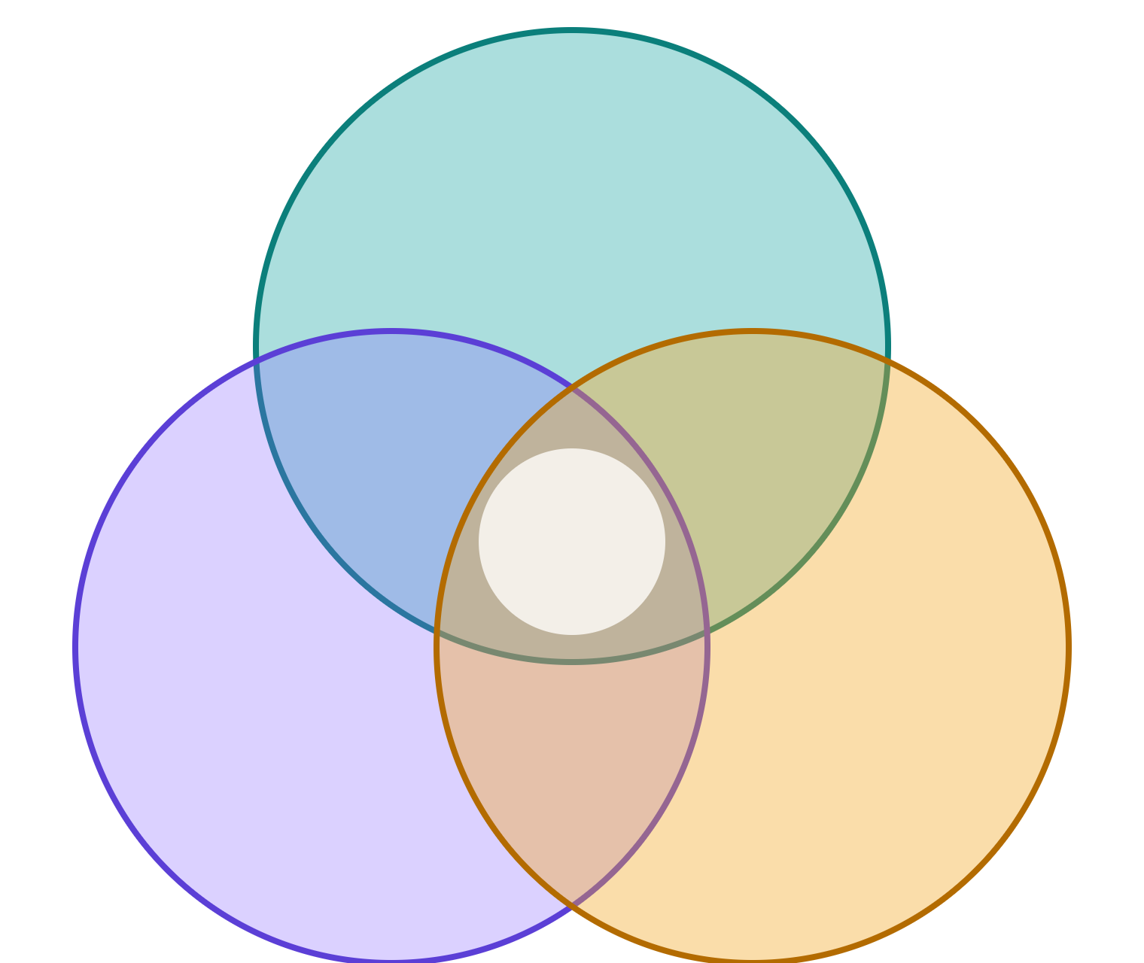




A promising idea sits in the overlap
EMPATHISE
Does it address a real user need?
Desirable
Can we build and deliver it?
Promising opportunity
Can it be sustained operationally and financially?
The overlap is a promising opportunity, not proof of success.
Feasible
Viable
Poll: which do teams assume most? Raise a hand.
Empathise
Define
Ideate
Prototype
Test
Notes:
2:00–4:00 (2 min). Build order: circles slide in one at a time (Desirable, Feasible, Viable), then the centre glows. SAY: A technically impressive solution can fail if people do not need it. A desired solution may be hard to deliver or sustain. Climate innovations must also consider context, access, safety and environmental conditions. Every stage we cover tests one of these three circles. ASK (pause and think): Quick poll. Which dimension do teams most often assume rather than test: desirability, feasibility or viability? No-tech option: show of hands for each.

Slide 5




Start with the problem, not the technology
EMPATHISE AND DEFINE
HOW MIGHT WE…?
A PROBLEM
…help women smallholder farmers prioritise limited hand-carried water across their plots?
Women farmers hand-carry limited water to their plots.
Who has the problem?
What do they want to achieve?
What stops them?
Empathise
Define
Ideate
Prototype
Test
Notes:
4:00–5:15 (1 min 15 s). Build order: problem card, arrow, then the HMW card, then the three questions. SAY: A How Might We question keeps the problem open: "How might we help [specific user] achieve [desired outcome] despite [constraint]?" Example as shown. ASK (pause and think): Silently turn your challenge into one HMW question. You will refine it with your team later. No-tech option: write it on paper.

Slide 6








Diverge before you converge
IDEATE
Community radio
How could a community receive and act on flood-risk information?
SMS alerts
Local volunteers
Visual signs
Phone interface
SCAMPER
Change an existing approach
Sensor-triggered alerts
Empathise
Define
Ideate
Prototype
Test
Notes:
5:15–7:00 total for the idea-generation set (1 min 45 s), split across three slides: this overview about 30 s, SCAMPER about 45 s, Crazy 8s about 30 s. Build order: the question, then branches grow one by one. SAY: HMW reframes the challenge as an opportunity. Aim for different approaches, not cosmetic variations. Next, two methods: SCAMPER, then Crazy 8s. The flood-risk prompt appears on the Crazy 8s slide.

Slide 7

SCAMPER: change what already exists
IDEATE: METHOD 1
S
C
A
M
Substitute
Combine
Adapt
Modify
Replace the smartphone alert with radio
Pair sensor alerts with local volunteers
Borrow how a village notice board already works
Make warnings louder, larger or earlier
P
E
R
Put to another use
Eliminate
Reverse
Pick one prompt and apply it to your challenge.
Reuse a farm sensor for flood warning
Remove the need for internet
Let the community report first
Empathise
Define
Ideate
Prototype
Test
Notes:
SCAMPER slot: about 45 seconds, taken from the original idea-generation slide's time. Build order: letters appear S to R, then the prompt tile. SAY: SCAMPER prompts deliberate changes to an existing approach: Substitute, Combine, Adapt, Modify, Put to another use, Eliminate, Reverse. The examples use the flood-risk question from the previous slide and are illustrative only. Aim for different approaches, not cosmetic variations. ASK (pause and think): Pick one prompt and apply it to your own challenge. No-tech option: write the letter and your idea on paper.

Slide 8






Solutions come in different shapes
IDEATE
Device
Digital
Process
Training
Hybrid
Physical product
Tool or data service
Community or operations
Information or behaviour change
A mix of the above
Which low-tech option might solve part of your challenge?
Empathise
Define
Ideate
Prototype
Test
Notes:
7:00–8:00 (1 min). Build order: cards pop in left to right. SAY: The best response may combine technology with people and existing systems. Technology should have a clear job to do. Not every problem needs an app or AI. ASK (pause and think): Which non-digital or low-tech option might solve part of your challenge? No-tech option: turn to a neighbour and share one.

Slide 9


Prioritise by impact and effort
IDEATE, THEN CHOOSE THE BET
Low effort
High effort
Also ask: what is the riskiest assumption?
High impact + low effort
High impact + high effort
Explore first
Break into smaller tests
Which idea could you investigate cheaply within 24 hours?
Test first
Idea A
Idea B
Idea C
Low impact + low effort
Low impact + high effort
Park for now
Deprioritise
Place your sticky notes on the matrix.
Empathise
Define
Ideate
Prototype
Test
Notes:
8:00–10:00 (2 min). Build order: quadrants appear, then the Test first marker, then the riskiest-assumption card. SAY: An impact-effort matrix is a first filter, not a substitute for evidence. A high-impact idea can still be a poor next step if the team cannot test it. Weigh uncertainty and the cost of learning. ASK (pause and think): Identify one idea you could investigate cheaply within 24 hours. No-tech option: place paper sticky notes on a flip-chart matrix. Facilitator note: slide 7 is also where teams pick one testable bet.

Slide 10





Validation is a learning loop
TEST: DESIGN THE EXPERIMENT
Assumption
Experiment
Evidence
Decision
What do we believe but not yet know?
What is the smallest useful test?
What did we observe or measure?
Continue, change, investigate further or stop.
Then iterate with what you learned
“Do you like our app?” or watching someone complete a real task: which is stronger evidence?
Empathise
Define
Ideate
Prototype
Test
Notes:
10:00–11:30 (1 min 30 s). Build order: Assumption, Experiment, Evidence, Decision, then the return arrow draws back to Assumption. SAY: Validation is not simply asking people if they like an idea. State the assumption before the experiment. Decide in advance what evidence would support, weaken or contradict it. ASK (pause and think): What is the difference between asking "Do you like our app?" and observing someone complete a real task using it? No-tech option: take two voices from the room.

Slide 11



Three kinds of assumptions to test
DEFINE
Desirability
Feasibility
Viability
Is the problem important to users?
Can the solution work reliably?
Can it be delivered and sustained?
Test: can a user complete the intended task?
Test: does a sensor give repeatable readings under defined conditions?
Test: can the service be maintained at a realistic cost?
For climate solutions, test context, access and safety too. Which is your biggest uncertainty?
Empathise
Define
Ideate
Prototype
Test
Notes:
11:30–12:30 (1 min). Build order: one column per click. SAY: One short example for each. Desirability: can a user complete the intended task? Feasibility: does a sensor produce repeatable readings under defined conditions? Viability: can the service be maintained at a realistic cost? For climate solutions, test context, access and safety too. ASK (pause and think): Choose your team's current biggest uncertainty: user need, technical performance, or delivery and sustainability. No-tech option: show of hands for each.

Slide 12

Write a testable hypothesis
TEST: DESIGN THE EXPERIMENT
FILL IN THE BLANKS
WORKED EXAMPLE
We believe [user] has [problem or need].
We believe intended users can understand this warning without extra explanation.
We will test this by [experiment].
We will observe or measure [evidence].
We will show a sample warning and ask them to explain the action they would take.
We will reconsider if [disconfirming result].
We will record misunderstandings and missing information.
Name one thing you could observe, not just ask about.
Empathise
Define
Ideate
Prototype
Test
Notes:
12:30–14:00 (1 min 30 s). Build order: template lines, then the worked example. SAY: Model one hypothesis: "We believe intended users can understand this warning without extra explanation. We will show a sample warning and ask them to explain the action they would take. We will record misunderstandings and missing information." Add the line "We will reconsider the idea if..." to name a disconfirming result. ASK (pause and think): Name one thing you could observe rather than merely ask about. No-tech option: write it in the worksheet.

Slide 13







What counts as a prototype?
PROTOTYPE
It makes part of an idea tangible, so you can investigate an important question.
Paper sketch
Interface mock-up
Service role-play
Data model
Hardware part
Can a paper drawing be a prototype? Yes, if it enables a useful test.
A prototype is not automatically a validated solution.
Empathise
Define
Ideate
Prototype
Test
Notes:
14:00–15:15 (1 min 15 s). Build order: statement, five tiles pop in, then the two cards. SAY: Prototypes can be paper sketches, storyboards, role-play, clickable mock-ups, spreadsheets, data simulations or working technical components. A prototype may be physical, digital, simulated or service-based. Choose the format from the assumption. ASK (pause and think): Can a paper drawing be a prototype? Confirm it can, if it enables a useful test. No-tech option: show of hands.

Slide 14


Climb the prototyping ladder
PROTOTYPE
Which level is enough to test your most important assumption?
Cost and complexity rise
4
Integrated prototype
3
Test a core end-to-end workflow
Proof of concept
2
Test one critical technical function
Experience
1
Role-play, manual service, clickable mock-up
Concept
Sketch, storyboard, paper model
Empathise
Define
Ideate
Prototype
Test
Notes:
15:15–16:45 (1 min 30 s). Build order: rungs climb one by one, left to right. SAY: Fidelity is how closely the prototype resembles the eventual experience or system. Do not add complexity until the next question requires it. A polished interface cannot prove sensor accuracy; a working sensor cannot prove adoption. ASK (pause and think): Which level is sufficient to test your team's most important assumption? No-tech option: hold up 1 to 4 fingers.

Slide 15






Match the method to the question
PROTOTYPE
Paper or storyboard
Role-play or manual service
Clickable mock-up
Spreadsheet or data model
Hardware proof of concept
Tests
Tests
Tests
Navigation and task completion
Tests
Tests
Information and user journey
Service and workflow
Calculations and decision rules
One technical function
Name a prototype type for your project, and the question it would answer.
Empathise
Define
Ideate
Prototype
Test
Notes:
16:45–18:15 (1 min 30 s). Build order: cards reveal left to right. SAY: Each type answers a different question. A manual simulation can test whether a service is useful before automation. A hardware prototype needs defined conditions and measurements. ASK (pause and think): One participant names a prototype type for their project and the question it would answer. No-tech option: say it aloud, facilitator repeats it.

Slide 16




Use the tools you have
PROTOTYPE
Sketching
Mock-ups
Feedback
Paper, markers, sticky notes
Figma, Canva, paper screens
Google Forms
Data
No-code
IoT and hardware
Sheets, Excel, Python
Glide, Bubble
Breadboards, microcontrollers, sensors
Tools are examples, not requirements. What is the simplest tool your team can use tomorrow?
Empathise
Define
Ideate
Prototype
Test
Notes:
18:15–20:00 (1 min 45 s). Icons stand for categories, not logos; paper and spreadsheets are first-class options and work offline. SAY: Tools are examples, not mandatory choices. Select by the question, team capability, equipment, connectivity, cost and accessibility. Do not lose build time installing unfamiliar tools if paper or a spreadsheet can answer the first question. ASK (pause and think): What is the simplest tool your team can use tomorrow? No-tech option: say it to your neighbour.

Slide 17





Prototype, MVP, product, scale
PROTOTYPE
Prototype
MVP
Product
Scale
Investigates an assumption
Smallest usable version that delivers core value and supports learning
Reliable, supported and maintainable
Expand when evidence and delivery capacity justify it
Amber diamonds are learning gates. Feedback may mean adapt, pivot or stop.
What must be true before you can responsibly call your prototype an MVP?
Empathise
Define
Ideate
Prototype
Test
Notes:
20:00–21:15 (1 min 15 s). Build order: stages left to right, gates pop in, then the feedback arrow draws back. SAY: An MVP is not just a prototype with fewer features. It must deliver core value to intended users in an appropriate context. A prototype may be simulated and not ready for operational use. Some ideas should change or stop after testing. ASK (pause and think): What must be true before you can responsibly call your prototype an MVP? No-tech option: one voice from the room.

Slide 18

Limited water, one decision rule
WORKED EXAMPLE: SOIL-MOISTURE DECISION SUPPORT
1 Plot sections
2 Readings
3 Recommendation
4 Farmer decision
A
B
C
SIMULATED
A visible decision rule
Explain the next action
Which section needs attention
This is the test
Three labelled sections
Sample values per section
DEMONSTRATED
STILL UNPROVEN
User workflow and clarity of the recommendation
Sensor accuracy, agronomic correctness, water savings, crop benefits, season-long reliability
Empathise
Define
Ideate
Prototype
Test
Notes:
21:15–23:00 (1 min 45 s). Build order: the four steps left to right, then Demonstrated, then Still unproven on click. SAY: Problem: limited water must be carried and applied manually. Idea: help prioritise which plot section needs attention. Label the sample readings as simulated unless real measurements exist. This prototype tests the user workflow and the clarity of the recommendation. It does not prove sensor accuracy, agronomic correctness, water savings, crop benefits or season-long reliability. Raw readings need interpretation in context. ASK (pause and think): What has this prototype demonstrated, and what remains unproven? Reveal the second card only after answers. No-tech option: call out answers.

Slide 19

Define the evidence before you test
TEST
1 Task
2 Observation
Include evidence that could disprove your assumption.
What will the user do?
What will you observe or measure? Record confusion and errors.
FINISH THE SENTENCE
We will know we have learned something useful when we observe…
3 Criterion
4 Decision
A reasonable success measure, set before the test.
Continue, change, investigate further or stop.
Empathise
Define
Ideate
Prototype
Test
Notes:
23:00–24:00 (1 min). Build order: the four test-card fields, then the disproof warning, then the sentence prompt. SAY: Examples of evidence: task completion without prompting, repeated measurements within a chosen tolerance, an alert received and correctly interpreted, or a user naming missing information. Criteria must fit the question; do not invent arbitrary thresholds. ASK (pause and think): Finish the sentence: "We will know we have learned something useful when we observe..." No-tech option: write it on the worksheet.

Slide 20

Design a test in three minutes
TEAM CHALLENGE
1
Name the user and problem
2
Pick one critical assumption
3
Choose the smallest prototype
4
Define what the user will do
5
State the evidence you will collect
At the end, underline your riskiest assumption.
Empathise
Define
Ideate
Prototype
Test
Notes:
24:00–27:00 (3 min). RUN: start the visible three-minute timer (the ring on this slide counts down when the slide loads; also keep a phone or room timer as backup). No-tech fallback: use the printed worksheet or draw the six fields on a flip chart. SAY: Work on your actual assigned challenge. Three minutes is a first draft, not a finished design. One person writes, another challenges the assumption. The prototype can be low-tech or simulated. Participants may write, sketch, explain verbally, or work with a teammate who records. AT THE END: Teams underline their riskiest assumption.

Slide 21



Is your prototype actually testable?
TEST
Can we name the intended user and task?
Is the assumption specific?
Show of hands: which check does your team still need to work on?
Can the prototype investigate it?
Can we record observable evidence?
20-second share: assumption, prototype, evidence.
Do we know what remains unproven?
Empathise
Define
Ideate
Prototype
Test
Notes:
27:00–28:00 (1 min). Build order: five checks tick one by one. SAY: Invite one team to give a 20-second share: assumption, prototype and evidence. Respond with one constructive question rather than redesigning the project for them. ASK (pause and think): Signal which of the five readiness checks your team still needs to work on. No-tech option: show of hands for each check.

Slide 22


From four days to six months
ITERATE
Day 1
Day 2
Day 3
Day 4
Mon 12 Oct
Tue 13 Oct
Wed 14 Oct
Thu 15 Oct
Define problem, assumptions and scope
Build a testable prototype
Test with users, learn and refine
Demonstrate evidence, learning and next questions
Six months: develop and validate through staged milestones
Evidence gates
Build to learn. Test to understand. Use evidence to decide.
Next, 3:00 PM: Team Lab 2, Define the Solution
Empathise
Define
Ideate
Prototype
Test
Notes:
28:00–30:00 (2 min). Build order: four days, then the six-month band and gates, then the tagline. SAY: Six months of development should not mean six months of adding features. It means resolving key risks, testing in relevant conditions, improving reliability and accessibility, assessing delivery costs and making evidence-led decisions, and deciding whether to pilot, iterate or stop. This is a planning principle, not a fixed programme schedule. ASK (pause and think): What is the single most important thing your team needs to learn before investing more time and resources? Take one response. No-tech option: write it at the bottom of the worksheet. CLOSING SCRIPT: "Your first prototype does not have to be perfect... It has to help you learn something important. Start with the person and the problem. Identify the assumption that matters most. Build only what you need to investigate that assumption, then test it honestly. Tomorrow, build something you can test. On Wednesday, learn from the people it is intended to serve. On Thursday, demonstrate what you created, what you learned, and what still needs to be proved. Build to learn. Test to understand. Use evidence to decide what comes next." Hand off at 3:00 PM to Team Lab 2: Define the Solution.

Slide 23


Thank you
Q
WOMEN-IN-WACREN CLIMATE INNOVATION LAB 2026
Questions and answers
Build to learn. Test to understand. Use evidence to decide.
A
Joshua Opoku Agyemang | +23354 888 9998
Empathise
Define
Ideate
Prototype
Test
Notes:
Optional closing slide, shown only if time remains; the 30-minute plan ends with the 3:00 PM hand-off on the previous slide, so this slide is best used as a backdrop for questions in the break or in Team Lab 2. SAY: Thank you. I am happy to take questions. Teams, bring your riskiest assumption to the 3:00 PM Team Lab 2: Define the Solution. ASK: What is one question you want answered before you start building tomorrow? No-tech option: raise a hand, or write it on a sticky note for the flip chart. Add contact details (email or social handle) here if you want participants to reach you after the session.

