Slide 1

FROM PROBLEMS TO SOLUTIONS
Designing practical, user centered digital solutions for climate resilience
PRESENTED BY: DR. VIVIAN CHINWE NNAMDI
DATE: 12TH OCTOBER, 2026
@ WOMEN-IN-WACREN CLIMATE INNOVATION LAB 2026
Notes:
<a href="https://www.freepik.com/free-photos-vectors/certificate">Certificate vector created by macrovector - www.freepik.com</a>

Slide 2
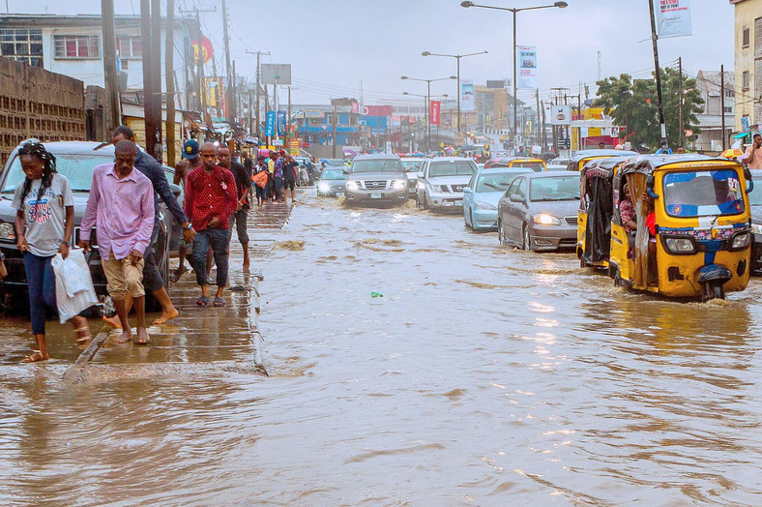


NOW WE UNDERSTAND THE CHALLENGE. WHAT DO WE DO NEXT?
START WITH PEOPLE
Understand who is affected
before
after
IDENTIFY THE NEED
A real climate challenge, such as flooding or drought affecting a community.
The difficulty people face: delayed warnings, missing information or limited access to useful data.
A simple concept, such as a flood-risk map, early-warning interface or climate information dashboard.
The intended benefit: earlier decisions, better preparedness or more effective resource allocation.
Find out what people need to do better.
DESIGN FOR IMPACT
Climate challenges become innovation opportunities when we understand people's needs and the decisions they struggle to make.

Slide 3
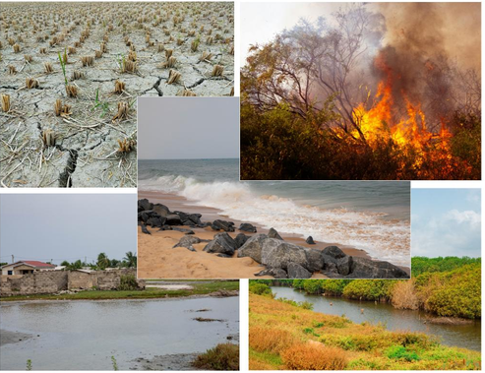
Country | Climate context | People / systems affected | Question to investigate
Ghana | Greater Accra flooding | Residents, commuters, traders, emergency services | Where are the biggest decision and response gaps?
Nigeria | Dry spells/rainfall variability | Smallholder farmers | What decisions are being made with insufficient climate information?
The Gambia | Flooding/coastal risks | Urban/coastal communities | Which vulnerabilities can realistically be reduced?
Liberia | Windstorm/storm-surge risk | Coastal communities | Where are preparedness and response weakest?
South Africa | Wildfire/severe-weather risks | Communities, farmers | Where can earlier information or intervention reduce losses?
Senegal | Coastal erosion/displacement | Coastal households, fishers | Which part of the displacement/resilience problem can be improved?
Different climate challenges, one innovation question…
Within the affected, what decision is difficult, and where might intervention help?

Slide 4
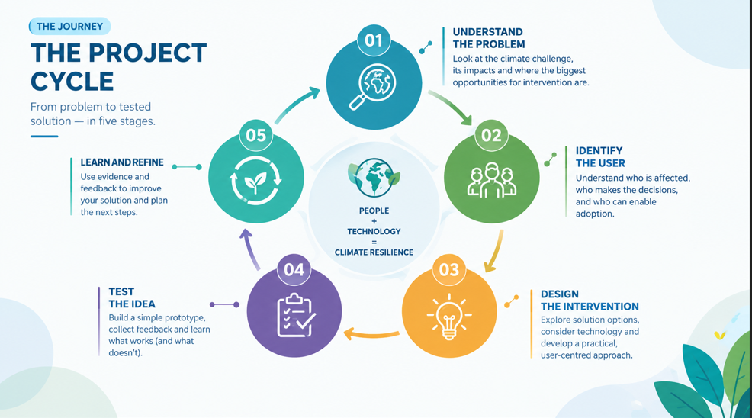
We are not building technology because everyone is doing it, rather, to solve a real problem.

Slide 5
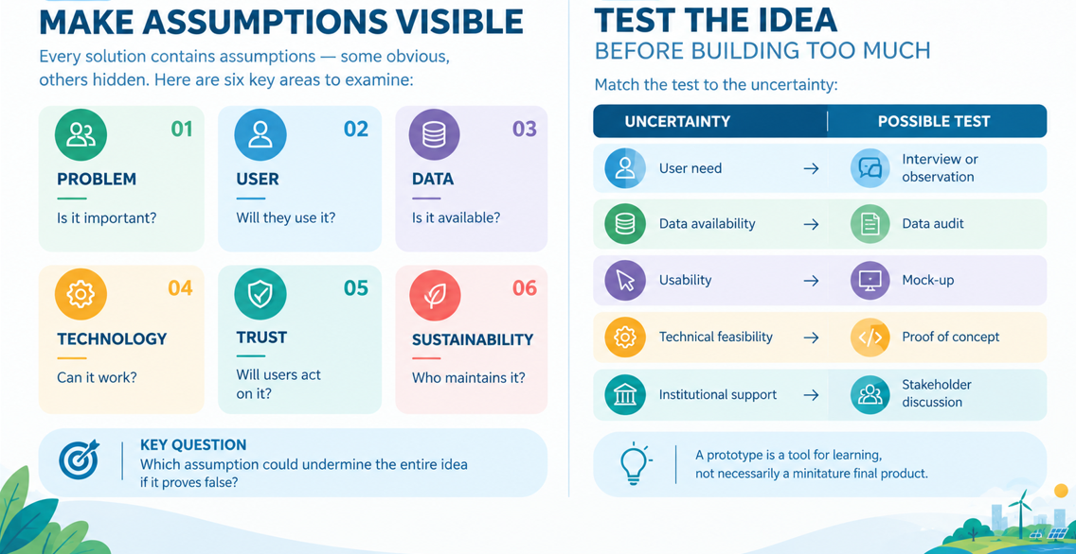
WHAT NEXT?
Make your assumptions explicit, test the riskiest ones first, and let evidence guide what you build next.

Slide 6
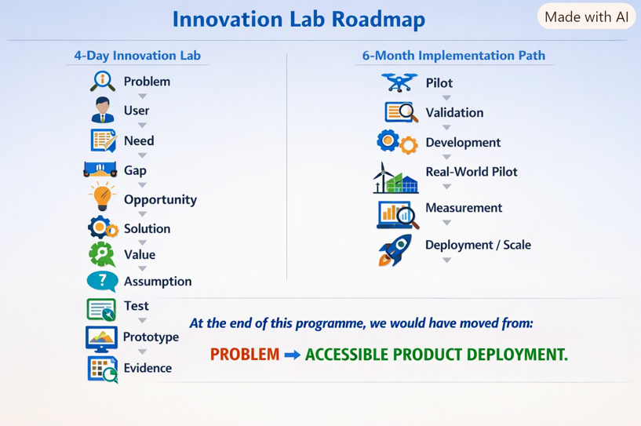
THE SOLUTION THINKING FRAMEWORK
B
A
WHAT SHOULD EXIST BY THE END OF DAY 4?
Each team should leave the four day Lab with:
1. A clearly defined climate resilience problem;
Not a broad climate issue, but a problem sufficiently focused to work on.
2. Identified target users
Specific people, organizations or stakeholders connected to the problem.
3. Evidence
Information from users and/or relevant domain stakeholders that supports, challenges or refines the problem and proposed intervention.
4. A demonstrable prototype
A prototype showing the core proposition, not necessarily a production-ready system.
5. A record of learning, what assumptions were:
confirmed,
challenged,
rejected,
or still untested?
6. A basis for deciding whether the idea should proceed
7. A six-month development hypothesis
In other words:, the goal is to learn enough to know what should be built next.

Slide 7
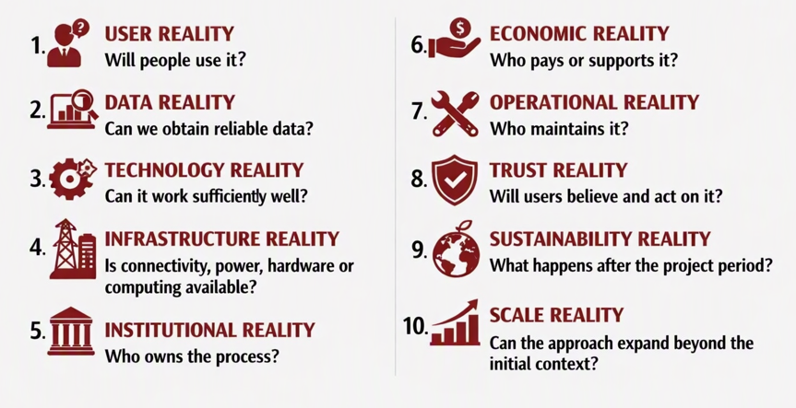

A SOLUTION MUST SURVIVE THE REAL WORLD
A technically functional prototype is not automatically a viable solution. It should be able to survive:
This is why a solution is a system, not merely an app.

Slide 8


THE SIX MONTH DEVELOPMENT HYPOTHESIS
At the end of the 4 day Lab, each team should be able to articulate and focus the next six months on:
Controlled Testing
Simulate climate conditions to test resilience and performance.
3
2
4
Technical Development
Build or refine renewable energy or disaster response technologies
Pilot Preparation / Implementation
Deploy prototypes in climate risk zones.
1
User & Stakeholder Validation:
Engage communities affected by floods, droughts, or heat waves etc.
5
Pilot Measurement & Evaluation
Collect and analyze environmental and social impact data.
The six month plan should emerge from what the team learns and not from a predetermined development wish list.

Slide 9












Prospective Timeline Deliverables
Day 1 - Define
1st Month - Prototype
1 - 3 months
2nd Month – Deeper Validation
Day 2 - Validate
3rd Month - Development
Day 3 - Prototype
4 days lab
4 – 6 months
4th Month – Real world Pilot
Day 4 – Refine
5th Month - Measurement
Day 4 – Plan, Present
6th Month – Deployment/Testing
Notes:
https://www.freepik.com/free-vector/remote-meeting-concept-illustration_11906661.htm#query=team&position=16&from_view=search
https://www.freepik.com/free-vector/avatars-set-with-people-face-social-media-profile-app-vector-flat-collection-men-women-heads-circle-frame-female-male-characters-portraits-with-different-hairstyle_22445017.htm#&position=0&from_view=detail#&position=0&from_view=detail

Slide 10

THANK YOU
Notes:
<a href="https://www.freepik.com/free-photos-vectors/certificate">Certificate vector created by macrovector - www.freepik.com</a>

