Slide 1
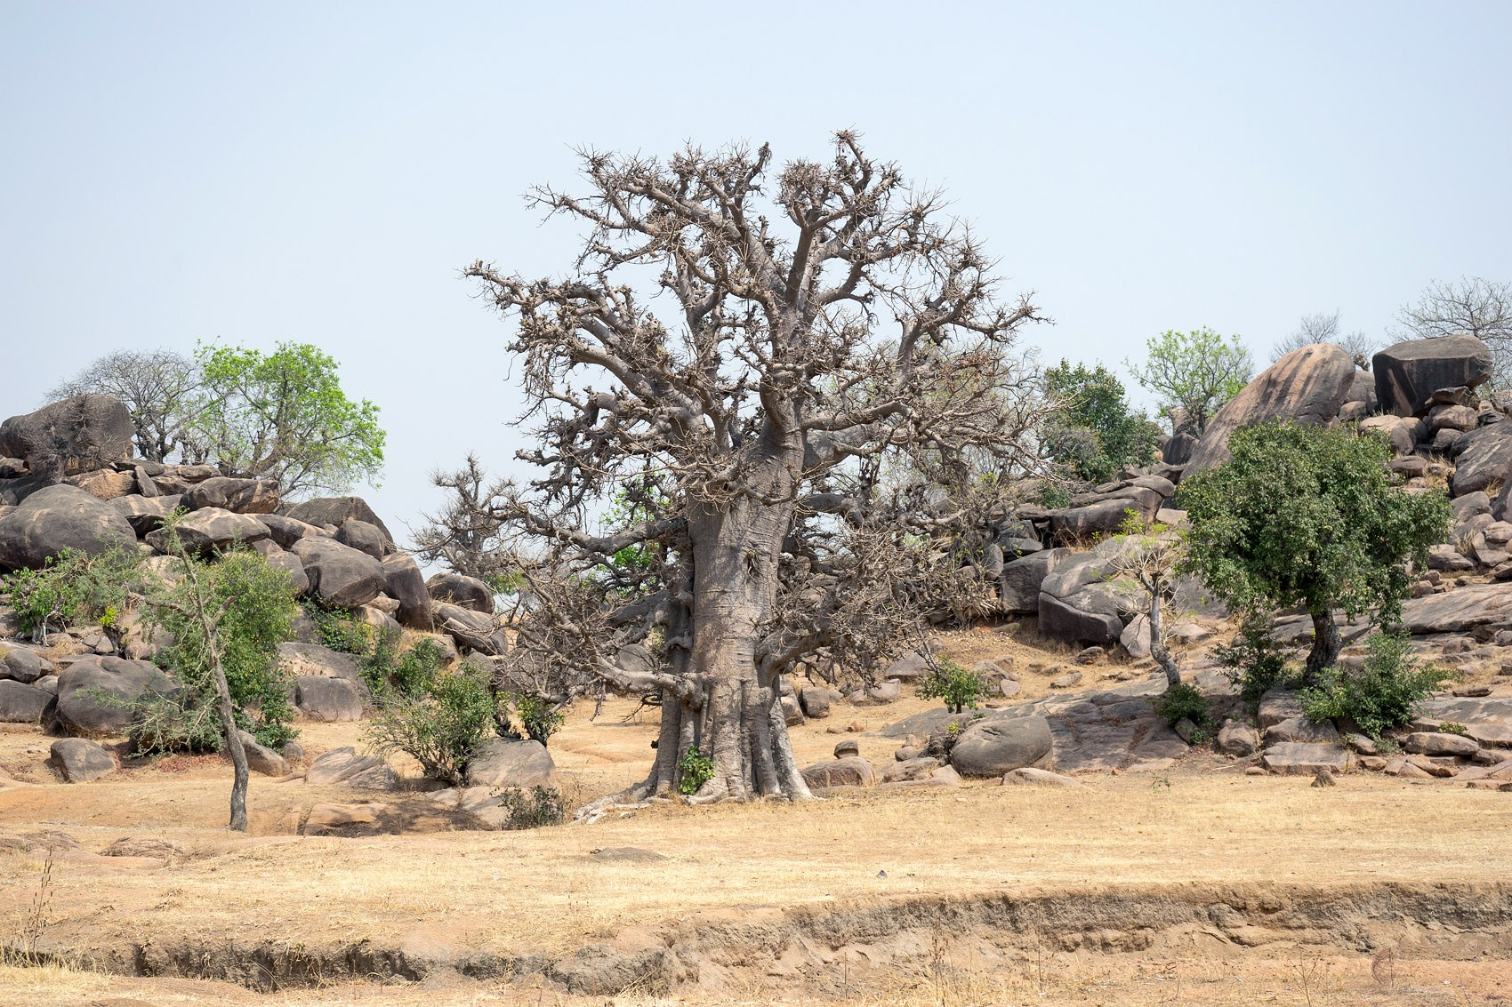
Climate Challenges and People
How Africa's climate risks can become Africa's opportunity to leapfrog
Prof. Amos T. Kabo-Bah
Women-in-WACREN Climate Innovation Lab 2026
Abuja, Nigeria, 12 October 2026
Email: akabobah@gmail.com
WhatsApp: +233 543859721
Baobab, Bongo, Ghana. Photo: Danieljatuat, CC BY-SA 4.0
Notes:
Good morning. Welcome to Abuja and to the Women-in-WACREN Climate Innovation Lab. Behind me is a baobab in Bongo, Upper East Ghana. The baobab survives the longest dry seasons because it stores water in its trunk during the rains, and across the Sahel and savanna, from Senegal to Chad, it is a meeting place and a source of food and medicine. That is the posture I want us to take this week: store up knowledge, store up ideas, and build things that help our communities survive and thrive through the dry seasons of climate change. My job in the next 30 minutes is to set the stage: what the climate challenges are, who carries them, and why I believe each challenge is also an opportunity for Africa to leapfrog.

Slide 2

Sankofa
Go back and fetch it
Our grandmothers read the sky. They knew the rains were near when the ants moved house, when the shea trees flowered, when the harmattan wind turned.
Today we add satellites, sensors and mobile phones.
African climate innovation does not start from zero. It starts by fetching what we already know and joining it to what technology now makes possible.
Adinkra symbol Sankofa, public domain
Notes:
The Sankofa bird looks backwards while its feet face forward, carrying a precious egg in its mouth. Sankofa means go back and fetch it. In every community you will work with, there is climate knowledge that has never been written down. Farmers who can read the onset of rains, fishers who know the tides, mothers who know which season brings the fevers. The best solutions in this Lab will fetch that knowledge and join it to data and digital tools. Ask yourselves on day one: what does my community already know?

Slide 3
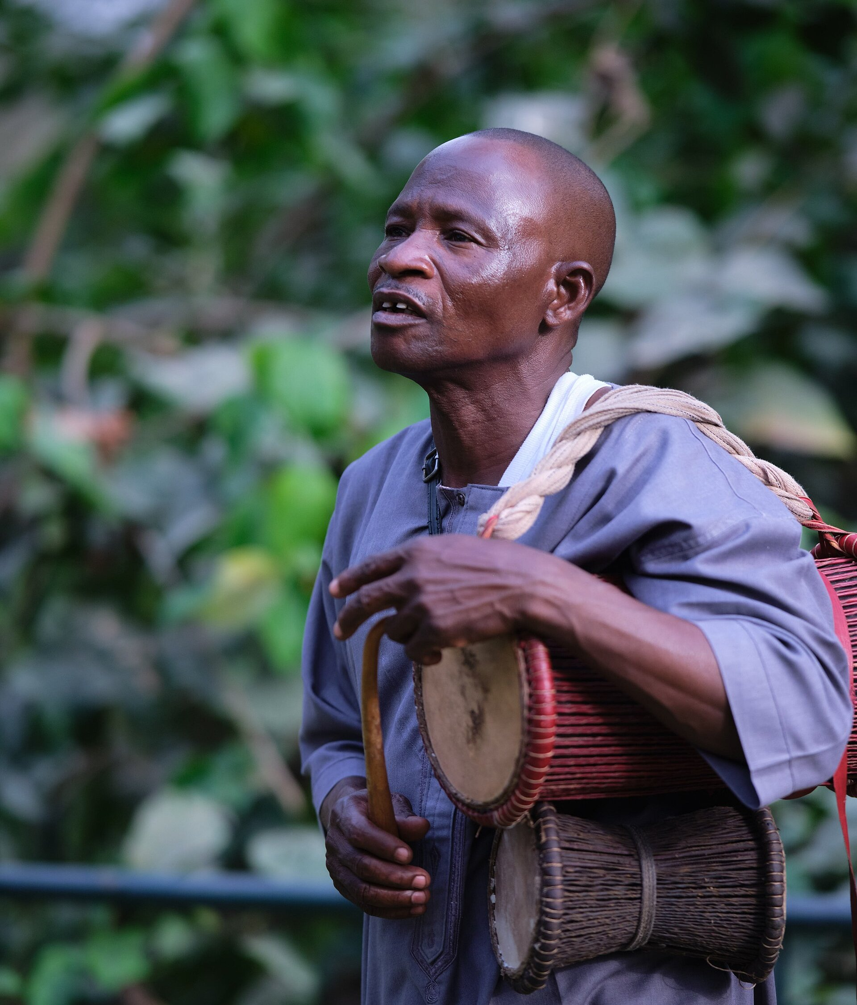
Africa's first early warning system was a drum
The talking drum carried a message from one village to the next before the danger arrived. It was fast, local, trusted and spoke the people's language.
That is still the test for every climate solution:
Does it reach the right person, in time, in a language she trusts, so she can act?
Your question this week: what is the talking drum of 2026?
Yoruba talking drum (dundun) player, Nigeria. Photo: Tijani Taofeek Bamidele, CC BY-SA 4.0
Notes:
Before radio, before SMS, the talking drum warned communities. It worked because it was fast, local and trusted. Many expensive early warning systems in Africa fail on exactly these three things: the warning arrives late, it is not local, or people do not trust it. Keep this test in mind as you design. Your prototype could be an app, a USSD service, a dashboard or a device. It does not matter. What matters is whether it reaches the right person, in time, in a language she trusts, so she can act.

Slide 4
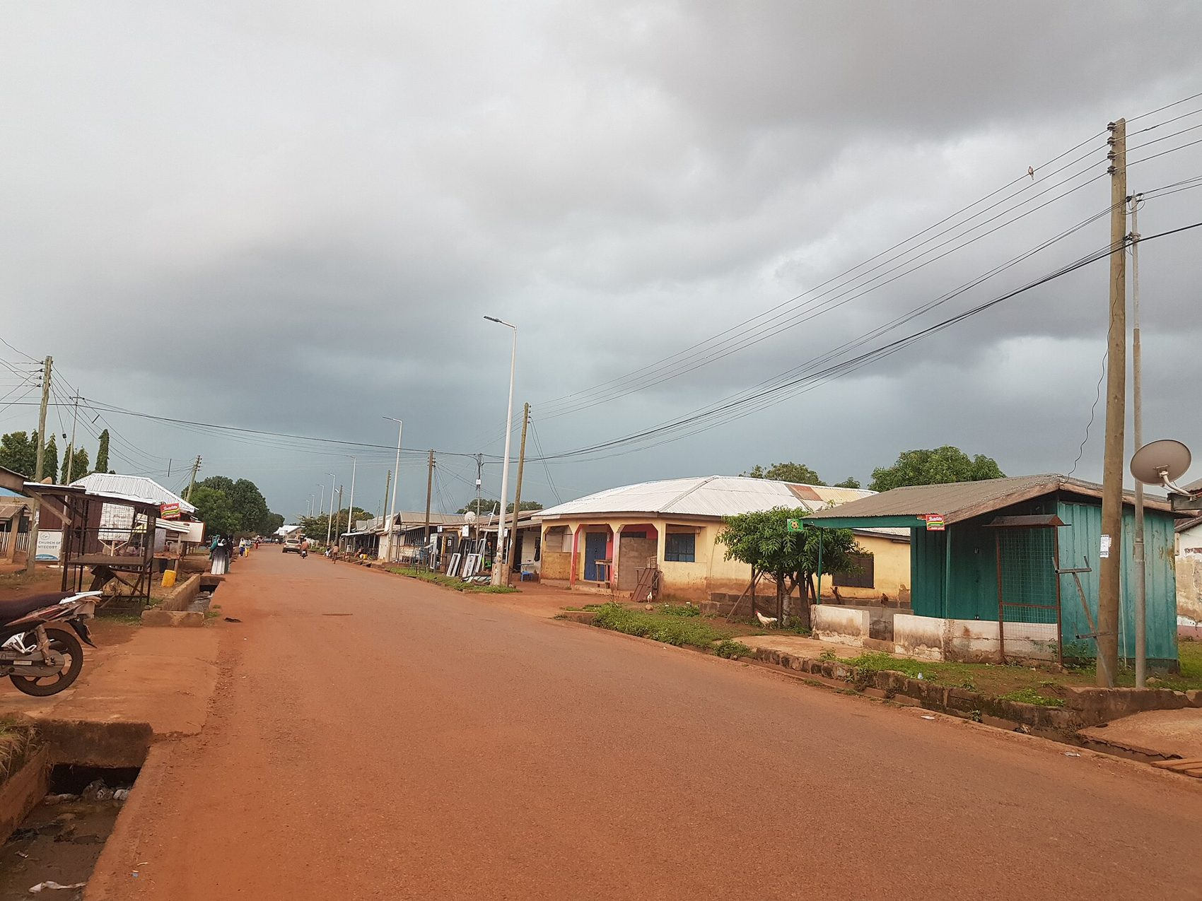
Weather is today's mood. Climate is character.
Weather
What the sky is doing now, today or this week.
"Will it rain on my farm this afternoon?"
Climate
The usual pattern of weather over 30 years or more, including its extremes.
"When does the rainy season usually start here?"
Climate is what you expect. Weather is what you get. Climate change means our expectations are no longer reliable.
Rain clouds over a Ghanaian town. Photo: OJjnr, CC BY-SA 4.0
Notes:
Let us start at the beginning. What is climate? Weather is the mood of the sky today: will it rain this afternoon? Climate is the character of a place: the pattern of weather we expect over thirty years or more, including the floods and droughts. Our grandmothers planted by climate, by what they expected. Climate change is serious precisely because those expectations no longer hold. The farmer prepares for the rains she expects, and gets weather she did not expect.

Slide 5
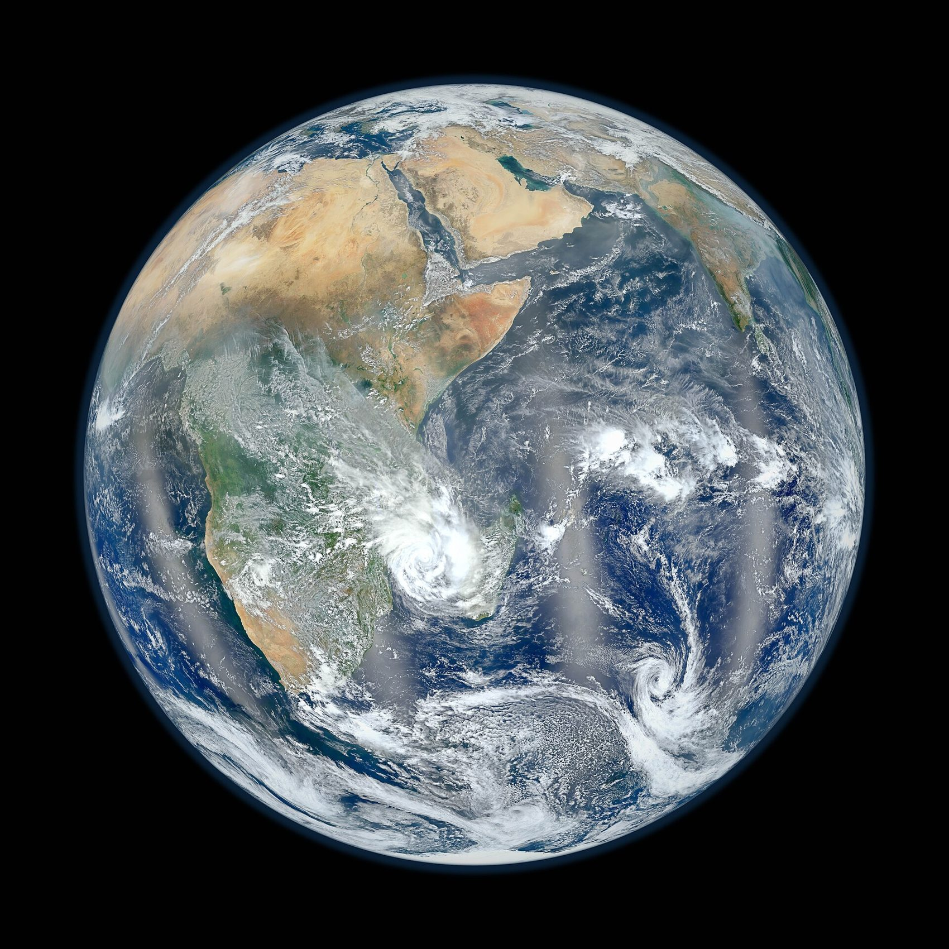
The climate system: five parts
1
Atmosphere
the air, clouds, winds and gases around us
2
Hydrosphere
oceans, rivers, lakes and groundwater; the Gulf of Guinea feeds our rains
3
Land surface
soils, forests, savanna, cities and farms
4
Biosphere
plants, animals and people, who now change the system
5
Cryosphere
ice and snow far away that still shape global sea level
Africa from the Suomi NPP satellite. NASA/NOAA, public domain
All five are powered by energy from the sun. Change one, and the others respond.
Notes:
Climate is not only the sky. It is a system of five connected parts: the atmosphere, the waters, the land, living things including us, and the ice. They exchange energy and water all the time, and the sun powers it all. For West Africa, the warm waters of the Gulf of Guinea are the source of our rains. When people clear forests, build cities and burn fuels, we change the land and the atmosphere, and the whole system responds.

Slide 6
The greenhouse effect: Earth's blanket
Sun
1. Sunlight warms the land and the oceans.
2. The warm Earth sends heat back towards space.
3. Carbon dioxide, methane, nitrous oxide and water vapour hold some of that heat, like a blanket on a harmattan night.
4. Burning coal, oil, gas and forests has thickened the blanket: carbon dioxide has risen from about 280 parts per million before industry to over 420 today.
A thin blanket keeps us alive. A thick one makes us sweat.
Sunlight comes in
Blanket of greenhouse gases
Notes:
Think of a blanket on a cold harmattan night. Without it you shiver; with the right blanket you sleep well. Earth has a natural blanket of gases: carbon dioxide, methane, nitrous oxide and water vapour. Without it, Earth would be frozen. But since industry began, burning coal, oil, gas and forests has added more and more carbon dioxide. Before industry the air held about 280 parts per million; today it is above 420. The blanket has become too thick, and the Earth is sweating. That sweating is global warming.

Slide 7
One degree: a fever for people, a fever for the planet
One degree sounds small. Ask anyone who has had a fever.
At 38°C your whole body is affected: headache, weakness, no appetite, you cannot go to the farm.
The Earth is now about 1.2°C warmer than before industry, and 2024 was the first year above 1.5°C. Every part of the system feels it: rains, crops, disease, rivers, power.
At 39°C or 40°C a person needs urgent care. That is why the Paris Agreement aims to keep warming well below 2°C and pursue 1.5°C.
38°C fever
About +1.2°C
37°C normal
Pre-industrial
A person
The Earth
One degree up: weak, unable to work
Average warming so far (WMO)
Notes:
Here is the simplest way I know to explain global warming. Your normal body temperature is about 37 degrees. If it rises by just one degree, to 38, you have a fever. You feel weak, your head aches, you cannot go to the farm or the market. One degree changes everything in the body. The Earth is the same. It is now about 1.2 degrees warmer than before industry, and 2024 was the first year on record above 1.5 degrees. That small number is spread across the whole planet, and every system feels it: rains, crops, disease, rivers and power. And just as a person at 39 or 40 degrees needs urgent care, the world agreed in Paris to keep warming well below 2 degrees. The Earth has a fever. Our job this week is to build some of the medicine and the thermometers.

Slide 8
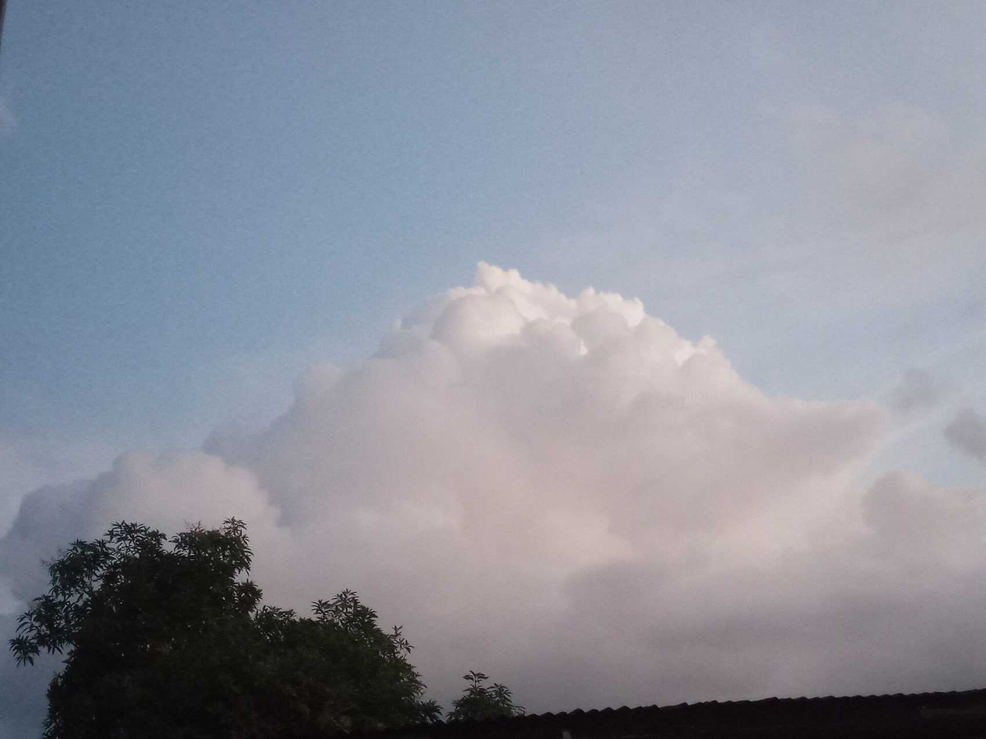
Our climate engine: the monsoon and the harmattan
The West African Monsoon carries moist air from the Gulf of Guinea inland, bringing the rains from about April to October
The harmattan blows dry, dusty air from the Sahara from about November to March
This rhythm sets our planting seasons, malaria seasons, river flows and hydropower
Warming is shifting the rhythm: later or false onsets, heavier storms, longer dry spells and hotter nights
When the rhythm changes, every calendar built on it breaks.
Cumulonimbus building up. Photo: Ceentia, CC BY-SA 4.0
Notes:
For us in West Africa, climate is a rhythm between two winds. The monsoon brings moist air from the Gulf of Guinea and gives us the rains. The harmattan brings dry dust from the Sahara. Every calendar we have, planting, fishing, malaria, school terms, even electricity, is built on this rhythm. Climate change is shifting it. False starts to the rains, intense storms that flood cities, long dry spells in the middle of the season. When the rhythm changes, every calendar built on it breaks.

Slide 9
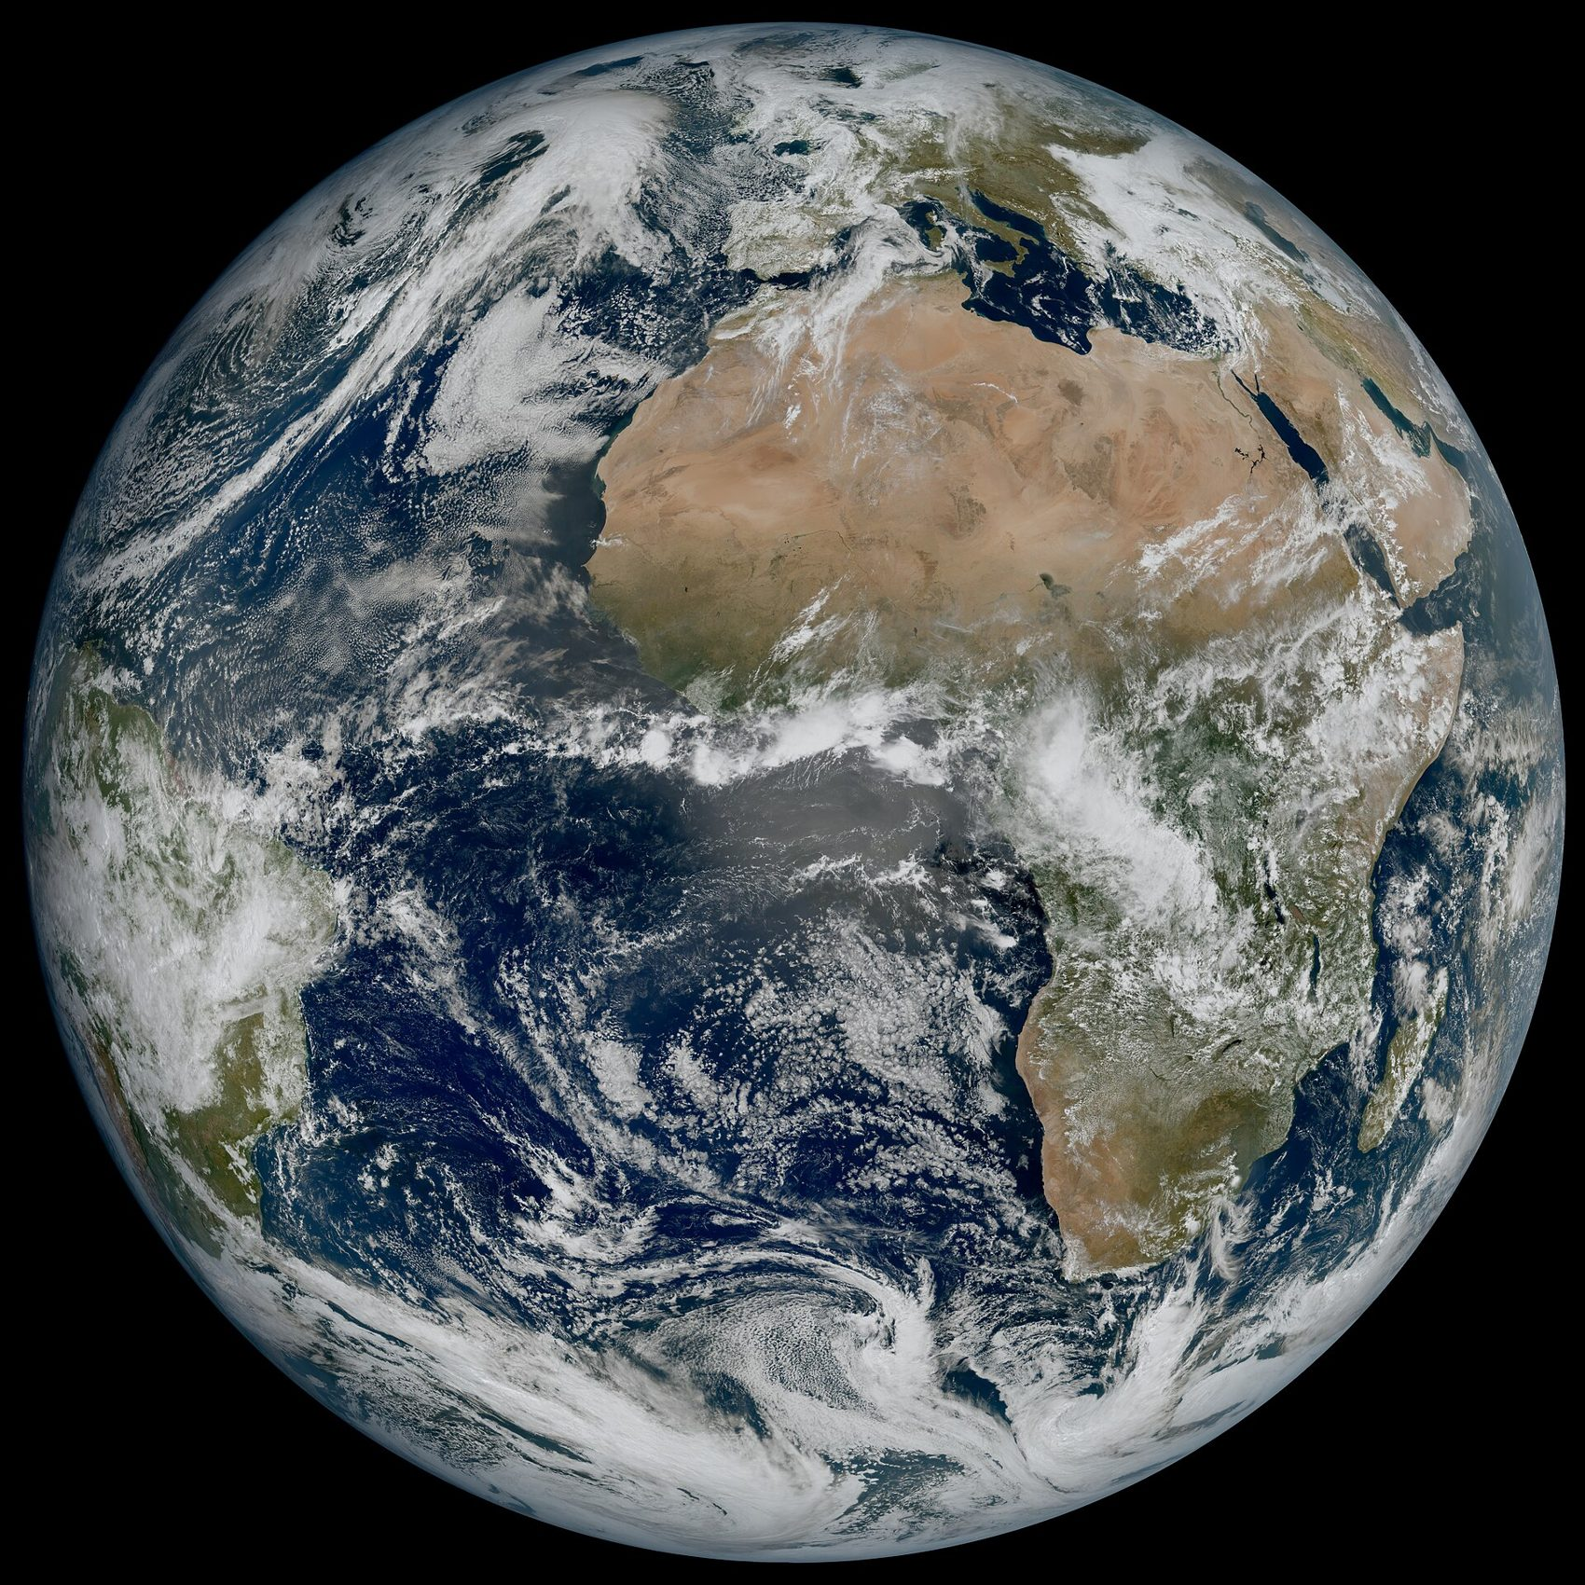
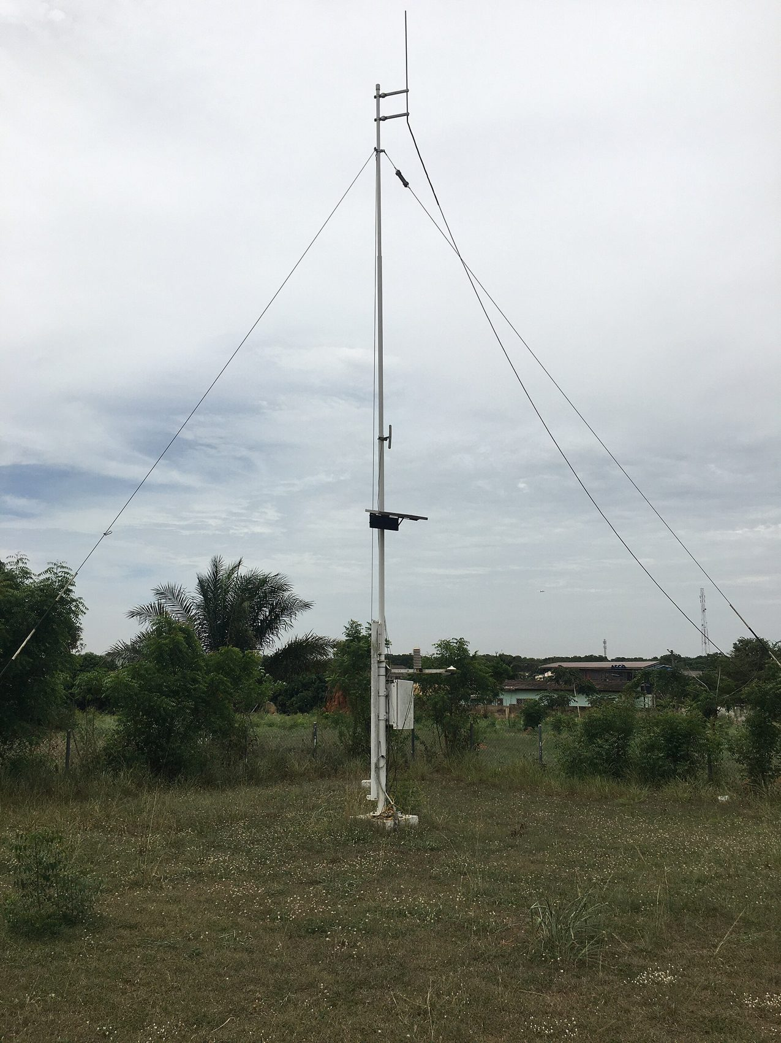
How we know: watching the climate
Satellites such as Meteosat watch Africa every 10 to 15 minutes; WACREN receives the data through EUMETCast
Ground stations, rain gauges and river gauges measure what satellites cannot
The Global Climate Observing System tracks Essential Climate Variables: rainfall, temperature, soil moisture, land cover and more
Africa still has the thinnest network of weather stations in the world
Left: Meteosat 12 first full disk image. EUMETSAT/ESA. Right: Automatic weather station, Ghana Meteorological Agency. Photo: Amuzujoe, CC BY-SA 4.0
Every gap in observation is a gap a young innovator can fill.
Notes:
How do we know all this? We observe. Satellites like Meteosat image the whole of Africa every few minutes, and WACREN brings that data to universities and agencies through EUMETCast. On the ground, stations like this one at the Ghana Meteorological Agency measure rain and temperature. Through the Global Climate Observing System, on whose Steering Committee I serve, the world tracks Essential Climate Variables. But Africa still has the thinnest station network in the world. That is a problem, and it is also a business: low cost sensors, citizen reports, and tools that turn satellite data into local answers.

Slide 10
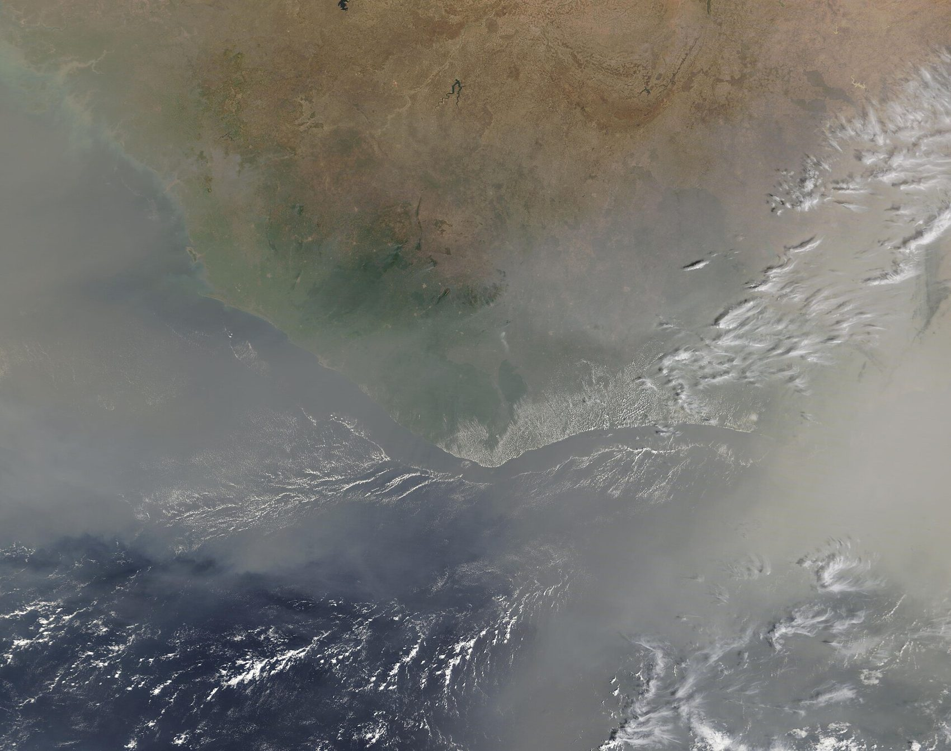
The picture in four numbers
Less than 4%
2 to 5%
Africa's share of global greenhouse gas emissions. We did least to cause the crisis.
of GDP lost each year by many African countries to climate extremes (WMO, 2024).
118 million
60% and 1%
extremely poor Africans exposed to drought, floods and extreme heat by 2030 (WMO, 2021).
Africa holds 60% of the world's best solar resources but only 1% of installed solar PV (IEA, 2022).
Harmattan dust over West Africa, 15 Feb 2020. Image: NASA MODIS, public domain
Notes:
Four numbers frame this week. First, Africa produces less than four percent of global emissions, yet it is among the regions hit hardest. Second, the World Meteorological Organization estimates that many African countries are losing two to five percent of GDP every year to climate extremes, and some spend up to nine percent of their budgets responding. Third, by 2030 up to 118 million extremely poor Africans could be exposed to drought, floods and extreme heat. But the fourth number is the turning point of this talk: Africa holds sixty percent of the best solar resources on the planet and only one percent of installed solar capacity. The image on the right is the harmattan dust seen from space. Satellites already watch our skies every day. The question is whether that data reaches the farmer, the nurse and the mother.

Slide 11
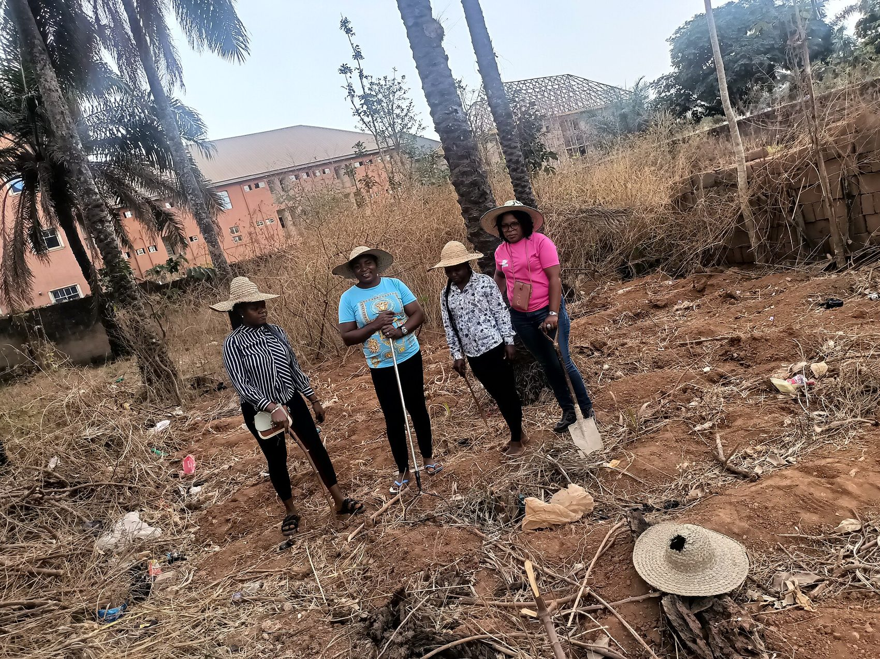
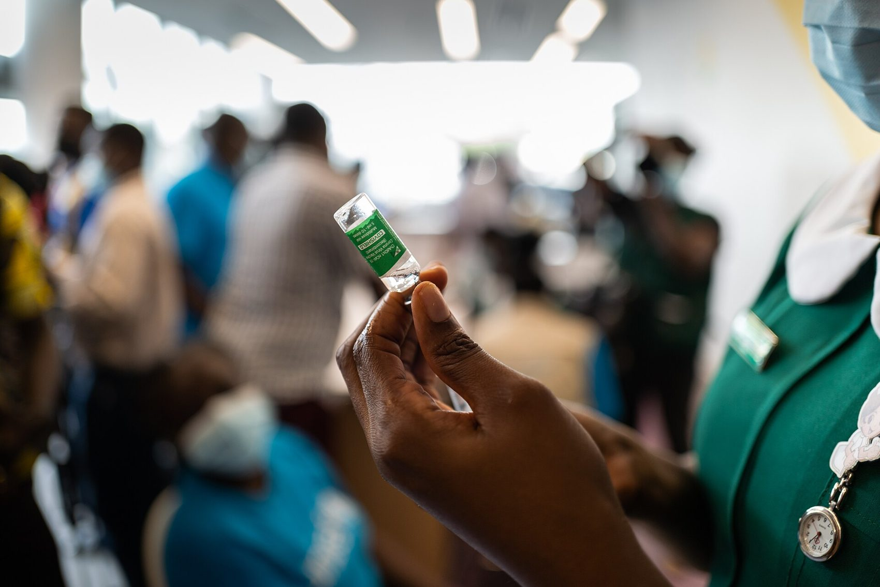
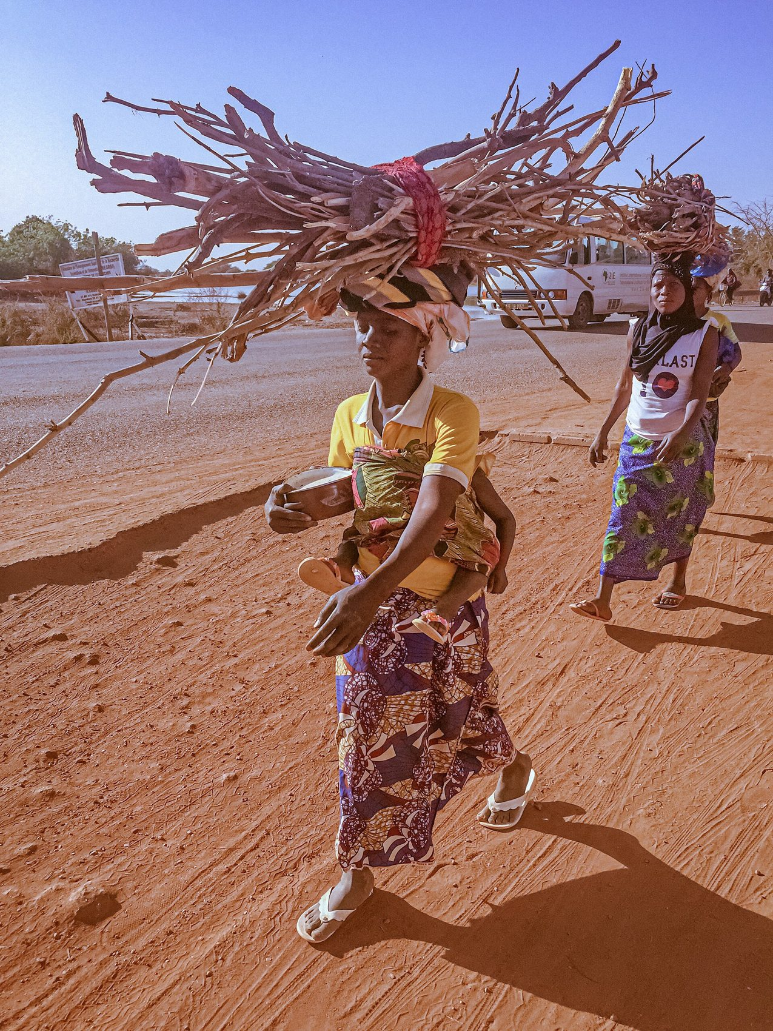
Three faces of one challenge
Agriculture
Health
Energy
Food on the table
Bodies and families
Fuel, light and power
Notes:
I will look at climate change through three faces: agriculture, health and energy. Water runs through all three, and I will come back to that. These are not three separate problems. They are three faces of one challenge, and they land on the same households, very often on the same woman.

Slide 12
Agriculture: rains we can no longer trust
Most farms in West Africa are rain-fed, and the rainy season now starts late, stops early or falls all at once
Dry spells in the middle of the season and harsher harmattan winds destroy crops already planted
Heat and humidity raise post-harvest losses in storage and at market
Women farmers carry the most risk with the least access to land, credit, insurance and advisories
Who is affected: smallholder and women farmers, fish farmers, extension officers, cooperatives, market women.
Women farmers in the harmattan, Nsukka, Nigeria. Photo: Chiemezie Atama, CC BY-SA 4.0
Notes:
Our agriculture is largely rain-fed. For generations, farmers planted by the calendar of the rains. That calendar is breaking. The rains start late, stop early, or come as a single destructive downpour. A dry spell of two or three weeks in July can wipe out a maize crop. The women in this photo are farming in the harmattan in Nsukka. Ask: who decides when to plant, what information does she have, and what does it cost her when she is wrong? That is a problem your team can solve.

Slide 13
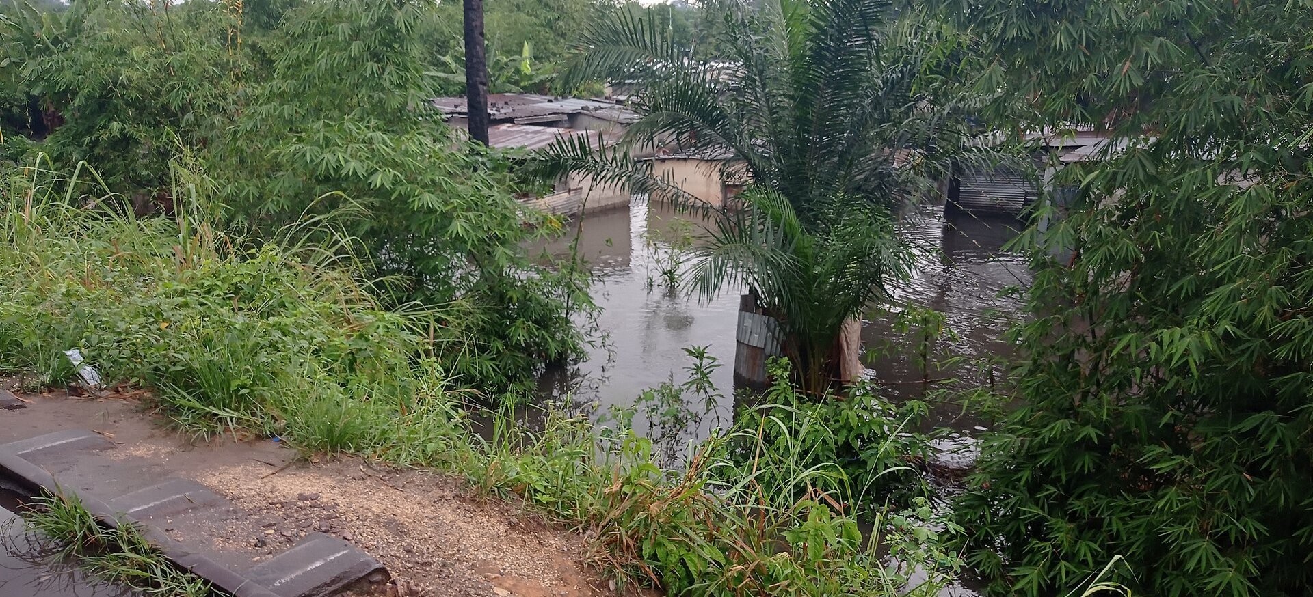
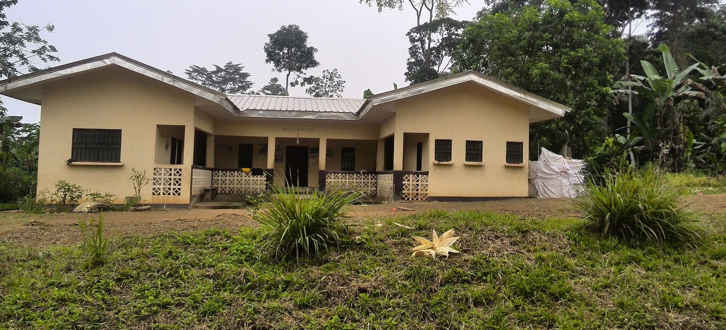
Health: when the water rises, so does disease
Urban floods in Accra, Lagos and Niamey spread cholera, typhoid and diarrhoea
Warmer, wetter seasons stretch malaria and dengue into new months and new places
Heat stress strikes pregnant women, babies, elders and outdoor workers first
Smoke from firewood cooking damages the lungs of women and children every day
Flooding after heavy rain, Kinshasa, DR Congo. Photo: Blovua, CC BY-SA 4.0
Who is affected: mothers and children, community health nurses, district health directorates, NADMO and NEMA responders.
Health centre, Akok, Cameroon. Photo: Bissayar, CC BY-SA 4.0
Notes:
Climate change is a health crisis wearing an environmental coat. After every major flood in Accra or Lagos, the clinics fill with cholera and diarrhoea cases. Malaria seasons are shifting. Heat is a silent killer that rarely appears in our statistics. Yet the satellite and weather data that could warn a district health team a week ahead rarely reaches them in a form they can use. That gap, between data that exists and a nurse who can act, is exactly where your teams can work.

Slide 14
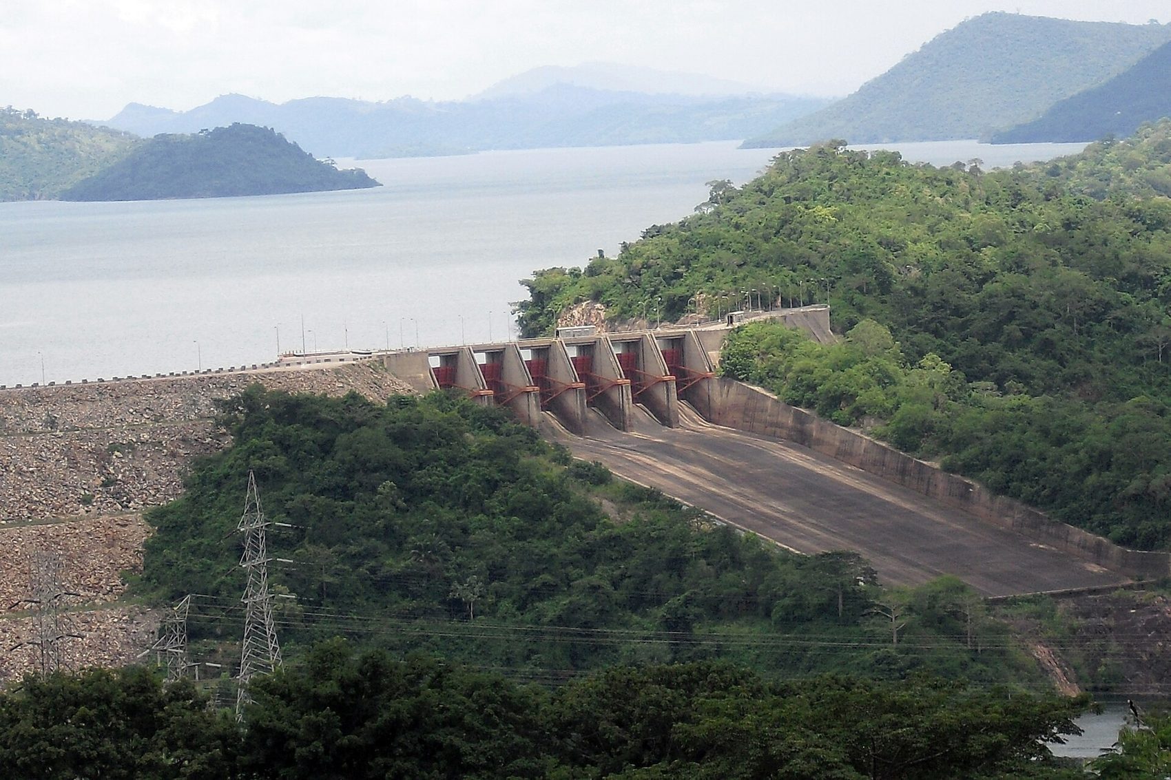
Energy: the water, power and firewood triangle
Hydropower from Akosombo, Bui and Kainji depends on rainfall; low inflows mean load shedding
Most households still cook with firewood and charcoal, feeding deforestation
Women and girls lose hours each day fetching fuel and water
When power fails, clinics, cold chains, pumps and small businesses stop
Who is affected: households, women and girls, clinics, schools, small businesses, utilities.
Akosombo Dam spillway, Ghana. Photo: ZSM, CC BY-SA 3.0
Carrying firewood, Kamboinse, Burkina Faso. Photo: Rikyelle Momo Nguematio, CC BY-SA 4.0
Notes:
In Ghana we learnt the hard way that energy is a climate issue. When the Volta inflows dropped, Akosombo could not deliver, and dumsor followed. At the same time, most families still cook with firewood. That firewood comes from the same forests that protect our rivers. And it is women and girls, like these women in Burkina Faso, who carry it on their heads. Energy, water and gender are tied together in one triangle.

Slide 15
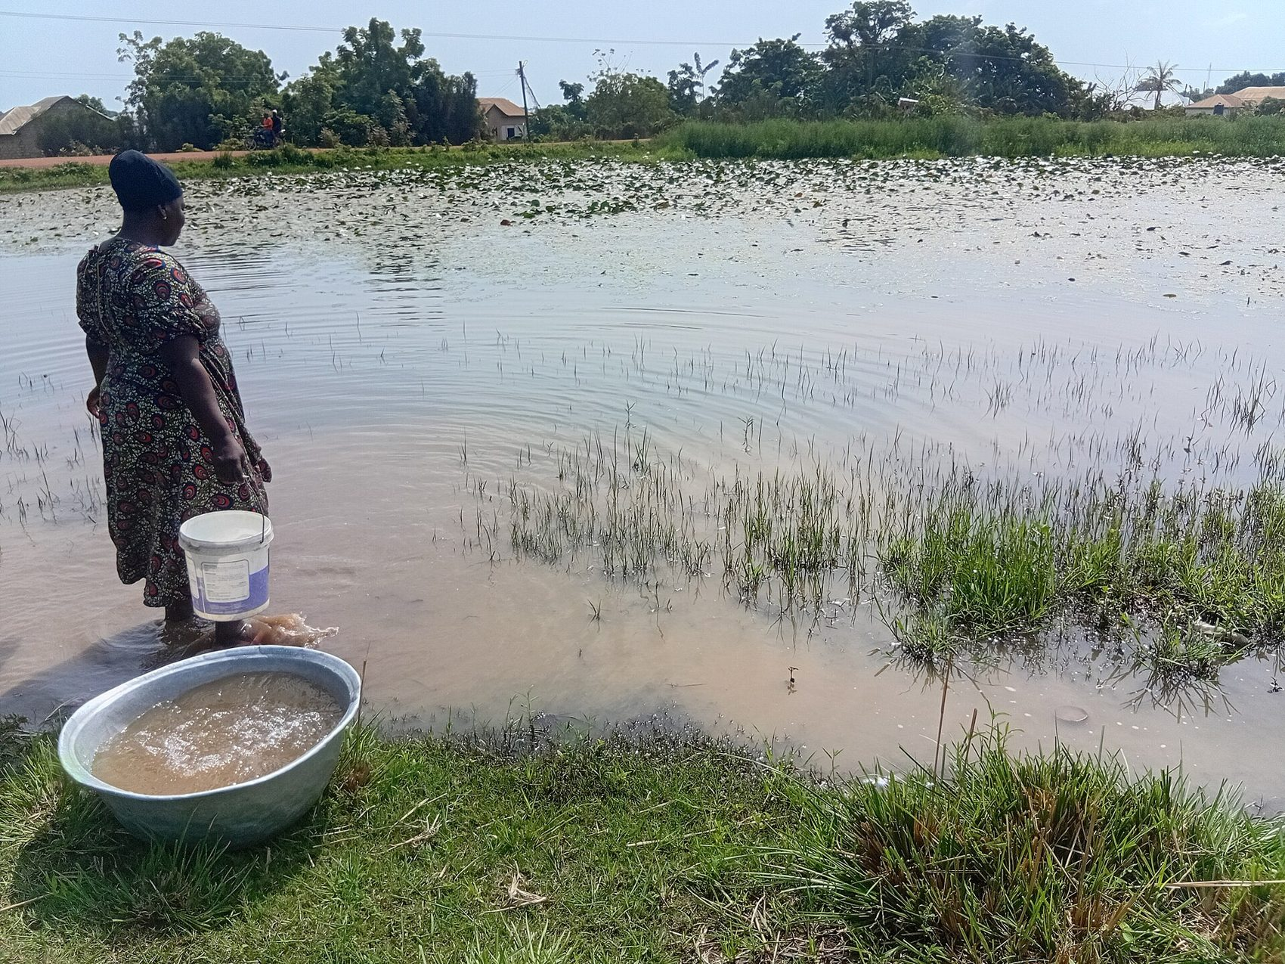

Two crocodiles, one stomach
Funtunfunefu Denkyemfunefu
Two heads fighting over food that ends up in one shared stomach. Unity in diversity.
Agriculture, health and energy share one stomach: water and climate.
The same rainfall decides the harvest, the cholera outbreak and the hydropower. A solution that sees only one head misses the stomach. A solution that sees the whole nexus can serve many users at once.
Fetching water at Mawo dam. Photo: Abass De General 1, CC0
Notes:
This Adinkra symbol shows two crocodiles with one stomach. They fight over the food, but it feeds the same body. Our sectors behave like this. Ministries of agriculture, health and energy plan separately, but they all depend on the same water and the same climate. The woman at the Mawo dam is the shared stomach: her water, her food, her fuel and her family's health all meet at this one water point. Design for her, and you will often solve more than one problem at once.

Slide 16
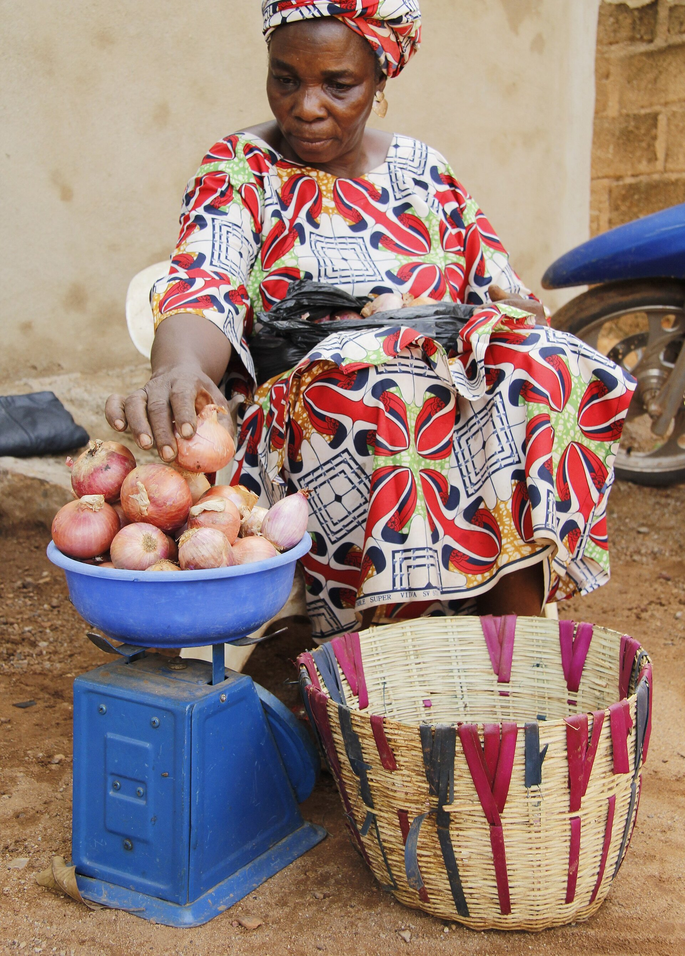
The people and institutions on the front line
Women smallholder farmers
Needs: a planting date and a price they can trust
Fish farmers and fisherfolk
Needs: warnings on water quality, heat and storms
Market women and traders
Needs: cool storage and fair prices after harvest
Mothers, children and elders
Needs: early warning on heat, floods and disease
District health teams
Needs: a plain language risk alert a week ahead
Utilities and basin authorities
Needs: inflow and demand forecasts for planning
Met and disaster agencies
Needs: last mile channels to reach every community
Extension services and cooperatives
Needs: tools to serve many farmers at low cost
Onion seller, Mali. Photo: Moussa Kalapo, CC BY-SA 4.0
Notes:
Here are the people and institutions your solutions will serve. Notice I have written what each one needs, not what technology they need. A market woman does not need an app. She needs her tomatoes not to rot. A district health officer does not need a satellite. She needs an alert she can act on. Every team should be able to name its user from this list, or add one, and say in one sentence what she needs.

Slide 17
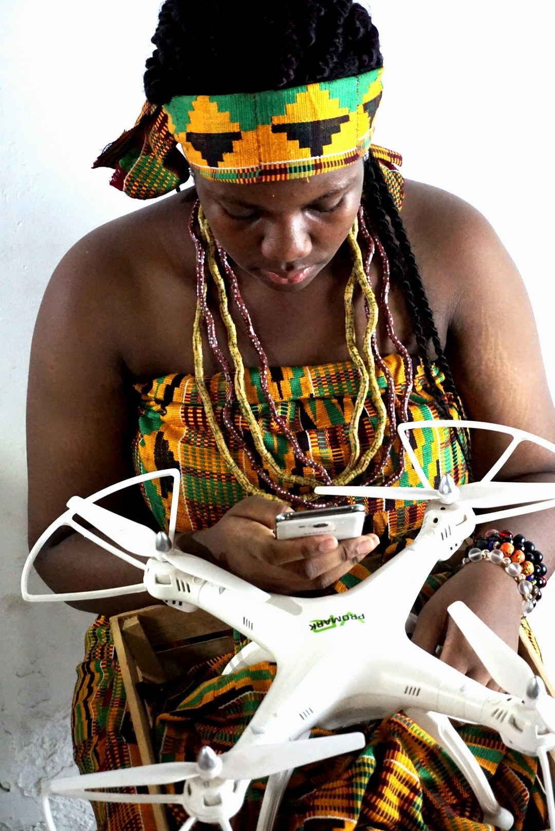

The challenge is also the opportunity
Africa skipped the landline and went straight to the mobile phone and mobile money.
We can do the same with climate: skip the polluting, centralised path and go straight to solar, digital and climate smart systems built by Africans for Africans.
Every gap in data, power or services is a market waiting for a woman-led venture.
Adinkra symbol Gye Nyame, CC0
Woman in kente operating a drone by phone. Photo: $ir$terlin, CC BY-SA 4.0
Notes:
Now the turn. Gye Nyame is the most familiar Adinkra symbol, often read as: nothing is impossible. Look at this young woman: dressed in kente, flying a drone from her phone. Tradition and technology in the same hands. Twenty years ago few people imagined this. Africa leapfrogged the landline. That is the model. Because we have not yet built heavy, polluting infrastructure everywhere, we can go straight to the solutions of the future. Every gap I have just described is also a market. Where there is no data, there is a data business. Where there is no power, there is an energy business. Where there is no warning, there is a service someone will pay for.

Slide 18
Three leapfrogs
From
To
Venture model
Agriculture
Guessing the rains
SMS, USSD and voice advisories built on satellite rainfall and local weather stations
Pay per advisory by mobile money; licences to cooperatives and agribusiness
Health
Reacting after the outbreak
Climate and health early warning dashboards for district health teams
Licences to health directorates, NGOs and insurers
Energy
Firewood and load shedding
Solar, clean cooking and usage tracking that proves impact
Programme software plus verified data for carbon and results based finance
Notes:
Here are three leapfrogs in one table. In agriculture we move from guessing the rains to advisories delivered by SMS, USSD or voice, built on satellite rainfall and the local weather stations WACREN and partners are installing. In health, from reacting after the outbreak to early warning dashboards. In energy, from firewood and load shedding to solar and clean cooking, with tracking that proves impact. Look at the last column. Each has a business model. In six months you will not build a company, but you can build the first proof that a company is possible.

Slide 19
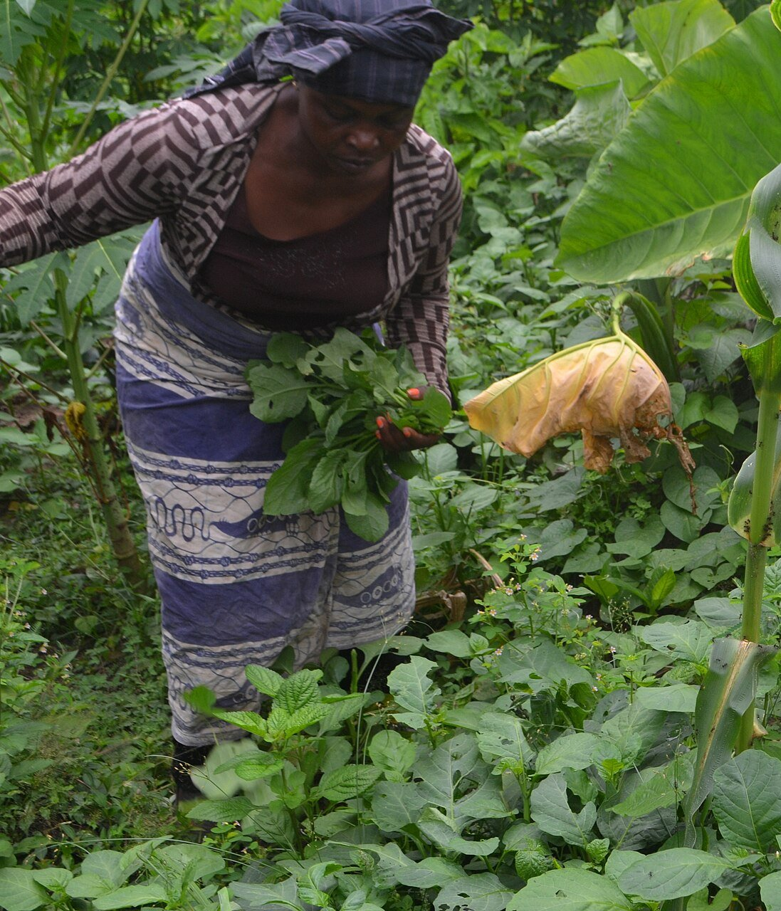
Leapfrog 1: agriculture
Planting window and dry spell alerts by SMS, USSD or voice in local languages
Soil moisture and microclimate tools that tell a farmer group when to irrigate
Water quality and heat alerts for fish ponds and aquaculture
Weather triggers that make crop insurance cheap and fast to pay out
Solar cold storage and market price tools that cut post-harvest losses
Start with one farmer group and one season.
Woman farmer harvesting vegetables, Cameroon. Photo: Minette Lontsie, CC BY-SA 4.0
Notes:
For agriculture, here are five places to start. Notice none of them needs a new satellite or a big lab. They need existing data, a phone and a clear user. My advice: start with one farmer group, one crop or pond, one season. If it works for thirty women in one community, it can work for thirty thousand.

Slide 20
Leapfrog 2: health
Flood linked cholera risk alerts for one district health office
Heat health warnings for pregnant women, elders and outdoor workers
Malaria season outlooks from rainfall and temperature data
Community reporting of flooded boreholes and polluted water points
Clean air advisories linked to cooking smoke and harmattan dust
Start with one clinic and one hazard.
Nurse preparing a vaccine, Ghana. Photo: Nana Kofi Acquah / WHO, CC BY-SA 3.0 IGO
Notes:
For health, the opportunity is to translate climate data into the language of a clinic. A district health officer does not want a rainfall map. She wants to know: will I see more cholera cases next week, and where? Pick one clinic, one hazard, and build the simplest alert that would change what she does on Monday morning.

Slide 21
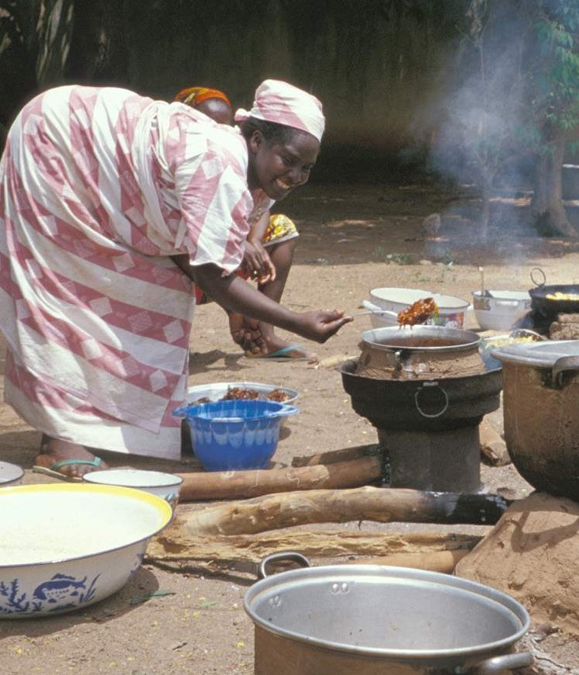
Leapfrog 3: energy
Usage and adoption tracking for clean cookstove and LPG programmes
Measurement and verification data that unlocks carbon finance for communities
Solar sizing and load planning tools for clinics, schools and mini-grids
Water availability tools for hydropower, irrigation pumps and mini-grid planning
Pay as you go models for solar lamps, fridges and pumps
Start with one existing programme and its real users.
Cooking on an improved stove, Cameroon. Photo: Trees for the Future, CC BY 2.0
Notes:
For energy, many cookstove and solar programmes already exist across our countries. What they lack is good data: are the stoves being used, is smoke reduced, is firewood saved? That data is worth money, because it can unlock carbon and results based finance. Partner with a programme that already exists, and build the tool it is missing.

Slide 22
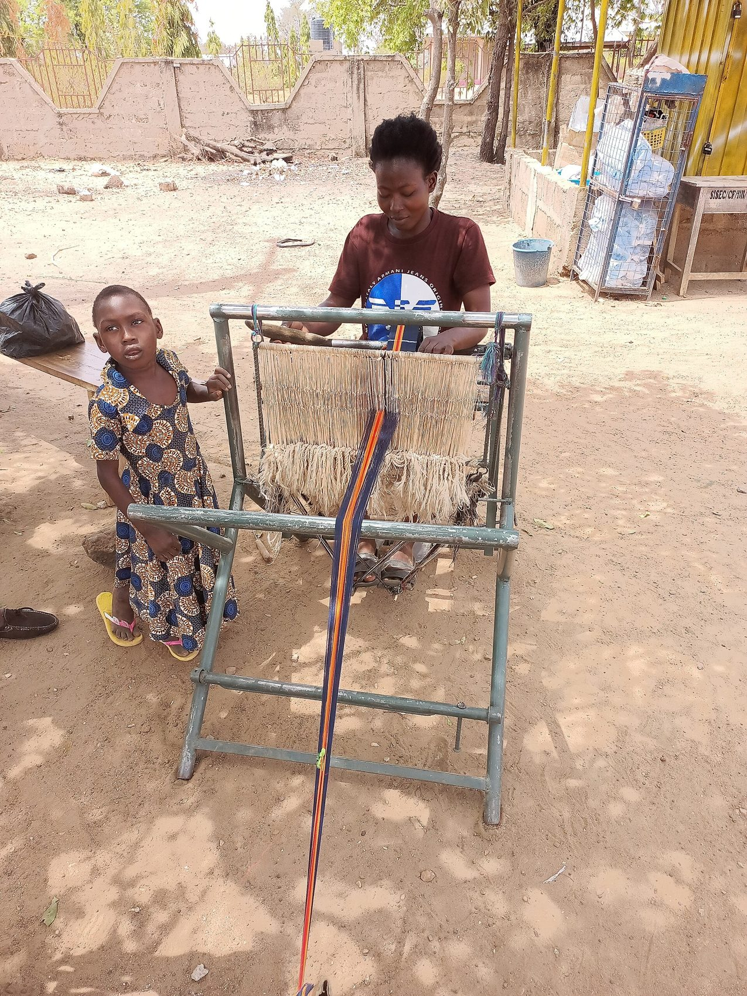

Weave the threads
One thread is weak. Woven together, it becomes cloth. A strong climate solution weaves four threads:
1
Indigenous knowledge
rain signs, local names, seasonal calendars
2
Earth observation
satellite rainfall, vegetation and dust from EUMETCast, Sentinel and Digital Earth Africa
3
Ground sensors
low cost weather stations, river gauges, phone reports
4
People
the farmer, the nurse, the mother who use and trust it
Weaving Kente, Sirigu, Ghana. Photo: Sir Amugi, CC BY-SA 4.0
Notes:
Kente is woven one narrow strip at a time, then the strips are sewn together into cloth. Climate solutions work the same way. One thread on its own breaks. Indigenous knowledge alone cannot scale. Satellite data alone does not reach people. Sensors alone are expensive. People alone lack the data. Weave all four. The Nyansapo, the wisdom knot, reminds us that wisdom is in how we tie things together.

Slide 23
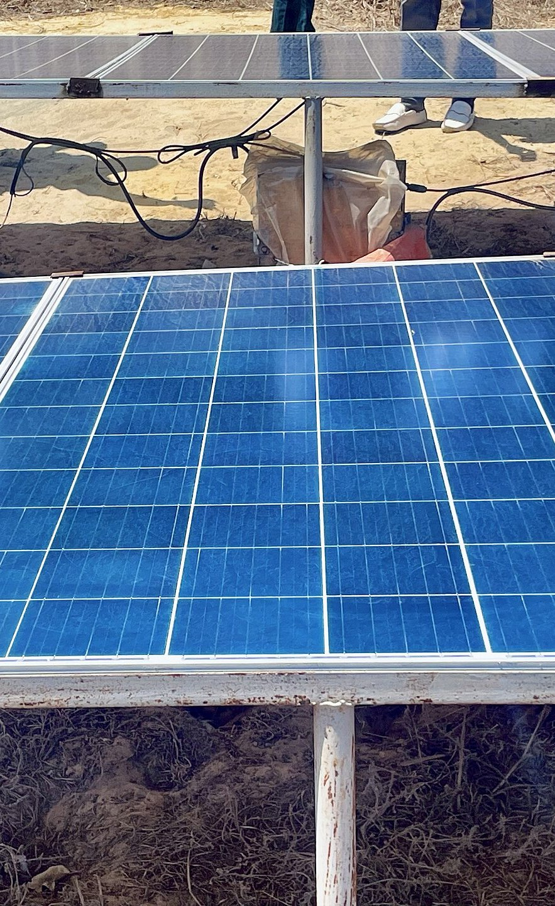
You are not starting from zero
1
2
Data and infrastructure
WACREN EUMETCast, WE-CAST portal, LoRaWAN stations and HPC; free Digital Earth Africa, CHIRPS and ERA5 data
Community hosts
Green WaterHut communities in the Black Volta Basin, Eden Foundation Ghana in Gomoa, and your own institutions and towns
3
4
Validation and growth
Your mentors for six months, peer review from other teams, WACREN networks and partner programmes
Policy hooks
AU Agenda 2063, STISA 2034, AU Climate Strategy 2022 to 2032, ECOWAS energy policy and your national plans
Reuse what exists. Spend your time on the user.
Solar powered farm, Niague, Senegal. Photo: Yagamar, CC BY-SA 4.0
Notes:
You are not starting from zero. WACREN brings EUMETCast satellite data, the WE-CAST portal, low cost weather stations and high performance computing. Open data from Digital Earth Africa, CHIRPS rainfall, ERA5 and Sentinel is free. There are real community hosts: Green WaterHut communities in the Black Volta Basin and Eden Foundation in Gomoa, and of course your own communities. Your mentors, the other teams and WACREN networks will help you validate and grow promising tools. Reuse what exists. Do not spend your six months building infrastructure.

Slide 24
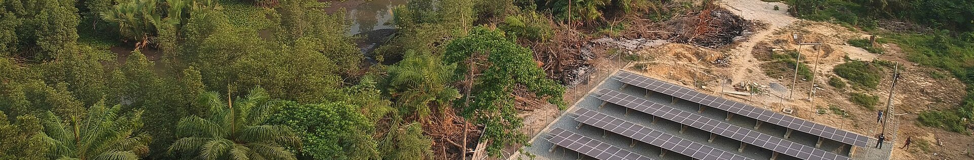
From idea to real case in six months
1
2
3
4
5
6
Discover
Month 1
Name a real host; meet users; review data
Define
Month 2
One narrow problem; smallest buildable product
Prototype
Month 3
Build in this Lab, reusing data and APIs
Test
Month 4
Real users at the host site; learn; iterate
Demonstrate
Month 5
Live pilot with the partner; capture evidence
Pitch
Month 6
Costed scale plan to mentors and funders
Solar mini-grid, Bayelsa, Nigeria. Photo: Rupumped, CC BY-SA 4.0
Notes:
This is the journey. Discover, define, prototype in this Lab, test with real users, demonstrate with a real partner, and pitch a costed plan in month six. The word real matters. A real case means real users at a named site, not a simulation. Keep your scope small enough to finish, and strong enough to grow.

Slide 25
Six teams, one ecosystem
Team 1
Share one data commons
One shared folder of datasets, APIs, code and contacts. What one team finds, all teams can use.
Team 6
Team 2
Review each other honestly
In the peer review rounds, challenge every idea with care: is it desirable, feasible and viable?
One shared goal: working prototypes in real hands
Lend your strength
Each mentor and each team also supports a second team. The coder helps the farmer team; the health team helps the flood team.
Team 5
Team 3
Link the solutions
A flood alert can feed a health alert; a farm advisory can ride on a women's network. Look for the joins.
Team 4
Notes:
Four English speaking teams and two French speaking teams, six mentors, three facilitators. If each team works in a silo, we get six small projects. If we work as one ecosystem, we get something much bigger. Four habits. First, share one data commons: a shared folder of datasets, code and contacts. Second, review each other honestly in the peer review rounds. Third, lend your strength: every mentor and team also supports a second team. Fourth, link the solutions: a flood alert can feed a health alert, a farm advisory can travel through a women's network. Look for the joins between your projects.

Slide 26
What tangible looks like
By Thursday
By Month 5
By Month 6
Community Day
Real case
Together
A clickable or working prototype demonstrated in 12 minutes
A named user, a named host site and a test plan
One link to at least one other team's solution
The prototype tested with real users at the host site
Evidence: who used it, what changed, what failed
At least one improvement made from user feedback
Six costed scale up pitches to mentors, partners and funders
A shared WiW climate solutions portfolio
A network of women who keep building after the Lab
Funtunfunefu: many heads, one stomach. Different teams, one shared success.
Notes:
So what does tangible mean? By Thursday, Community Day, every team demonstrates a prototype in twelve minutes, names a real user and host site, and shows a test plan, plus at least one link to another team's solution. By month five, the prototype has been tested with real users and you have evidence. By month six, six costed pitches, one shared WiW climate solutions portfolio, and a network of women who keep building long after this Lab. Remember the crocodiles: many heads, one stomach. Different teams, one shared success.

Slide 27
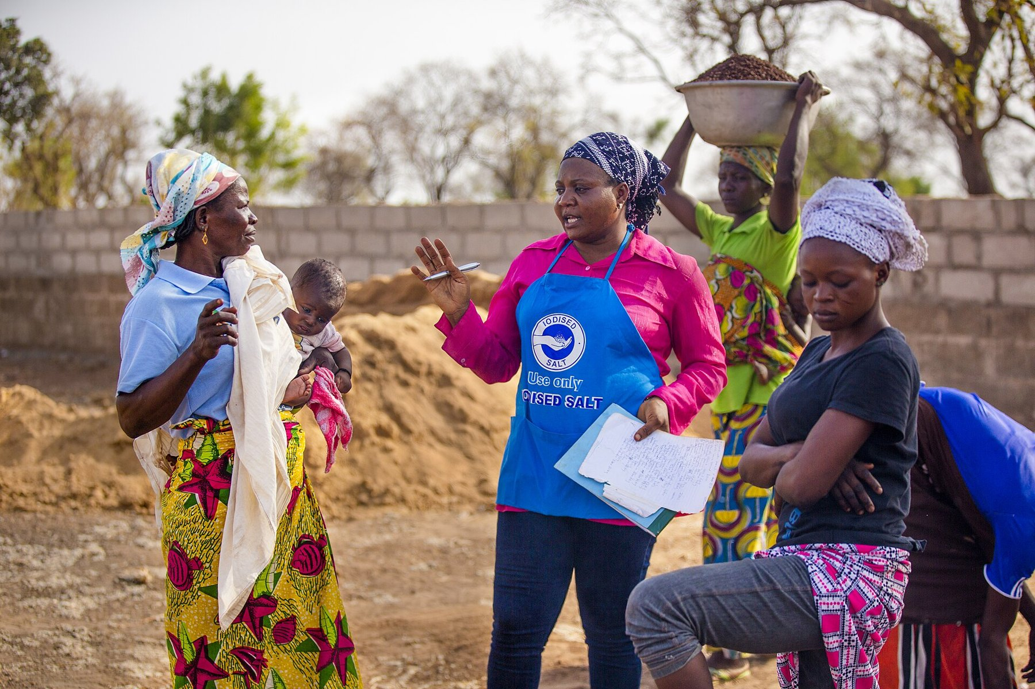
Do not build for African women. Build with them.
Sankofa: fetch the wisdom. Leapfrog: build the future.
Thank you. Medaase. Na gode. Daalu. E se.
Prof. Amos T. Kabo-Bah
Email: akabobah@gmail.com
WhatsApp: +233 543859721
Women shea processors, Ghana. Photo: USAID in Africa, public domain
Notes:
I will close with these women shea processors in Ghana. Shea is women's gold: an indigenous resource, processed by women, sold to the world. It is proof that African women already run climate sensitive businesses. Our job this week is not to build solutions for them, but with them. Sankofa: fetch the wisdom. Leapfrog: build the future. Thank you, and over to Dr Vivian, who will take us from problems to solutions.

Slide 28
Sources and image credits
Sources
WMO (2024). State of the Climate in Africa 2023. WMO, Geneva.
WMO (2021). State of the Climate in Africa 2020. WMO, Geneva.
IEA (2022). Africa Energy Outlook 2022. IEA, Paris.
WMO (2025). State of the Global Climate 2024. WMO, Geneva.
NOAA Global Monitoring Laboratory, atmospheric CO2 records.
WiW Climate Innovation Lab 2026 Concept Note, August 2026.
Adinkra symbols via Wikimedia Commons: Sankofa (PD), Gye Nyame (CC0), Funtunfunefu (CC0), Nyansapo (CC0), Nkyinkyim (CC BY-SA 4.0).
Photographs (Wikimedia Commons)
Baobab, Bongo, Ghana. Photo: Danieljatuat, CC BY-SA 4.0
Solar mini-grid, Bayelsa, Nigeria. Photo: Rupumped, CC BY-SA 4.0
Yoruba talking drum (dundun) player, Nigeria. Photo: Tijani Taofeek Bamidele, CC BY-SA 4.0
Rain clouds over a Ghanaian town. Photo: OJjnr, CC BY-SA 4.0
Africa from the Suomi NPP satellite. NASA/NOAA, public domain
Cumulonimbus building up. Photo: Ceentia, CC BY-SA 4.0
Meteosat 12 first full disk image. EUMETSAT/ESA
Automatic weather station, Ghana Meteorological Agency. Photo: Amuzujoe, CC BY-SA 4.0
Harmattan dust over West Africa, 15 Feb 2020. Image: NASA MODIS, public domain
Women farmers in the harmattan, Nsukka, Nigeria. Photo: Chiemezie Atama, CC BY-SA 4.0
Flooding after heavy rain, Kinshasa, DR Congo. Photo: Blovua, CC BY-SA 4.0
Health centre, Akok, Cameroon. Photo: Bissayar, CC BY-SA 4.0
Nurse preparing a vaccine, Ghana. Photo: Nana Kofi Acquah / WHO, CC BY-SA 3.0 IGO
Akosombo Dam spillway, Ghana. Photo: ZSM, CC BY-SA 3.0
Carrying firewood, Kamboinse, Burkina Faso. Photo: Rikyelle Momo Nguematio, CC BY-SA 4.0
Fetching water at Mawo dam. Photo: Abass De General 1, CC0
Onion seller, Mali. Photo: Moussa Kalapo, CC BY-SA 4.0
Woman in kente operating a drone by phone. Photo: $ir$terlin, CC BY-SA 4.0
Woman farmer harvesting vegetables, Cameroon. Photo: Minette Lontsie, CC BY-SA 4.0
Cooking on an improved stove, Cameroon. Photo: Trees for the Future, CC BY 2.0
Weaving Kente, Sirigu, Ghana. Photo: Sir Amugi, CC BY-SA 4.0
Solar powered farm, Niague, Senegal. Photo: Yagamar, CC BY-SA 4.0
Women shea processors, Ghana. Photo: USAID in Africa, public domain
Notes:
Credits slide. Leave on screen during questions if useful.

