Slide 1


Session 1:Identité & Confiance
Fondements
Lomé, Janvier 2026

Slide 2
Sommaire
1. Apercu sur l’Identité et la confiance
2. Composants de l’infrastructure eduroam
3. deploy eduroam at the national level
4. deploy eduroam at the Campus level
5. Test EAP and eduroam
6. Configuring Supplicants
7. Policies and strategy for the development and management of the National Federation eduroam

Slide 3
Identité Fédérée ou Fédération d’Identité
Composants clés
Fournisseur d’Identité ou Identity Provider (IdP): Entité de confiance gérant les identités numériques et offrant le service d’authentification (e.g.,https://nrentogostaff.togorer.eduid.africa ).
Fournisseur de Service ou Service Provider (SP): La ressource (service ou application) protégé ou partagée (e.g., https://wacren.zoom.us ).
Relation de confiance: Un accord entre organisation pour partager les données d’authentication, accord souvent établi á travers les échanges de métadonnées.
Jetons de sécurity ou Security Tokens: Assertions cryptées (souvent SAML ou OpenID Connect tokens) envoyé de l’ IdP vers le SP pour vérifier l’ identité.

Slide 4
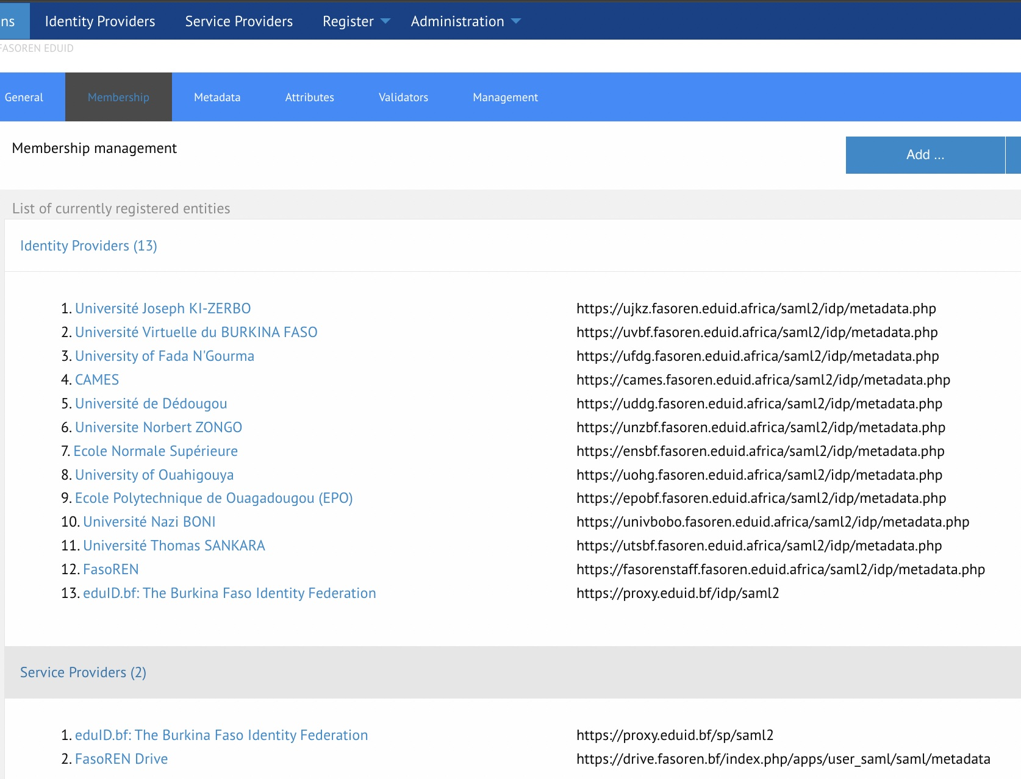
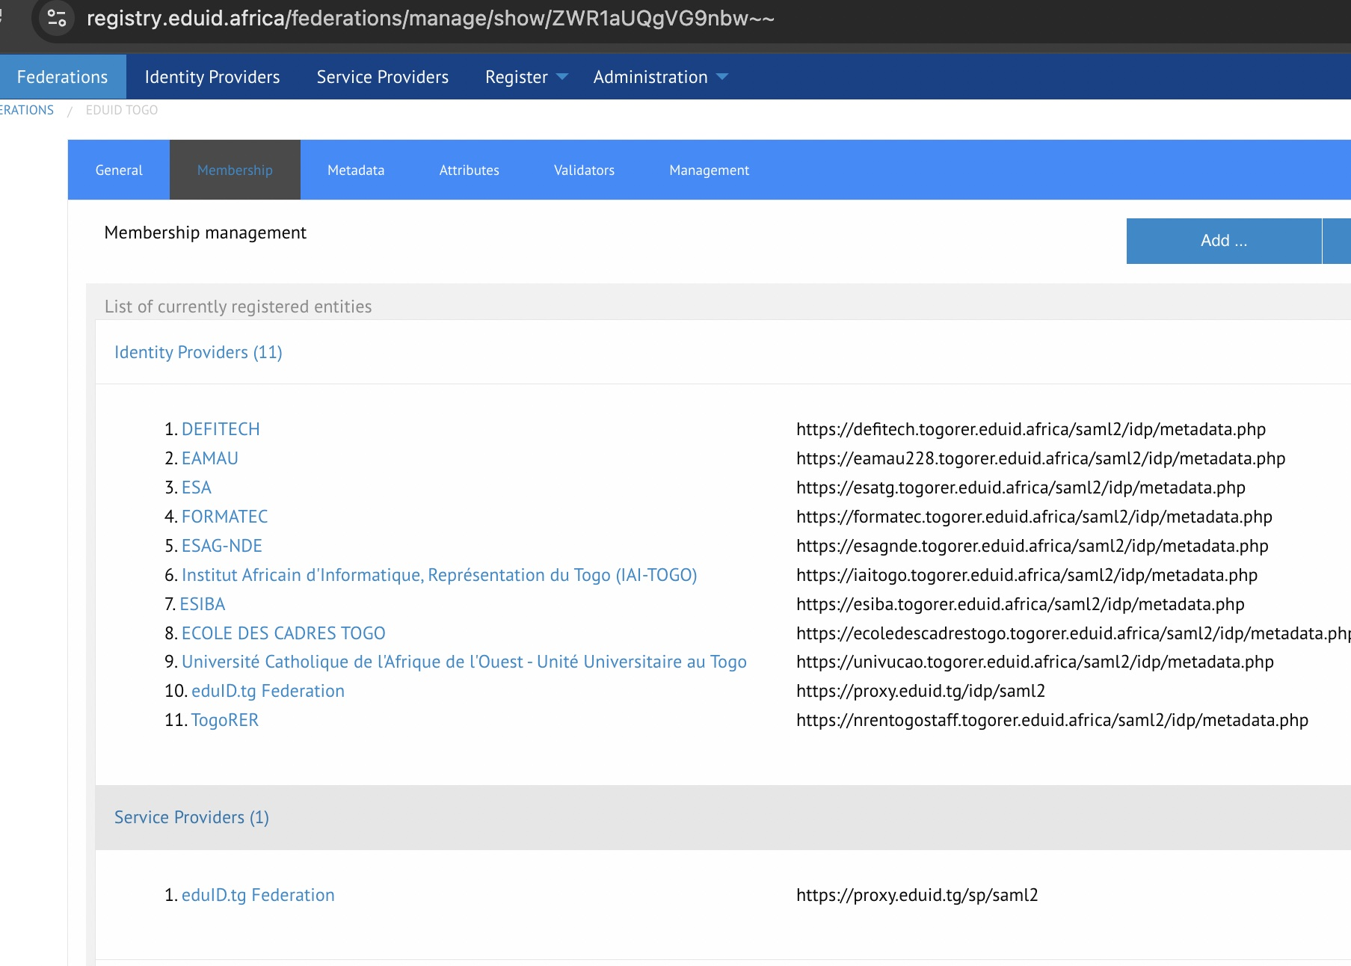
Identité Fédérée ou Fédération d’Identité
Fédération nationales et eduGAIN
Fédérations nationales:
++ eduID.bf : (13IdPs) ++ eduID.tg : (11 IdPs ).

Slide 5
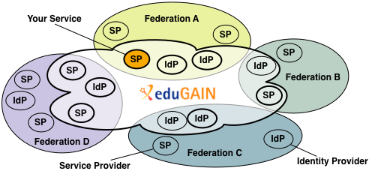
Identité Fédérée ou Fédération d’Identité
Fédération nationales et eduGAIN
eduGAIN
** eduGAIN wiki : https://wiki.geant.org/spaces/eduGAIN/overview
** How to offer a Service in eduGAIN : https://wiki.geant.org/spaces/eduGAIN/pages/121348108/How+to+offer+a+service+in+eduGAIN
** eduGAIN metadata : https://mds.edugain.org/edugain-v2.xml
** Technical eduGAIN : https://technical.edugain.org/

Slide 6
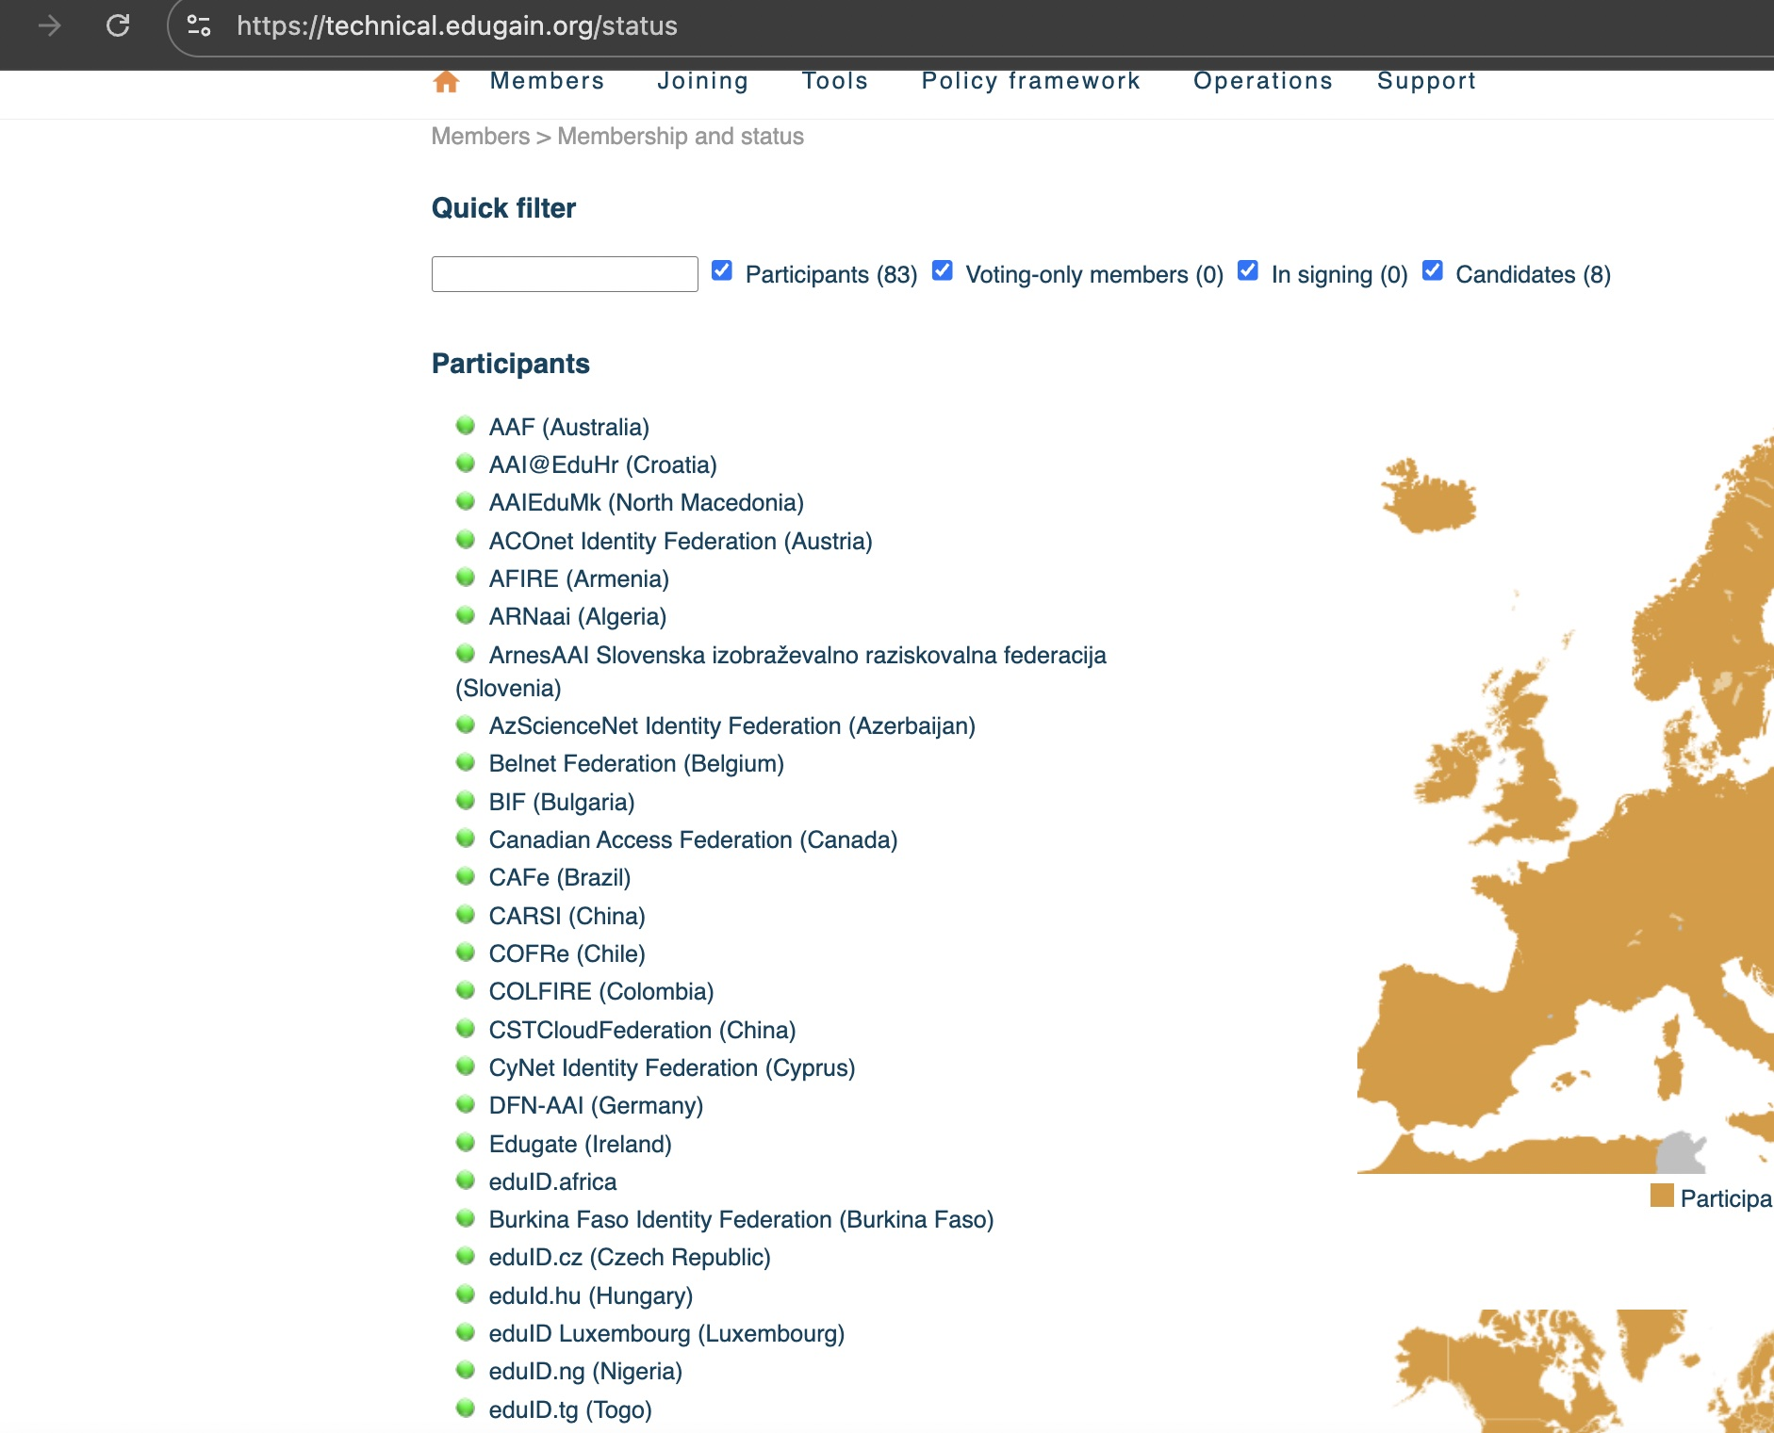
Identité Fédérée ou Fédération d’Identité
Fédération nationales et eduGAIN
eduGAIN:
** members & status : https://technical.edugain.org/status
** Open ID Federation Pilot :
https://wiki.geant.org/spaces/eduGAIN/pages/1072398451/eduGAIN+-+Open+ID+Federation+Pilot

Slide 7
Identité Fédérée ou Fédération d’Identité
Roles des Fédérations d’Identité
** Role fondamental :
Etablir la confiance entre :
IdP (Identity Providers)
→ universités, centres de recherche, organismes fournissant les identités
SP (Service Providers)
→ plateformes e-learning, bibliothèques, PIDsLink, outils collaboratifs, baobab, etc.
++> Définit:
- des politiques communes (sécurité, protection des données, niveaux
D’assurance) des règles d’adhésion (qui peut être IdP ou SP)
- des bonnes pratiques opérationnelles
Mutualiser et distribuer les métadonnées :
→ Collecte des métadonnées des IdPs et SPs
→ Validation, signature, et publication des métadonnées
→ Mise a jour réguliere des métadonnées
++> Permet:
- l’authentification SSO
- la définition et la normalisation d’attributs d’identité

Slide 8




Identité Fédérée ou Fédération d’Identité
Cas d’Usage

Slide 9
Apercu de eduroam
educational roaming, est une infrastructure réseau sans fil mondiale qui vise a faciliter un acces sécurisé aux utilisateurs des institutions académiques participantes suivant le principe “Démarrez votre ordinateur et soyez connectez”.
eduroam est basé sur les mécanismes Authentification,Autorisationand of Accounting/Statistics implementé par le serveur RADIUS.
Plusieurs serveurs RADIUS collaborent entre eux pour réaliser l’authentification(by eduroam IdP) and Authorization (by eduroam SP)

Slide 10
Assistances a la configuration d’eduroam
2 Types d’assistance a la configuration :
** switchboard.eduroam.africa
** cat.eduroam.org

Slide 11
Assistances a la configuration d’eduroam
** switchboard.eduroam.africa

Slide 12
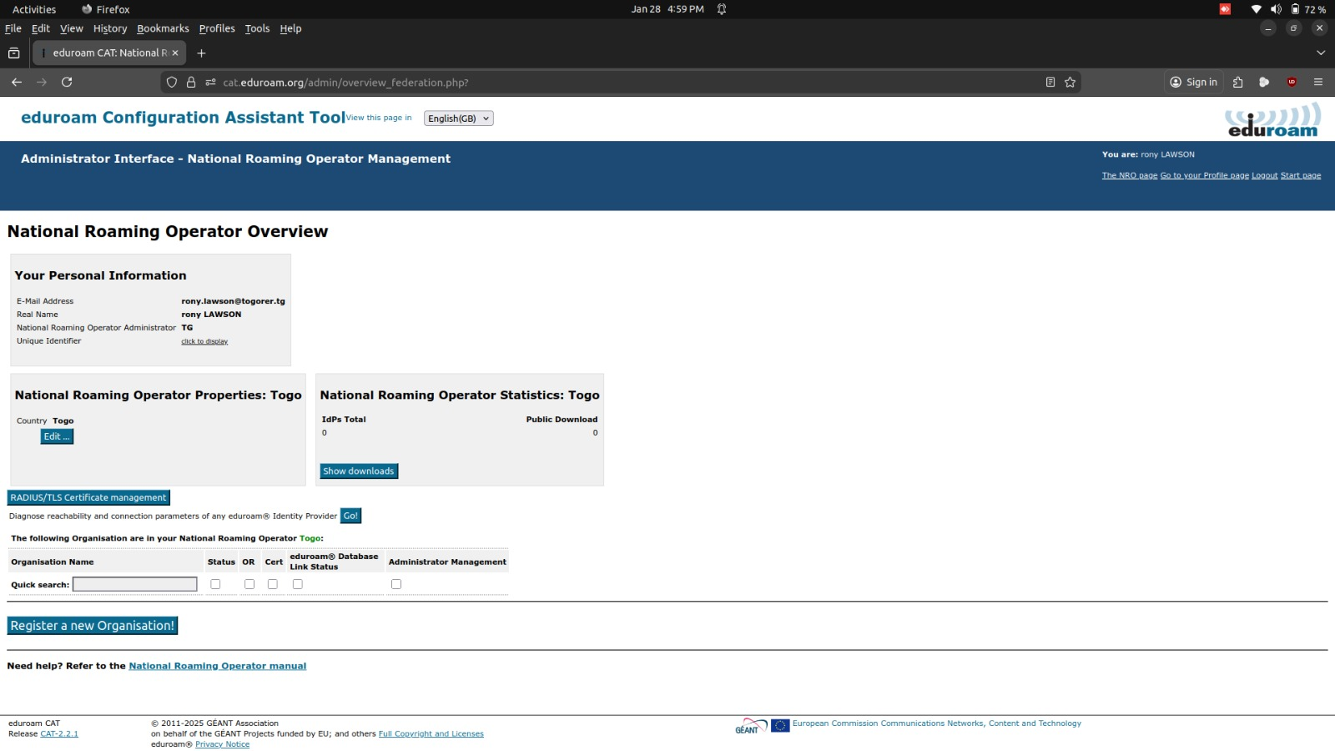
Assistances a la configuration
d’eduroam
** cat.eduroam.org
++ Administration NRO: Federation
nationale eduroam(ex: .tg)

Slide 13
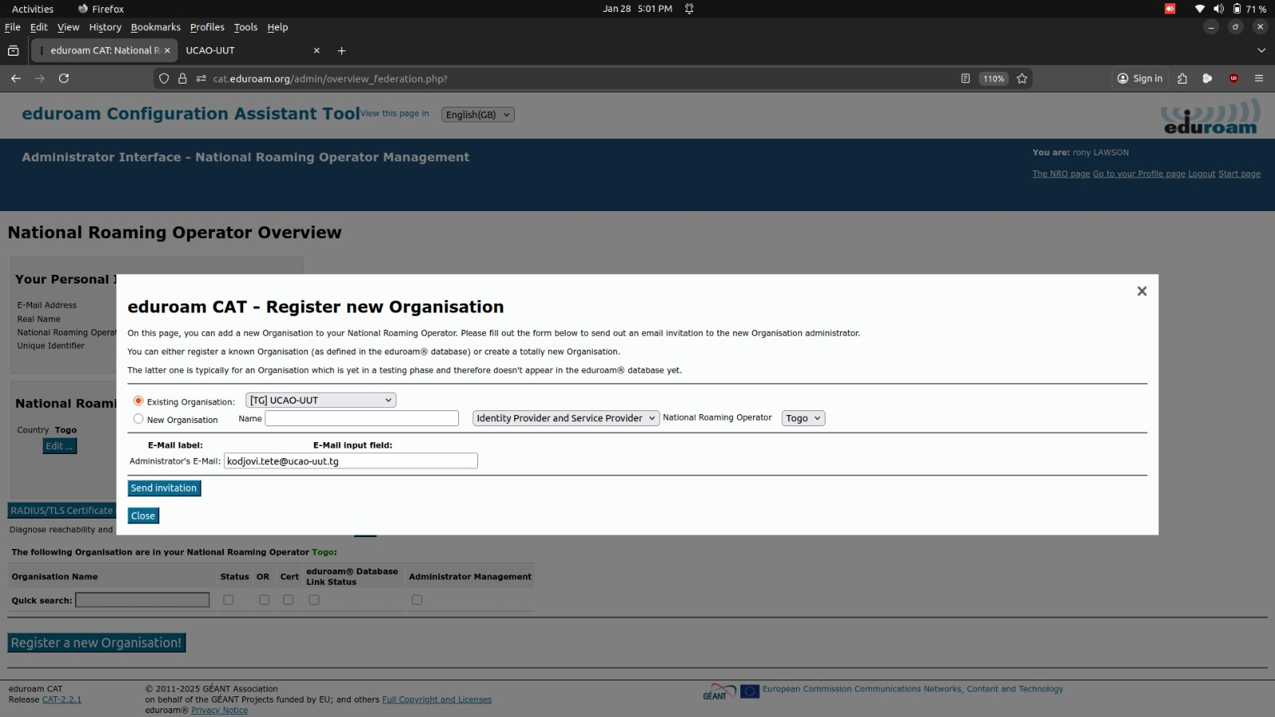
Assistances a la configuration
d’eduroam
** cat.eduroam.org
++ Administration NRO: Federation
nationale eduroam(ex: .tg)

Slide 14
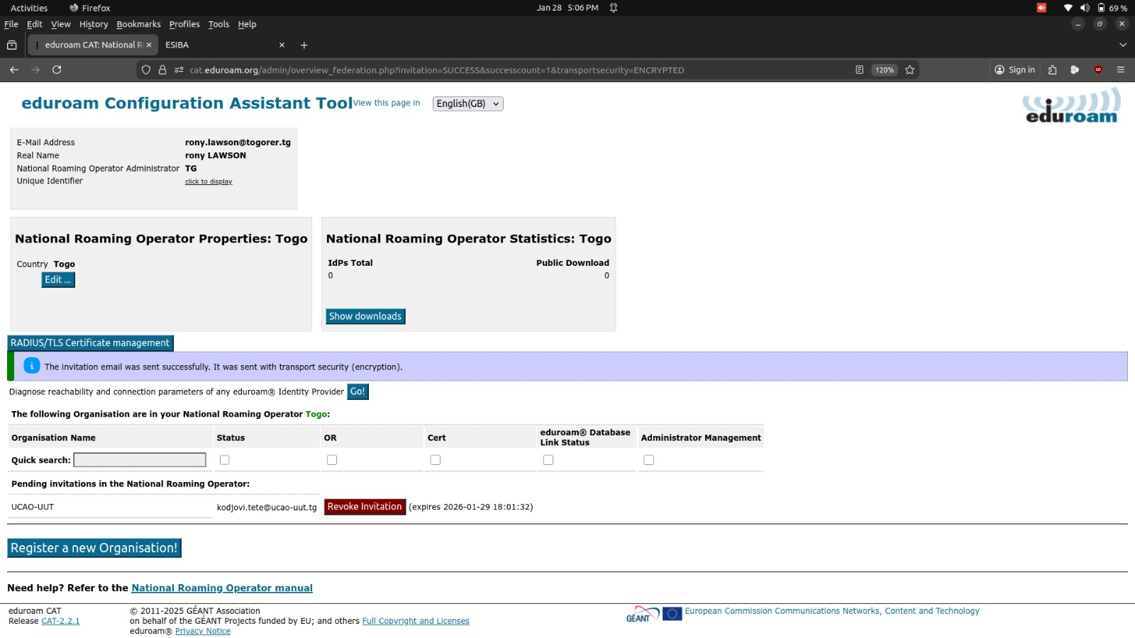
Assistances a la configuration
d’eduroam
** cat.eduroam.org
++ Administration NRO: Fédération
nationale eduroam(ex: .tg)

Slide 15
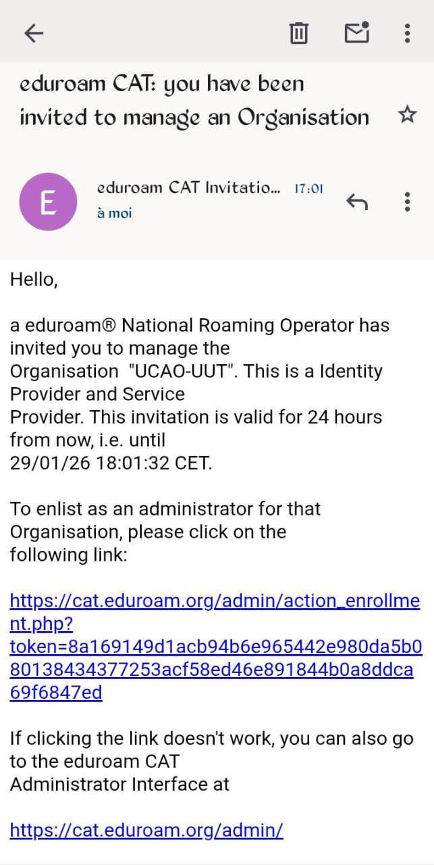
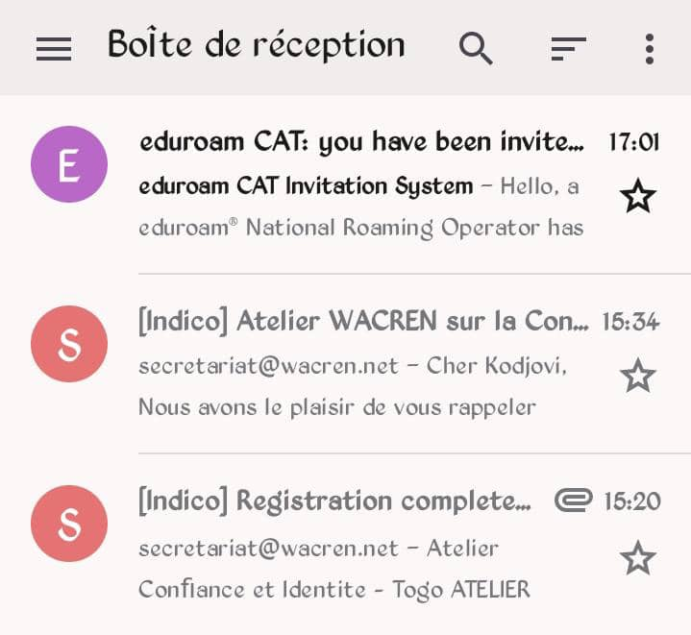
Assistances a la configuration d’eduroam
** cat.eduroam.org
++ Administration Institution: Gérer le profil
CAT eduroam d’une institution (ex: ucao-uut.tg)

Slide 16
Deploying eduroam at campus level
eduroam-idp+sp
Configuring the Freeradius service as an SP requires the following considerations:
1- The SP only forwards requests to other RADIUS servers
2- The SP does not perform authentication
3- The SP must be aware of the NAS
4- The SP must be configured to receive and process requests from the upstream (FLR)
Codes available for IdP+SP
1-https://gitlab.wacren.net/Service/eduroam/eduroam-idp
2- Ansible:
https://gitlab.wacren.net/Service/eduroam/eduroam-ansible

Slide 17
Deploying eduroam at campus level
User Support
Optimize user support through:
1- a dedicated helpdesk service(support@eduroam.tld|support@eduroam.realm).
2- Assisted configuration

Slide 18
Deploying eduroam at campus level
eduroam CAT (https://cat.eduroam.org)
Configuration Assistant Tool(https://wiki.geant.org/display/H2eduroam/A+guide+to+eduroam+CAT+for+IdP+administrators )
1- help to generate a personalized supplicant for your Institution and different OS.
2- requires: idp name, location, logo, support contacts and eduroam IdP server settings
3- The NRO must feed the eduroam database

Slide 19
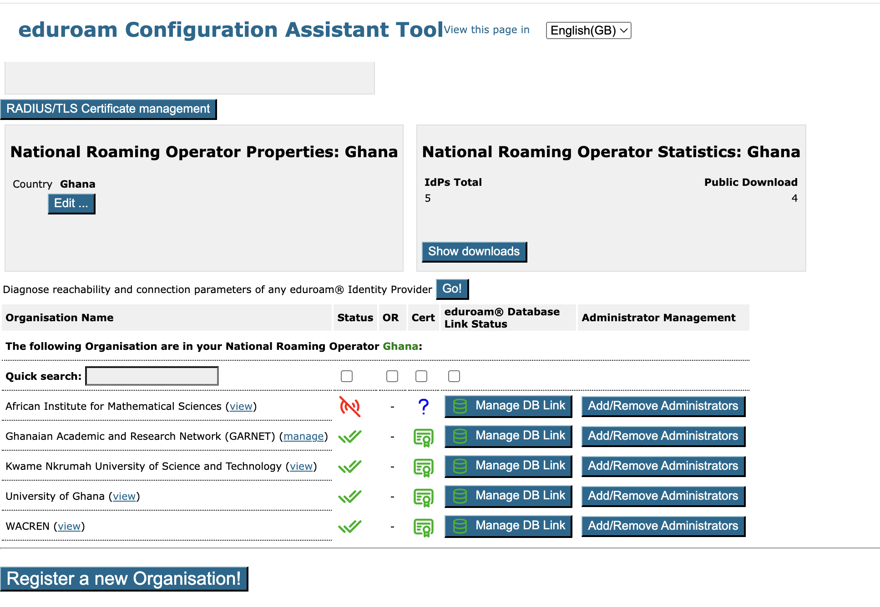
Deploying eduroam at campus level
eduroam CAT
(https://cat.eduroam.org)

Slide 20
Deploying eduroam at campus level
EAP Testing
Test EAP with rad_eap_test (https://github.com/CESNET/rad_eap_test) :
Build rad_eap_test:https://wiki.geant.org/display/H2eduroam/Testing+with+eapol_test
1- EAP-MSCHAPv2
eric@vm3:~/rad_eap_test$ ./rad_eap_test -t 60 -H 196.216.191.183 -P 1812 -S testing123 -utest.eduroam@uv.bf-p xxxx -m WPA-EAP -e PEAP -2MSCHAPV2-s eduroam
access-accept; 0.24 sec |rtt=244ms;;;0;60000 accept=1;0.5:;0:;0;1
2- EAP-TTLS
eric@vm51:~/rad_eap_test$ ./rad_eap_test -t 60 -H 196.216.191.183 -P 1812 -S testing123 -utest.ujkz@ujkz.bf-p xxxx -m WPA-EAP -eTTLS-s eduroam
access-accept;0.23 sec |rtt=227ms;;;0;60000 accept=1;0.5:;0:;0;1
{:"(3742) SentAccess-AcceptId 10 from 172.30.0.2:1812 to196.216.191.183:54934 length 186\n","time":"2023-06-17"}
{:"(3742) MS-MPPE-Recv-Key = 0xf024a7…...a1\n",,"time":"2023-06-17T12:38:37"}
{:"(3742) MS-MPPE-Send-Key = 0xc152….6\n",,"time":"2023-06-17T12:38:37.166156745Z"}
{:"(3742) EAP-Message = 0x03ba0004\n","time":"2023-06-17T12:38:37.166164397Z"}
{:"(3742) Message-Authenticator = 0x00000…..00000\n","stream":"stdout","time":"2023-06-17T12:38:37.166171767Z"}
{:"(3742)User-Name = \" test.eduroam@uv.bf \"\n","stream":"stdout","time":"2023-06-17T12:38:37.166213969Z"}
{:"(4842) SentAccess-AcceptId 21 from 192.168.128.2:1812 to196.216.191.191:52662 length 287\n","time":"2023-06-20"}
{:"(4842) MS-MPPE-Recv-Key = 0xf024a7…...a1\n",,"time":"2023-06-20T10:30:37"}
{:"(4842) MS-MPPE-Send-Key = 0xc152….6\n","time":"2023-06-20T10:30:37.156256745Z"}
{:"(4842) EAP-Message = 0x03ca0004\n","time":"2023-06-20T10:30:37.156256745Z"}
{:"(4842) Message-Authenticator = 0x00000…..00000\n","stream":"stdout","time":"2023-06-20T10:30:37.156256745Z"}
{:"(4842)User-Name = \" test.ujkz@ujkz.bf \"\n","stream":"stdout","time":"2023-06-20T10:30:37.156256745Z"}

Slide 21
Deploying eduroam at campus level
Configuring NAS or access points
The configuration of access points varies depending on the manufacturer (Cisco, Huaewi, Unify, etc.).
But in general it is necessary to:
1- Define a security profile (which specifies the eduroam-idp+sp server and the shared secret)
2- create an ssid eduroam with WPA2-Enterprise support and associate the profile defined in 1

Slide 22
Deploying eduroam at campus level
Logging client connection
e_idp |(10) ReceivedAccess-RequestId 23 from 102.180.19.51:37756 to 172.29.0.2:1812 length 288
e_idp |(10) User-Name = " testuser@wacren.net "
e_idp |(10) NAS-IP-Address = 192.168.11.113
e_idp |(10) NAS-Identifier = "7ad79a18b48e"
e_idp |(10) Called-Station-Id = "7A-D7-9A-18-B4-8E:eduroam"
e_idp |(10) NAS-Port-Type = Wireless-802.11
e_idp |(10) Service-Type = Framed-User
e_idp |(10) Calling-Station-Id = "8E-32-29-7B-BD-63"
e_idp |(10) Connect-Info = "CONNECT 0Mbps 802.11b"
e_idp |(10) Acct-Session-Id = "82B6E62A96E3B9BC"
e_idp |(10) Acct-Multi-Session-Id = "D535140D9761B8C8"
e_idp |(10) WLAN-Pairwise-Cipher = 1027076
e_idp |(10) WLAN-Group-Cipher = 1027076
e_idp |(10) WLAN-AKM-Suite = 1027073
e_idp |(10) Framed-MTU = 1400
e_idp |(10) EAP-Message = 0x0282002e190017030300234b5a2059e391865d9bbca1e252f65d556e1eb38aa99306de70fa542
e_idp |(10) State = 0xc0d366c9c9517ffbfb513e9673252cb4
e_idp |(10) Message-Authenticator = 0x857dcf391a55463a95ffdeab03033079
(10)Proxying request to home server196.216.191.177 port 1812 timeout 20.000000
|(10) Sent Access-Request Id 140 from 0.0.0.0:60916 to 196.216.191.177:1812 length 179
|(10) User-Name = " testuser@wacren.net "
|(10) NAS-IP-Address = 192.168.11.113
|(10) NAS-Identifier = "7ad79a18b48e"
|(10) Calling-Station-Id = "8E-32-29-7B-BD-63"
|(10) EAP-Message = 0x0282002e190017030300234b5a2059e391865d9bbca1e252f65d556e1eb38aa99306de70fa542
|(10) State = 0xc0d366c9c9517ffbfb513e9673252cb4
|(10) Message-Authenticator = 0x857dcf391a55463a95ffdeab03033079
|(10) Operator-Name := "uvbf.bf"|(10) Proxy-State = 0x3233

Slide 23
Deploying eduroam at campus level
Logging client connection
eduroam_idp | (10) SentAccess-AcceptId 23 from 172.29.0.2:1812 to 102.180.19.51:37756 length 166
eduroam_idp | (10) MS-MPPE-Recv-Key =0x68ee64fcb04e068cbcb1322f6332e95cf6b8a7735efb9f6059d68871e3c33e94
eduroam_idp |(10) MS-MPPE-Send-Key =0xed8862c92dd3d7b4b9ac68dfb33ff0a1e3ffcef158ed34df8bf3f33d623134a6
eduroam_idp |(10) EAP-Message = 0x03820004
eduroam_idp |(10) Message-Authenticator = 0x1ff2cb027a949095a289038c3f89c810
eduroam_idp |(10) Framed-MTU = 994
eduroam_idp |(10) Completed request

Slide 24
Deploy eduroam: monitoring
F_Ticks(Federated Ticker Systemc -https://monitor.eduroam.org/f_ticks_about.php- )
Tick:Event/Result of authentication with an eduroam SP
Configure and enable f_ticks
-activate the module/opt/etc/raddb/mods-enabled/f_ticks
-In the inner-tunnel (eduroam-inner-tunnel) sectionpost-authAnd subsectionPost-Auth-Type Reject
post-auth {
cook-inner
reply_log
f_ticks
…
Post-Auth-Type Reject {
Cui-inner
reply_log
f_ticks
}
}

Slide 25
Deploy eduroam: monitoring
F_Ticks Statistics logging format
F-TICKS/eduroam/1.0#REALM=uv.bf#VISCOUNTRY=BJ#VISINST=1sptic.uac.bj#CSI=47-bf-65-de-da-1f#RESULT=OK#
This shows a user from Université Virtuelle (Burkina-Faso – The REALM-), visiting Bénin (VISCOUNTRY – BJ - ) and being granted access by an AP at Université d'Abomey-Calavi (VISINST – uac.bj -)

Slide 26
Deploy eduroam: monitoring
CUI(Chargeable-User-Identity)

Slide 27
Management policy and strategy of the National Federation eduroam
Become an eduroam Federation Operator (NRO)
Administrative Requirements
- the management and supervision of the FLR, eduroam Identity Providers, eduroam Service Providers;
- maintenance of authentication logs;
- a monitoring and diagnostic infrastructure;
- user support;
- compliance with requirements regarding availability times, etc.;
- good understanding of the service definition document as well as the roles and responsibilities of the federation members;
- join eduroam by signing the eduroam policy document;

Slide 28
Management policy and strategy of the National Federation eduroam
Become an eduroam Federation Operator (eduroam flr)
Technical Requirements
- Produce national eduroam statistics (https://www.eduroam.ctld/generate/ro.jsonor ro.xml, institution.json; institution.xml)
- Provide statistical data tohttps://monitor.eduroam.org/fact_eduroam_db.php

Slide 29
Management policy and strategy of the National Federation eduroam
Operate eduroam at campus level (eduroam idp+sp)
Administrative Requirements
- management and supervision of the institution's Identity/eduroam Service Providers;
- maintenance of authentication logs;
- a monitoring and diagnostic infrastructure;
- user support;
- compliance with requirements regarding availability times, etc.;
- good understanding of the service definition document as well as the roles and responsibilities of the federation members;
- join eduroam by signing the eduroam policy document;

Slide 30
Management policy and strategy of the National Federation eduroam
Operating eduroam at campus level (eduroam idp+sp)
Technical Requirements
- Campus WiFi infrastructure with IEEE 802.1x, WPA2/AES auth support;
- Open UDP ports 1812/1813 on firewalls;
- user support;
- If the institution supports EAP-TLS, manage the PKI infrastructure

Slide 31
Management policy and strategy of the National Federation eduroam
Become an eduroam Federation Operator
Managing a Federation Radius Server
Measuring the performance of the federation

Slide 32
EAP certs bootstraping
1- Clean existing certs
wacrenadmin@eduroam-unilag1:~/eduroam-idp$ docker compose exec -it --workdir /opt/etc/raddb/certs eduroam-idp make clean
2- Regenerate new certs
wacrenadmin@eduroam-unilag1:~/eduroam-idp$ docker compose exec -it --workdir /opt/etc/raddb/certs eduroam-idp make ca server client

Slide 33
EAP eduroam CAT configuration
1- NAPTR record in DNS
Ex:
wacren.net. 600 IN NAPTR 100 10 "s" "x-eduroam:radius.tls" "" wacren-idp.ip4.
2- Regenerate new certs
wacrenadmin@eduroam-unilag1:~/eduroam-idp$ docker compose exec -it --workdir /opt/etc/raddb/certs eduroam-idp make ca server client

Slide 34
References
https://confluence.terena.org/pages/viewpage.action?pageId=121346324
Managing a Federation Radius Server
Measuring the performance of the federation

Slide 35
Thank you!
THANKS!

