Slide 1
Introduction to Identity Federations
Heather Flanagan, NSRC

Slide 2
Learning Objectives
Why identity management is important, and what federations have to offer
What policies and operational practices you need to have in place
How to engage with the global R&E community
How to build a business model that in support of identity federation on your campus
How identity federation can enable campus services and research
How to bring identity management and identity federation to your campus or region

Slide 3
What Is Identity Federation?
“a common framework for trusted shared management of access to on-line resources” InCommon
“...identities from one organisation may use Shibboleth [or another authentication service] to gain federated access to services hosted by another organisation. Membership of a federation places obligations on members which allow members to trust identity assertions provided by other members.” JISC

Slide 4
Building Blocks of Federation
Attributes
Identity Provider / Service Provider
Discovery
Federation Tools
Metadata
Policy

Slide 5
Who Benefits? Students and Researchers
Students and researchers
more collaboration opportunities
potential access to more resources and data
The research community
more efficient utilization of resources
easier research collaboration – can be setup within hours rather than days/weeks
easier to share or move data between sites/nodes - where relevant
Notes:
Added items to the 3rd bullet point

Slide 6
Who Benefits? The Campus
The campus or institution
a solidly branded institutional identity which improves the overall reputation of the organization
a stronger security profile for the network
an ability to logically budget for the network based on actual data (who is on the system, how quickly is it growing, where are the bottlenecks)
fewer bilateral contracts; more organizations can function under a common framework
“Identity federation participants could spend time establishing operating principles, technology hooks, and agreed-upon data exchange elements with each partner; or they could do it once through the federation and then leverage these common elements for many relationships.” -- InCommon

Slide 7
Benefits/Compelling Reason to Act
Reduces work
Authentication-related calls to Penn State University’s helpdesk dropped by 85% after they installed Shibboleth
Provides current data
Studies of applications that maintain user data show that the majority of data is out of date. Are you “protecting” your app with stale data?
Insulation from service compromises
In FIM data is pushed to services as needed. If those services are compromised the attacker can’t get everyone’s data.
Minimize attack surface area
Only the IdP needs to be able to contact user data stores. All effort can be focused on securing this one connection instead of one or more connections per service.
Notes:
Thanks to Ann Harding at SWITCH for this slide

Slide 8
What Are Some Compelling Service Possibilities?
eduroam
eduGAIN
digital libraries
licensed software
Learning Management Systems
Wikis
Cloud service providers supporting research and education
Researchresearch.com
Qualtrics
AWS Research Grants
Notes:
Added NZ relevant items

Slide 9
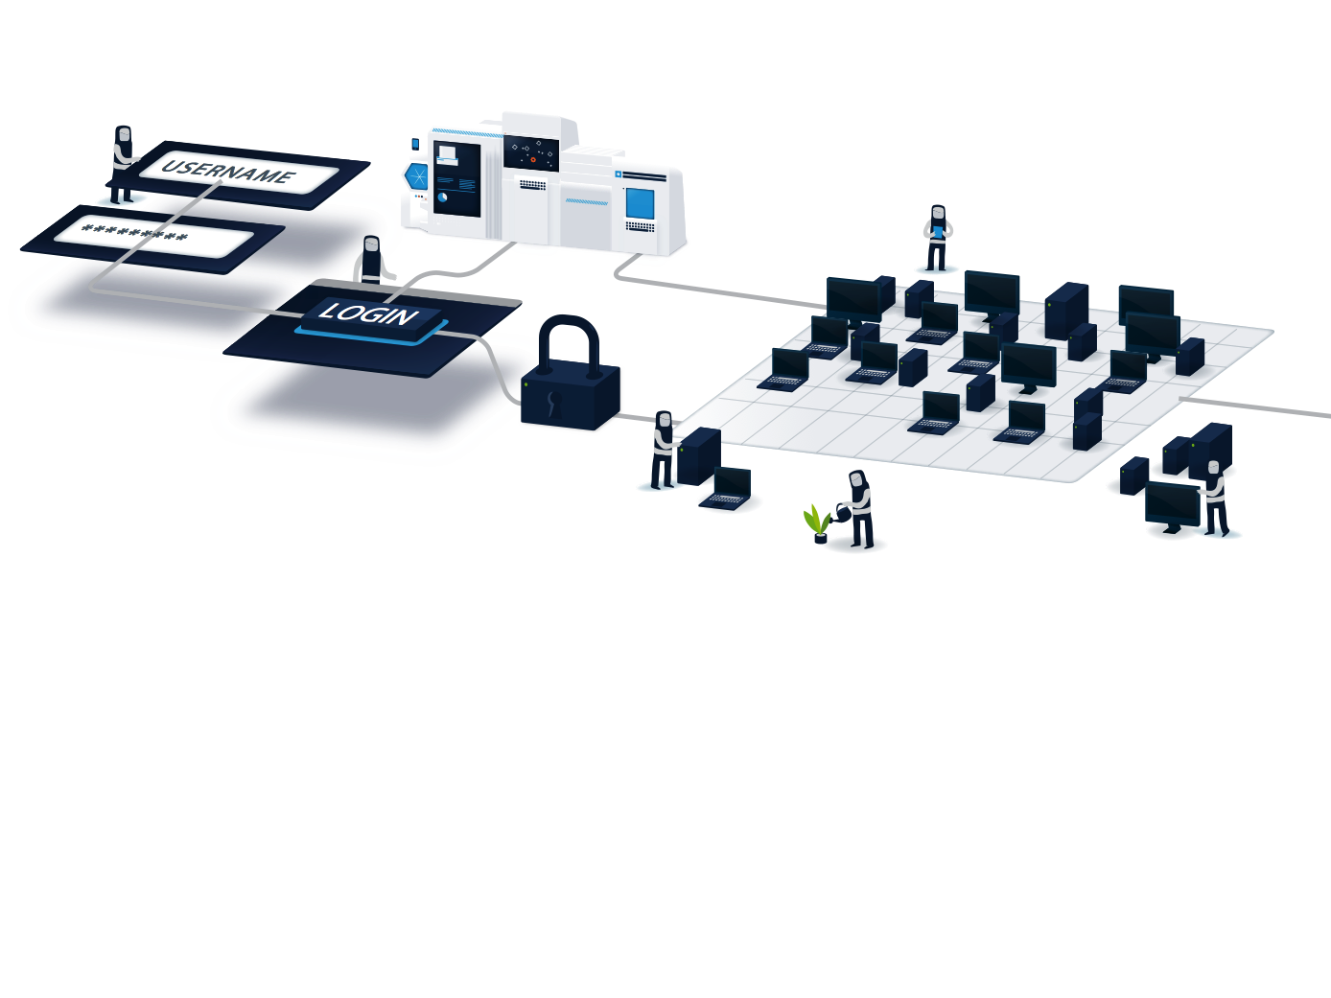
What do Federations do?
Some federations
Provide self-service tools for managing IdP and SP data (Resource Registry)
Provide application integration support
Host or help with outsourced IdPs (IdP in the Cloud, hosted IdP
Provide tools for managing "guest" users
Develop custom tools for the community
Most federations also
Define agreements, rules, and policies
Provide some user support (documentation, email list, etc.)
Operate a central discovery service and test infrastructure
At a minimum a federation maintains the list of which IdPs and SPs are in the federation

Slide 10
How to Make Federated Identity Work
Start with establishing campus identity systems
Base-level requirements:
centralized campus or institution identity store (e.g., database, LDAP directory)
documented policies regarding the life cycle of organizational identity
a business model for ongoing development and support

Slide 11
Additional Reading Material
“Ready the Pipes” – Campus Technologies. https://campustechnology.com/articles/2010/03/01/ready-the-pipes.aspx
“Lowering costs of identity proofing by federated identity management” – Swedish Alliance for Middleware Infrastructure. http://www.incommon.org/docs/other/SWAMI_federated_idm_roi.pdf
“Identity Management Toolkit” – JISC. https://identitymanagementinfokit.pbworks.com/w/page/50989755/Home

Slide 12
The NSRC cultivates collaboration among a community of peers to build and improve a global Internet that benefits all parties. We facilitate the growth of sustainable Internet infrastructure via technical training and engineering assistance to enrich the network of networks. Our goal is to connect people.
www.nsrc.org
Notes:
TEIN*CC on left and EU on the right, bottom

