Slide 1
STRATEGIES FOR SUSTAINING IOT INITIATIVES POST-WORKSHOP
Nutifafa Yao Agbenor-Efunam

Slide 2
ABOUT ME
NUTIFAFA YAO AGBENOR-EFUNAM
Student
I am a Student of the Department of Physics – KNUST
Research Interests
Artificial Intelligence,
Smart Systems.
Internet of Things (IoT),
Technological Innovation.
Environmental Monitoring,
Healthcare Technology,
Renewable Energy.

Slide 3
Some Devices I was Involved In Developing
Speedometer
Traffic light
Motion detection
Elevator
Timers
Buzzer
Home/Office Automation
Data loggers
Auto light switching
Water levels sensing
Automation
Developed Examination Timers
Developed Quiz Buzzers
Developed trackers

Slide 4
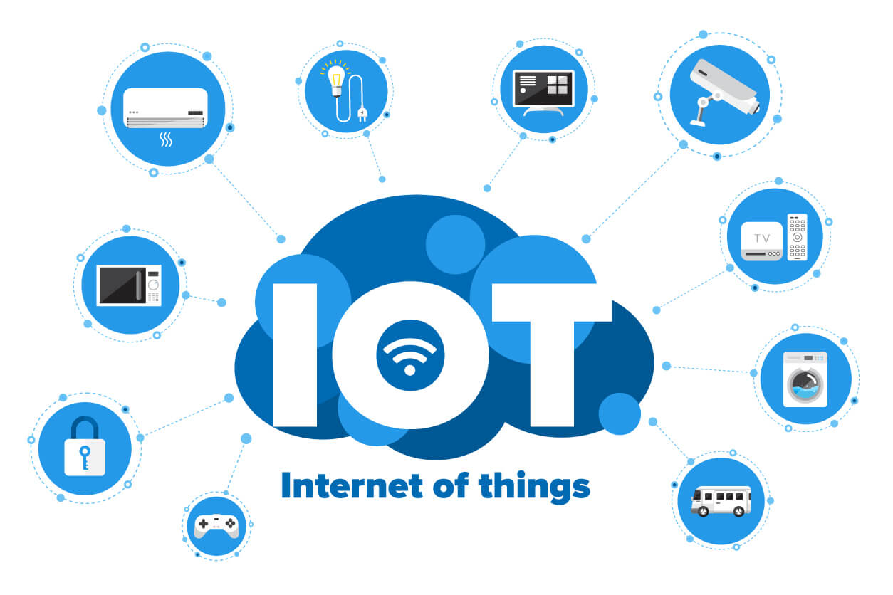
Internet of Things (IoT)
The Internet of Things (IoT)
is a concept that refers to the interconnection of everyday physical devices to the internet, allowing them to collect, share, and analyze data.
Core Components of IoT
Devices/Things
Sensors and Actuators
Connectivity.
Data Processing and Analytic
User Interface

Slide 5
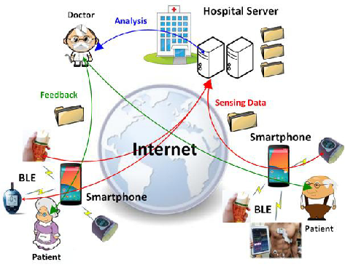
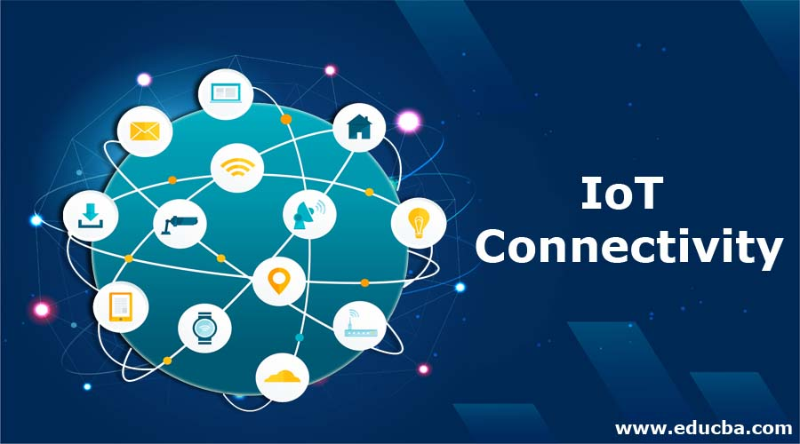
INTERNET OF THINGS: Connectivity
Internet or other networks
Wi-Fi,
Bluetooth,
Zigbee,
LoRa, or
cellular networks (e.g., 4G, 5G).

Slide 6
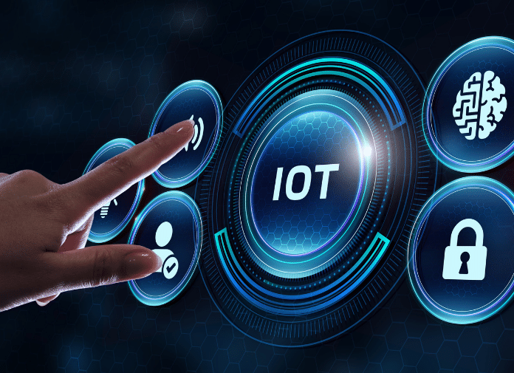
INTERNET OF THINGS: User Interface
The interaction between users and IoT systems
mobile apps,
Users can monitor, control, receive notifications, and make informed decisions based on the data provided.
web dashboards, or
voice-activated systems.

Slide 7
IoT Initiative
is simply a project or plan where a person, business, or organization decides to use IoT technology to improve something.
For example, a company might start an IoT initiative to make their manufacturing process more efficient by
using sensors on machines to track performance and
predict when maintenance is needed.

Slide 8
IoT Initiative: Outcome
IoT initiatives aim to make things smarter and more responsive.
For instance, a smart irrigation initiative in agriculture could automatically water crops based on soil moisture levels, saving water and improving crop yields.

Slide 9
Sustaining IoT initiatives
refers to the ongoing efforts required to keep Internet of Things (IoT) projects or programs operational, effective, and impactful over time, even after their initial implementation.

Slide 10
Sustaining IOT initiatives
Key Aspects
Continuous Monitoring and Maintenance
Resource Management
Adapting to Changes
Long-Term Planning
Data Management and Security
Feedback and Improvement

Slide 11
Strategies for Sustaining IoT Initiatives Post-Workshop
Strategies for Sustaining IoT Initiatives
refers to the approaches and actions needed to ensure that Internet of Things (IoT) projects continue to thrive and deliver value even after the completion of a workshop or training event.

Slide 12
Strategies for Sustaining IoT Initiatives Post-Workshop
Approach
Community Building and Networking
Mentorship and Guidance
Skills Development and Training
Project Management and Planning
Evaluation and Feedback Loops

Slide 13
Strategies for Sustaining IoT Initiatives
loT of Practice
There is a need to do a lot of practice .
Find Your Motivation
This can be automation,
Developing thing Such as devices,
Knowledge,
Money.

Slide 14
Strategies for Sustaining IoT Initiatives Post Workshop
Attend IoT workshops and conferences
this will expose you to more interesting ideas and interest.
Attend and participate in competition related to IoT
this will aid you to develop your problem solving skills in specific field,
build your confidence and
also gives you an avenue to earn some income.

Slide 15
Q&A
Thank you for your attention.
Now, let's open the floor for questions and discussions.

Slide 16
THANK YOU

Slide 18
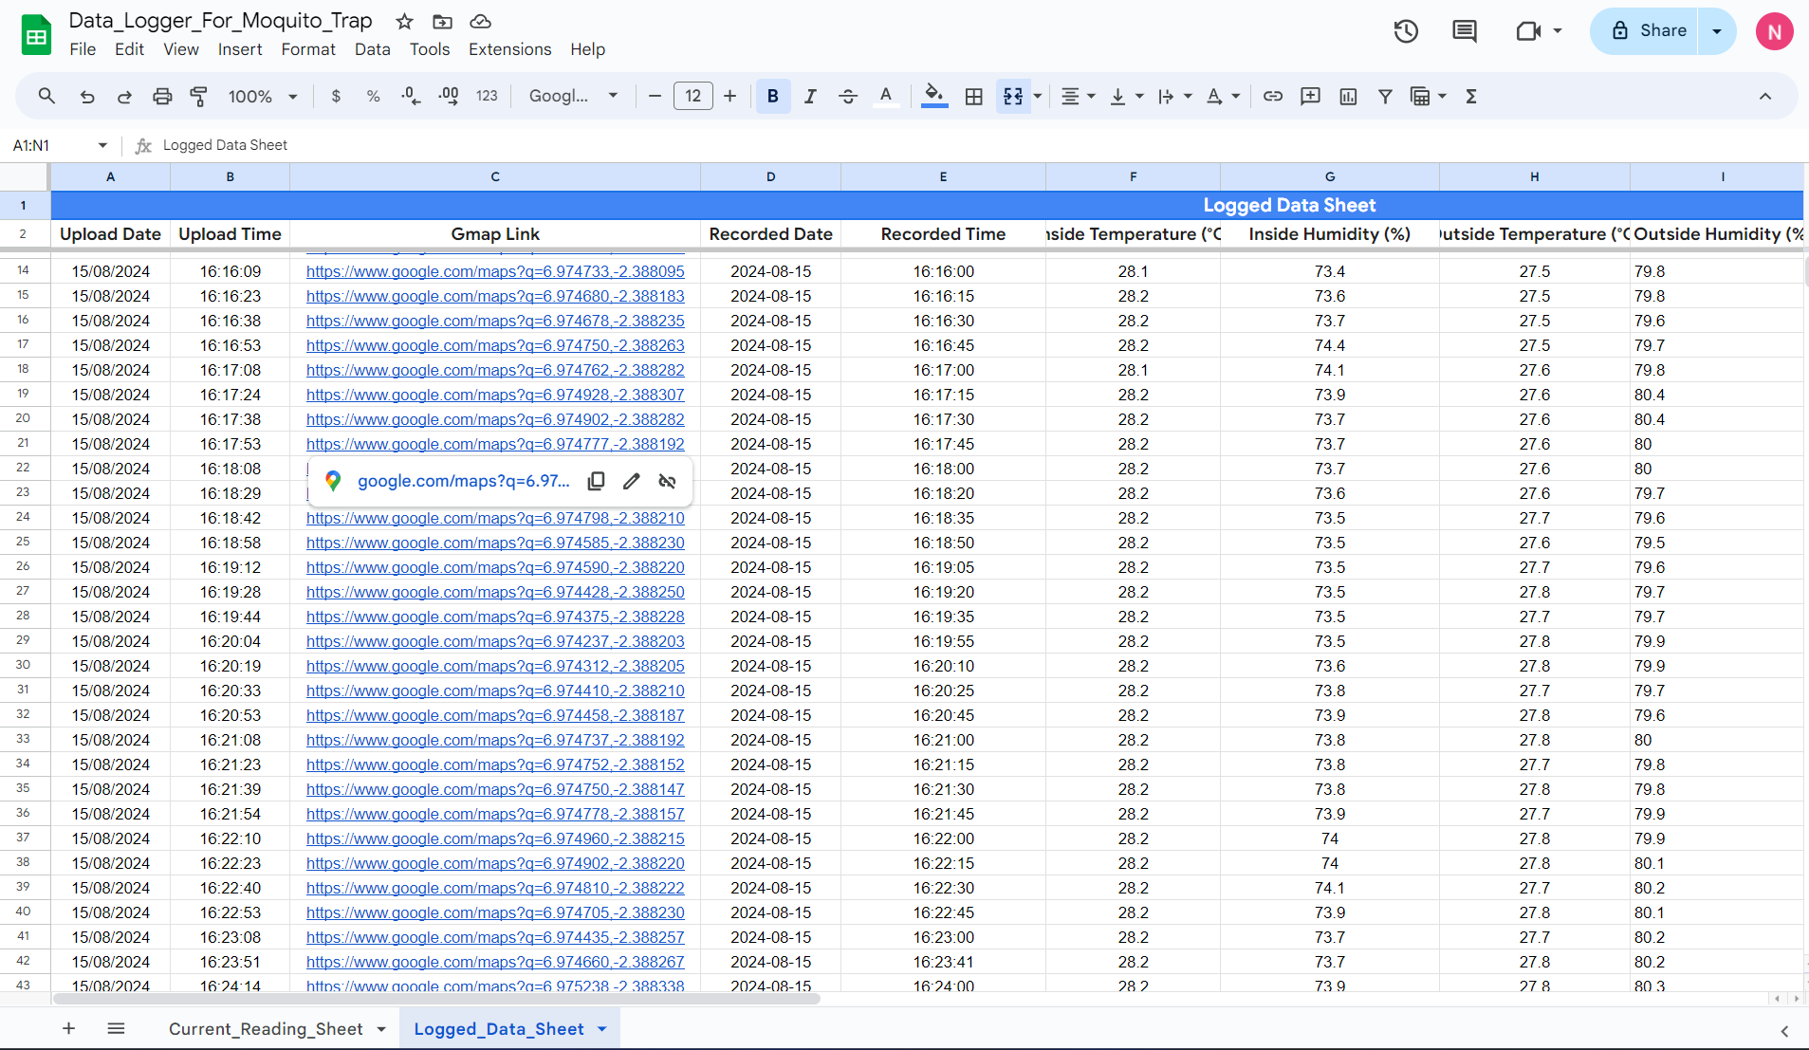

Slide 19
Strategies for Sustaining IoT Initiatives Post-Workshop
By Nutifafaf Yao Agbenor-Efunam

Slide 20
Internet of Things (IoT)
The Internet of Things (IoT) is a concept that refers to the interconnection of everyday physical devices to the internet, allowing them to collect, share, and analyze data.
Connectivity: IoT devices are connected to the internet or other networks using various communication protocols such as Wi-Fi, Bluetooth, Zigbee, LoRa WAN, or cellular networks (e.g., 4G, 5G). This connectivity allows devices to share data with each other and with central servers or cloud-based systems.

Slide 21
Internet of Things (IoT)
Connectivity: IoT devices are connected to the internet or other networks using various communication protocols such as Wi-Fi, Bluetooth, Zigbee, LoRa WAN, or cellular networks (e.g., 4G, 5G). This connectivity allows devices to share data with each other and with central servers or cloud-based systems.
User Interface: The interaction between users and IoT systems is facilitated through various interfaces, such as mobile apps, web dashboards, or voice-activated systems. Users can monitor and control their devices remotely, receive notifications, and make informed decisions based on the data provided.

Slide 22
Internet of Things (IoT)
Connectivity:
IoT devices are connected to the internet or other networks using various communication protocols such as
Wi-Fi, Bluetooth, Zigbee, LoRa WAN, or cellular networks (e.g., 4G, 5G).
This connectivity allows devices to share data with each other and with central servers or cloud-based systems.
User Interface:
The interaction between users and IoT systems is facilitated through various interfaces, such as mobile apps, web dashboards, or voice-activated systems. Users can monitor and control their devices remotely, receive notifications, and make informed decisions based on the data provided.

