Slide 1
Business Models and the Expansion of the NREN’s Service Portfolio
Dr Leonie Schäfer (DFN)
WACREN NREN Academy – 16-17 January 2024 - Accra, Ghana

Slide 2
Principles of eduGAIN
Objective: To find the right starting point for working with Federations and eduGAIN
Video „How to benefit from interfederating through eduGAIN”
Step-by-step discussion “How is the situation in your country / at your NREN?”

Slide 3
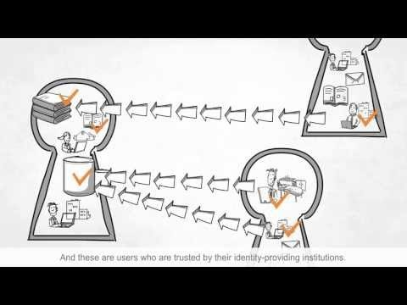
Video “How to benefit from interfederating through eduGAIN”
https://youtu.be/x1YhuFPxMz8?si=40x7bgPLoTUMdghm

Slide 4
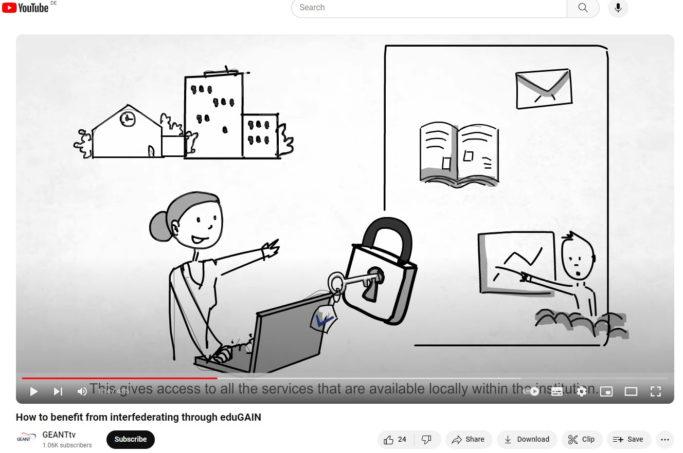
Video – „Single Sign-on“

Slide 5
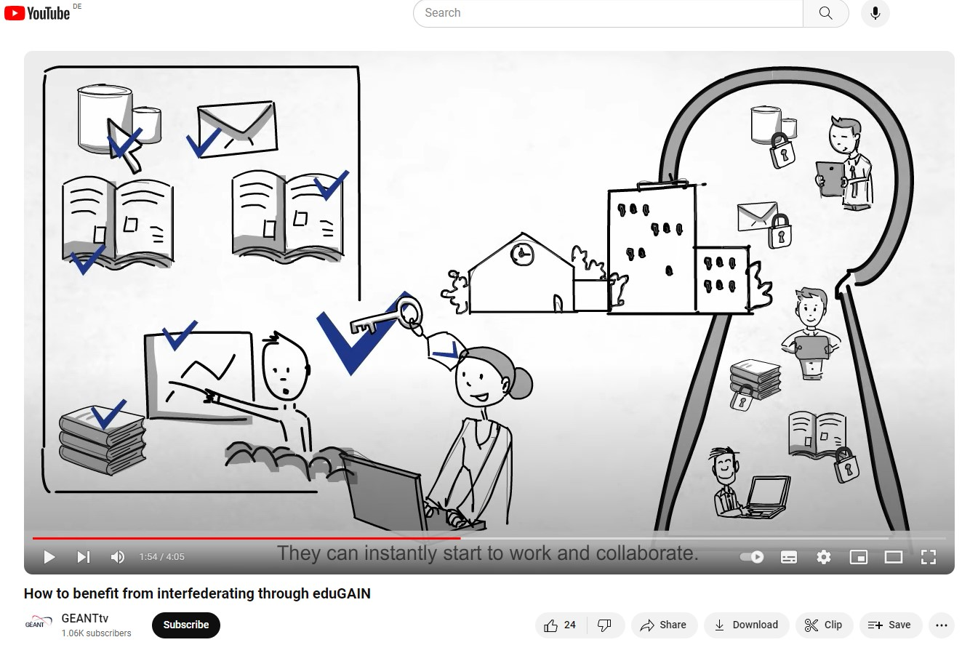
Video – „User Benefit“

Slide 6
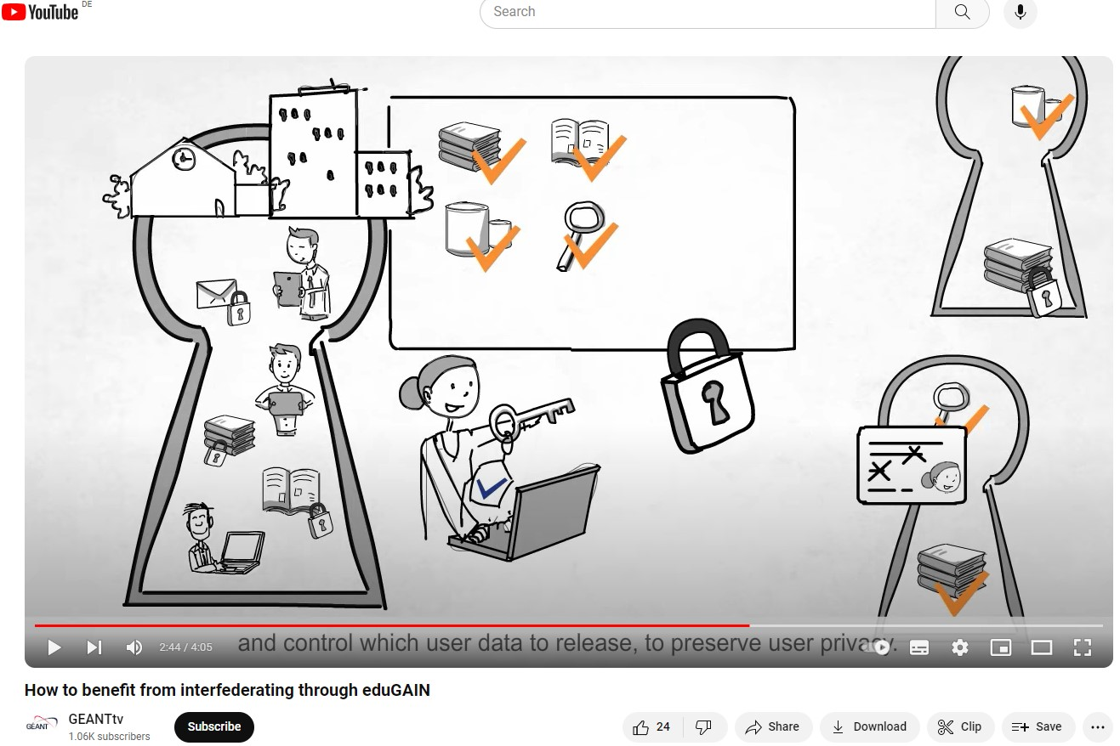
Video „Trusted Services and User Benefits“

Slide 7
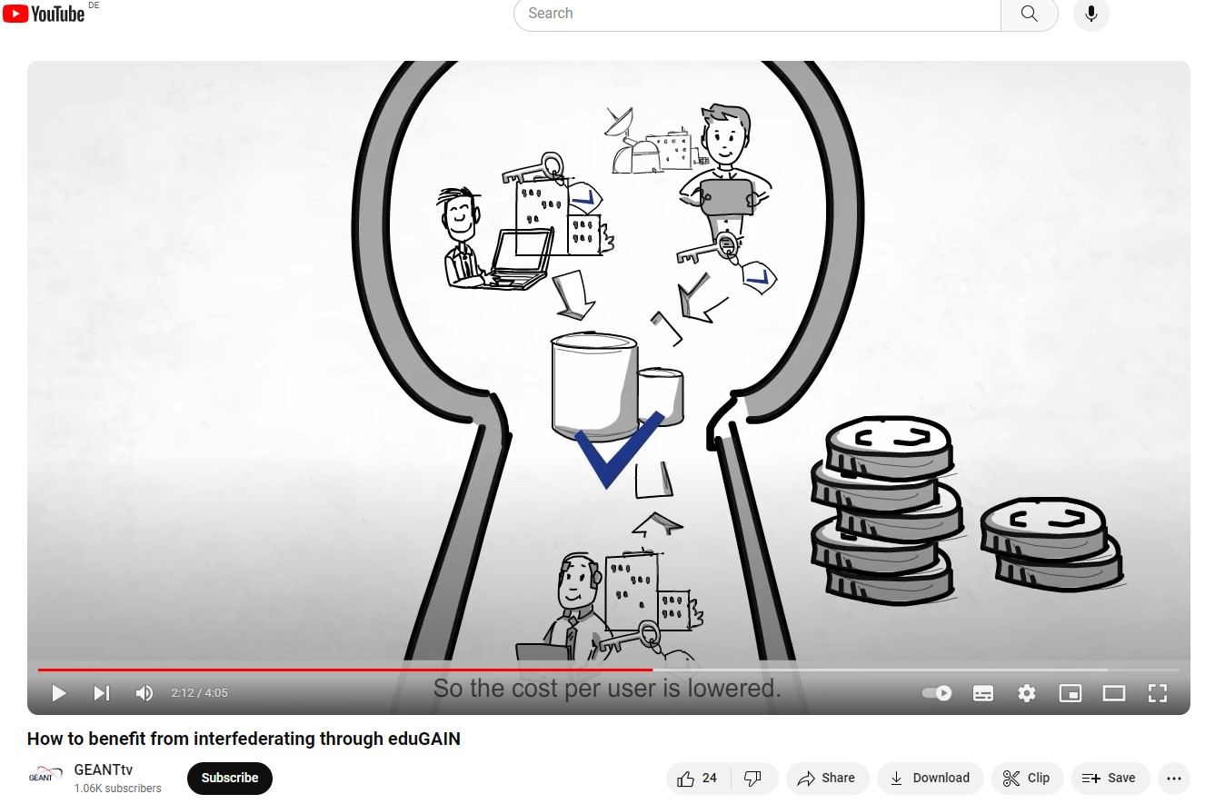
Video „Benefit for Service Providers“

Slide 8
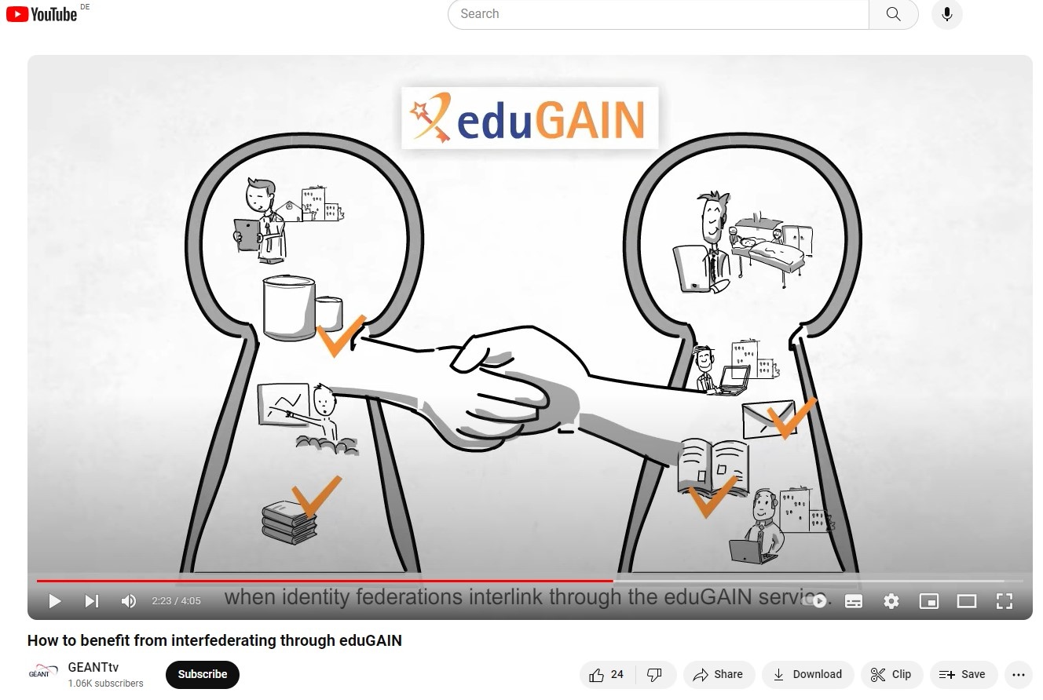
Video „Identity Federations interlinkingthrough eduGAIN“

Slide 9
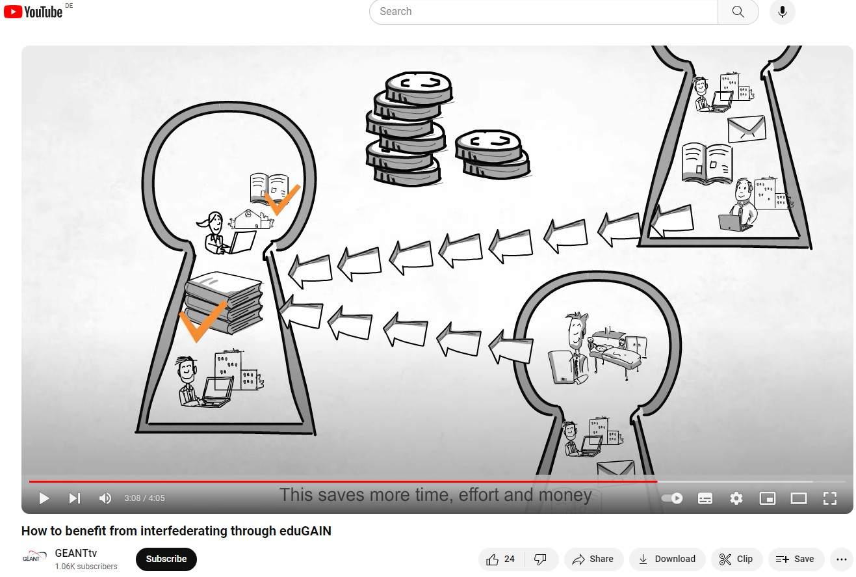
Video „Benefit for Service Providers Internationally“

Slide 10
Thank you!
Any questions?

