Slide 1
Deploying Educational Roaming (eduroam) in ICER Mali: Challenges and Lessons Learned
Sidy Soumare - IT Site leader, Malian International Centre for Excellence in research,NIAID/NIH
Lloyd Ssentongo- IT Site Leader , Ugandan International Center for Excellence in Research, NIAID/NIH
Chairman – ICT Directors forum RENU, Uganda

Slide 2
What’s Eduroam ?
Eduroam stand for education roaming.
It’is the secure, world-wide roaming access service developed for the international research and education community. eduroam allows students, researchers and staff from participating institutions to obtain Internet connectivity across campus and when visiting other participating institutions by simply opening their laptop.

Slide 3
What’s the importance of Eduroam ?
Eduroam facilitates travelers from academic institutions by allowing them to gain network access with minimal configuration and no need for the visited institution to grant them the access explicitly. This benefits visiting faculty, academics traveling for conferences and collaborative work, study abroad students, visitors and even regional academic exchange.
By joining Eduroam you extend the network to visitors at your institution without adding any additional maintenance responsibilities to your IT staff. Moreover, by extending the network, you help to guarantee access to your own students and faculty while they are abroad.

Slide 4
Eduroam - Technical overview

Slide 5
As described in the introduction the eduroam project is "A worldwide federation of RADIUS servers facilitating network access for roaming academic affiliates using IEEE 802.1x as the vehicle.
Eduroam's use of 802.1x in concert with RADIUS means the network is built around well understood, established, and easy to manage standards which are often already deployed within the network infrastructure of educational institutions."

Slide 6
Eduroam offers two distinct services: Identity Provider (“IDP”) and Service Provider (“SP”).
IDP: When an institution is connected to eduroam as an IDP, its students, faculty, and staff can use their personal credentials from their institution to join eduroam anywhere around the world.
SP: When an organization is connected to eduroam as an SP, students, faculty, and staff from around the world can join the eduroam network as visitors of that organization.

Slide 7
Eduroam SSID broadcast: With todays WIFI services, creating a new SSID is straightforward.
Most of the institutions, have already several SSIDs in production. In the case of WiFi, less is better when it comes to the number of SSIDs. The recommendation is being 5 per AP.
With eduroam, an institution can verify the legitimacy of a visitor without direct access to the user's credentials (SSL/TLS tunnel goes between user's device and user's home RADIUS server)

Slide 8
Eduroam SSID broadcast:
With eduroam, a user can verify the legitimacy of an infrastructure (When verifying the SSL/TLS certificate during the EAP exchange, the user also makes sure that the infrastructure is a valid member of the federation).
With eduroam, the wireless traffic is encrypted between the user's device and the institution's infrastructure.

Slide 9
Access role: Access roles can be created based on the outer-identity of the 802.1X authentication request. A user with an outer identity that matches the realm (i.e. domain) of the organization can be assigned to VLANs with access to sensitive resources, while all other users’ with realms that do not match the organization will be assigned to VLANs with less privileged access.
Raduis servers: Radiator and FreeRADIUS are the two RADIUS servers generally used. The configuration are slightly different while implementing Raduis for SP or Raduis for SP+IDP.

Slide 10
Challenges during the implementation of Eduroam in Mali

Slide 11
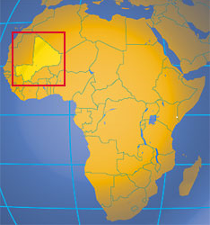
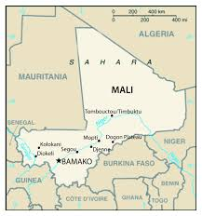
The country:
Mali, officially the Republic of Mali, is a landlocked country in West Africa. Mali is the eighth-largest country in Africa, with an area of just over 1,240,000 square kilometers. The population of Mali is 16 million. Its capital is Bamako and the Official language is French.

Slide 12
Eduroam implementation in Mali - Context
The establishment of the Mali Research and Education Network (MaliREN) is underway and this institution would like to include in its services access to the "Eduroam” infrastructure. In order to ensure this, MaliREN has delegated to ICER Mali (the International Center of Excellence in Research), one of its member institutions, the deployment and maintenance of its Radius server for "Eduroam” access management.

Slide 13
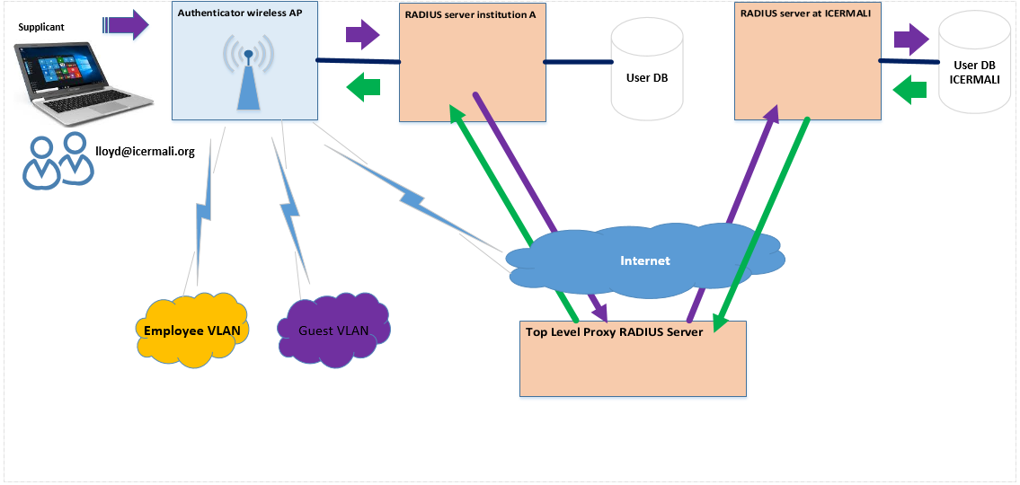
Eduroam implementation in Mali – Architecture
Straightforward…

Slide 14
ICER Mali: ICER Mali is a bio-medical research center. It has running it’s own data center in the campus of medical school since 10+ years
ICER Mali infrastructure:
2 X HP Proliant ML350p Gen8 + VMware vSphere 5 Enterprise
2 X DS2246 nodes (NetApp storage)
2 X Cisco 2960 command line switches for NFS traffic
Radius server: FreeRadius !
CentOS Linux 7 (Core)-Kernel 3.10.0-327.36.1.e17.x86_64
vSphere VM Version 8
CPU: 1vCPU / Memory: 2048MB / vDisk: 16GB

Slide 15
Challenges during the implementation of eduroam
The country have no National level Radius proxy server.
||||
National level RADIUS proxy server in a different country at WACREN Headquarter.
||||
Country code Top Domain issues. Icermali.org instead of the preferred icermali.ml
||||
It took some time to get exemptions at the ETLR
||||
The network infrastructure for MaliREN was not ready

Slide 16
Acknowledgements
Michael Tartakovsky, CIO NIAID/NIH, Director OCICB
Christopher J Whalen, IBRSP/OCICB/NIAID/NIH
Economou Matthew , IBRSP/OCICB/NIAID/NIH
Brian k Moyer, IBRSP/OCICB/NIAID/NIH
Omo Oaiya – CTO WACREN
Davy Abeye - WACREN

