Slide 1
REN Startup Win-Win Program
Ibrahim ALIO SANDA
Digital Entrepreneur, CTO Niger-REN
ibrahim.aliosanda@niger-ren.ne
WACREN 2017 Conference, Abidjan, 31 march 2017

Slide 2
Introduction
About WACREN NRENs and Campus Networks?
The startup ecosystem
The REN Startup WIN-WIN Program
Conclusion
WACREN 2017 Conference, Abidjan, 31 mars 2017

Slide 3
About WACREN NRENs and Campus Networks
Less developed NRENs / Even no real campus networks for some members
Big efforts ongoing (Public funding, Africa Connect2, …)
But need for minimal resources (human, technical, financial) to be ready to benefit
WACREN 2017 Conference, Abidjan, 31 mars 2017

Slide 4
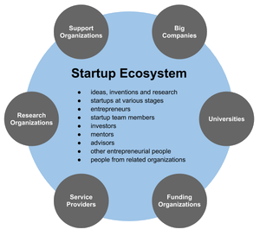
The startup ecosystem
Source : wikipedia
Startups phenomena
Incubators are rising
Most of them in or from the R&E community
WACREN 2017 Conference, Abidjan, 31 mars 2017

Slide 5
The REN Startup WIN-WIN Program
Goal : Open your mind and unleash your potential!
Pun intended : Startup your REN using startups
Partner with the startup ecosystem / create or empower practical communities
Plan, finance, setup and maintain infrastructures and services
WACREN 2017 Conference, Abidjan, 31 mars 2017

Slide 6
Use cases
Registration management
Campus WIFI
Hackathons on other services development
WACREN 2017 Conference, Abidjan, 31 mars 2017

Slide 7
Conclusion
Business Model ?
Sustainability ?
Let’s here from you!
WACREN 2017 Conference, Abidjan, 31 mars 2017

