Slide 1
MIPAR (Extension)– Intermediate report
Olusola Olabanjo– Lagos State University - Nigeria (olabanjoolusola@yahoo.com )
WACREN e-Research Hackfest – Lagos (Nigeria)

Slide 2
Outline
Scientific problem
Architecture of the use case
Objectives and milestones
Achievements so far
Any problems encountered
Plans till the end of the hackfest

Slide 3
Scientific Problem
Some of the challenges in the field of medical image analysis
Imaging equipment are very expensive
Image acquisition is very expensive
There are limited availability of medical image analysts in Nigeria
Limited collaboration efforts and ability to share expertise amongst clinical experts
The advancements in internet technology, data communication and reduction in hardware cost has led to the birth of Science Gateway
Science Gateway can help in solving medical image analysis problems by offering tools for
Creating of image repository
Making image analysis tools available
Making workflow available
Adapting some of the tools to make them intelligent
Science Gateway is in top gear in the developed world but very sluggish in Africa
In particular, there is no platform for image analysis in Africa

Slide 4
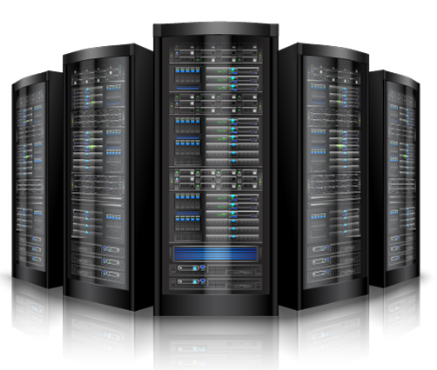
Architecture of the use case and orchestration of e-Infrastructure services
Clinicians
Researchers
Students
Others
Access the tools via the web interface via their PCs and other web-enabled devices
Upload to /Download from OAR
Submit Images for Processing
Analyze (Image) Data
OAR
Future Gateway

Slide 5
Objectives and milestones (Part 1)
Install R on the Server
Expand the MIPAR interface to allow for statistical analyses
Write Shell Scripts to perform regression

Slide 6
Achievements so far
R has been successfully installed
The MIPAR interface has been extended to allow for Analyses
The bash script for regression is being written and we hope to push it to a reasonable extent today.

Slide 7
Any problems encountered
Not yet!

Slide 8
Plans till the end of the hackfest
Write shell scripts to perform correlation
Write shell scripts to compute volume
Push the scripts to FG API Server and successfully interface it with the MIPAR portal

Slide 9
Thank you!
sci-gaia.eu
info@sci-gaia.eu

