Slide 1
DRUG DESIGN, DISCOVERY AND DEVELOPMENT PLATFORM AND REPOSITORY (D4PR)- FINAL REPORT
Tochukwu Eze, Ekene Ezeasor, and Ikemefuna Uzochukwu
Nnamdi Azikiwe University, Awka, Nigeria – (https://d4pr.unizik.edu.ng)
(td.eze@unizik.edu.ng, ezeasor.ekene@unizik.edu.ng, ic.uzochukwu@unizik.edu.ng)
WACREN e-Research Hackfest – Lagos (Nigeria)

Slide 2
OUTLINE
Scientific problem
Work done during the Hackfest
Results achieved so far
Future plans
Summary and conclusions

Slide 3
SCIENTIFIC PROBLEM
Health: Neglected Tropical Diseases (NTDs) & Non-communicable diseases (diabetes mellitus)
Drug Design, Discovery and Development
Computer Aided Drug Discovery (CADD)
Drug Repurposing

Slide 4
SCIENTIFIC PROBLEM
Process automation
Drug Design (compounds bioscores)
Drug Discovery (compounds binding affinities)
Ligand & receptor preparation in AutoDockTools®
Molecular docking simulations in Autodock Vina®
Molecular dynamics simulations in Gromacs®
Reduction in computational cost & time
Molecular docking simulations
Molecular dynamics simulations
Decision support (graphical analyses)
Drug Design
Drug Discovery
Non-visibility (globally)
OAR
AGSG
Collaborative Research & Development
GitHub
Capacity of local investigators/scientists
Design, development & deployment of D4PR
Use of D4PR for drug discovery process

Slide 5
WORK DONE DURING THE HACKFEST
System analysis
Design front end
Data curation (MS Excel)
Publication upload (OAR)
Draft D4PR manuscript (MS word)

Slide 6
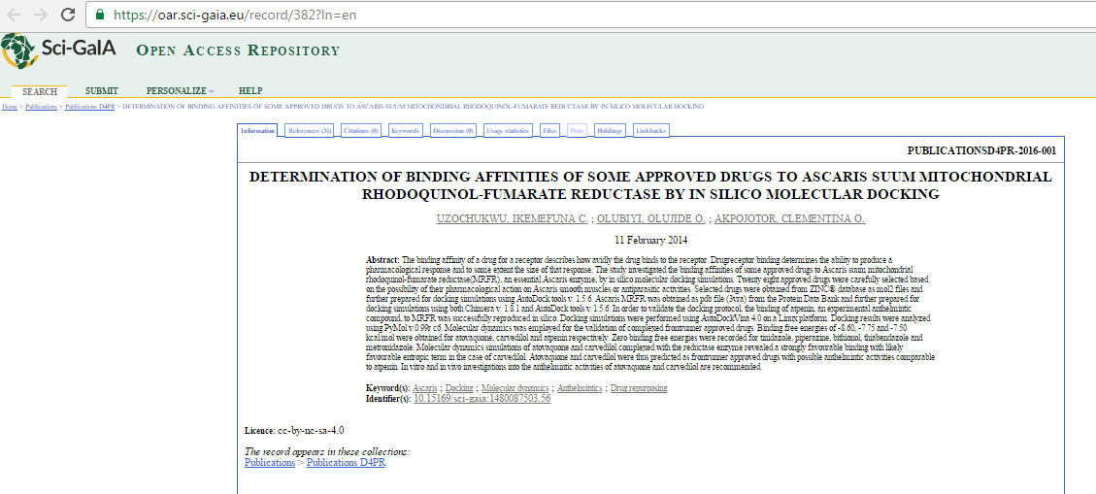
RESULTS ACHIEVED SO FAR

Slide 7
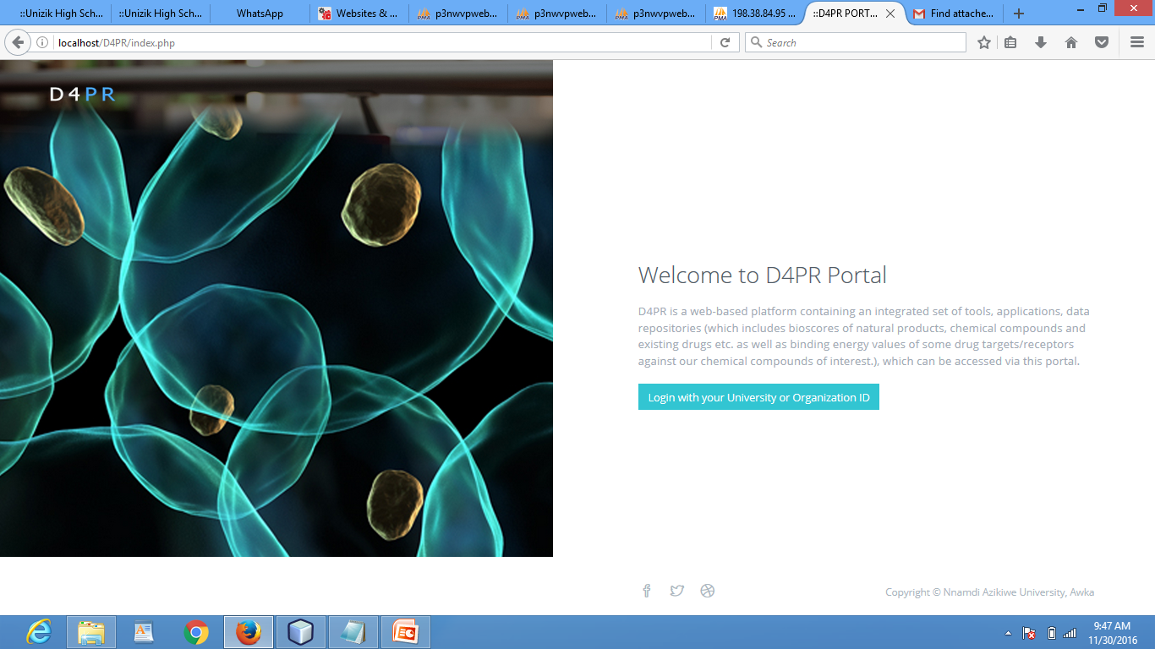
RESULTS ACHIEVED SO FAR

Slide 8
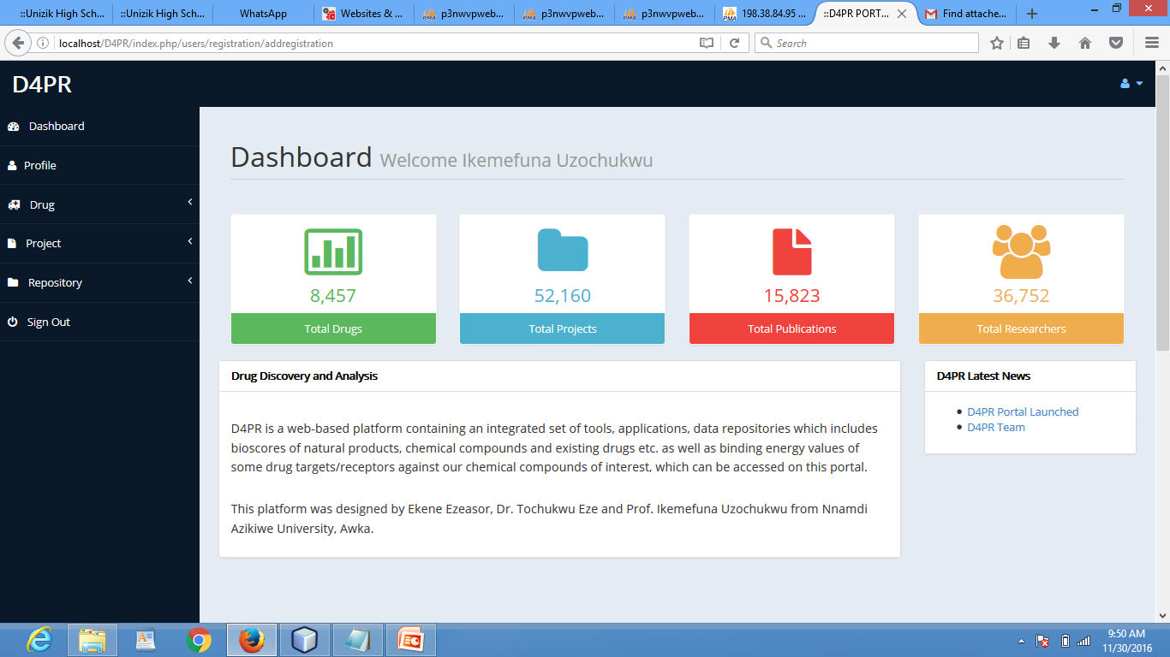
RESULTS ACHIEVED SO FAR

Slide 9
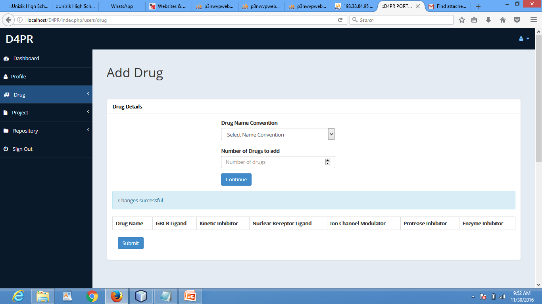
RESULTS ACHIEVED SO FAR

Slide 10
RESULTS ACHIEVED SO FAR
Uploaded code on github – github.com/unizik/D4PR
Initiated implementing SSO using Shibboleth
Mounted the CODE-RADE repositories on our local machine.
Access to the tools on the CODE-RADE Repository
Designed and created the database for the system

Slide 11
IMPROVED WORK FLOW
User File
User File
User File
User File
FUTURE GATEWAY
Autodock
Glibrary
Vina/Gromacs
Autodock
Vina/Gromacs
Autodock
Vina/Gromacs

Slide 12
Future plans (until end of the year and until the Sci-GaIA Final Event in Pretoria on March, 23-24, 2017)
Back end coding, testing on local machine: December 15, 2016
Host D4PR on AGSG cloud e-infrastructure: December 20, 2016
Test and validate drug design protocol on D4PR local machine: December 17, 2016
Test and validate drug discovery protocol on D4PR local machine: December 20, 2016
Write second draft of D4PR manuscript: December 23, 2016

Slide 13
SUMMARY AND CONCLUSIONS
Learning about new technologies and tools
Began new collaborations
The organization
Resource persons

Slide 14
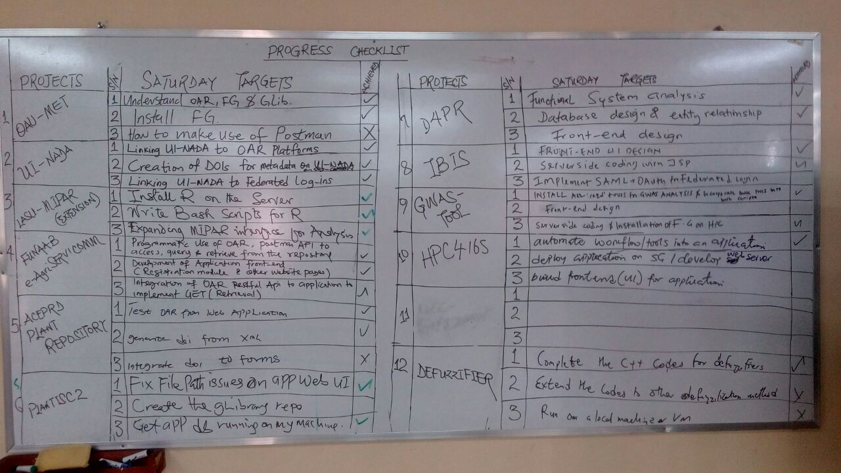
VOTE OF THANKS
Thirteen (13) Use Cases
Health (7)
Agriculture (2)
Environment (2)
Information Management (2)
Sci-GaIa (Roberto, Bruce, Mario, Adedeji, Aribisala)
Wackren (Omo)
EcoKonnect (Owen, Goodness, Ejiro, Kafayat)
LASU (VC, School of Transport, Computer Science, Prof Aribisala)
Participants
Ethiopia (Joseph & Korma)
NC (UNIJOS; Uche & David)
SE (UNN: Udanor & UNIZIK: Ekene, Tochukwu & Uzochukwu)
SW (UI; CU; OAU; LASU; FUNAAB)

Slide 15
Thank you!
sci-gaia.eu
info@sci-gaia.eu

