Slide 1
ACEPRD Plant Repository
David Oguche and Ohaeri Uchechukwu – ACEPRD University of Jos - Nigeria (aceprd@unijos.com)
WACREN e-Research Summer Hackfest – Lagos (Nigeria)

Slide 2
OUTLINE
Background on ACEPRD University of Jos
Scientific problem
ACEPRD Project
System Requirements
Implementation strategy
User Scenarios
Summary and Conclusion

Slide 3
Background on ACEPRD University of Jos
Africa Centre for Excellence in Phytomedicine Research and Development (ACEPRD)
Established 2014
World Bank alliance between the regional governments of West Africa to harness the untapped potentials of collaboration among African researchers with the focus of creating a sustainable agenda for health innovation in Nigeria and Africa

Slide 4
Scientific Problem
ACEPRD has noticed a paradigm shift from traditional pharmaceuticals to plant derived medication in the treatment of diseases. This paradigm shift has led to a global demand for plant-derived medicines (phytomedicines) as a primary and complementary medical tool. Within the region, traditional medicine has not been fully integrated into the modern healthcare delivery system due to the following challenges such as the safety, efficacy and stability of traditional remedies have not been fully documented, Inadequate authentication, documentation and comprehensive database of flora in the sub region, Poor academia- industry relationship and so on.

Slide 5
The ACEPRD Project
ACEPRD aims to overcome these challenges by developing the field of Phytomedicine that includes the development of ACEEPRD Plant Repository to aid the integration of Phytomedicine research into the healthcare delivery system in the African sub-region.
Researchers and traditional medical professionals will make use of the Plant Repository to access most of the medicinal plant properties.

Slide 6
The ACEPRD Project Contd.
Capture researched plants and their various properties in a digital library.
Name
Medicinal effect
Images of plant
Description of plant
Locale
Etc.

Slide 7
System Requirements
Software Tools Used for Development
OAR
Python
Django
PostGres
NginX
Redis
Gunicorn
Software Requirement for Users
Web browser
Internet

Slide 8
Implementation Strategy
Integrate Open Access Repository to web application
Implement Authentication System
Implement User Roles for the Library
Guest User (Visitor)
Scientists (Researcher)
Administrator

Slide 9
Implementation Strategy Contd.
Collection Phase:
Collection and storage of researched plant information
Deployment Phase:
Enable visibility of Phytomedicine Library.
Management (Monitoring) Phase:
View usage of library
Editing of content when corrections are necessary

Slide 10
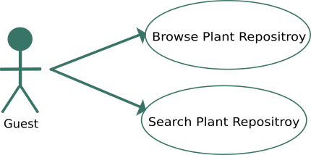
User Scenarios

Slide 11
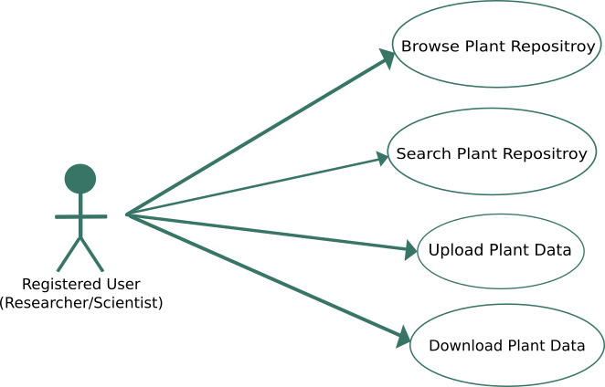
User Scenarios Contd.

Slide 12
Summary and Conclusions
Integrate the Open Access Repository (OAR) and possibly future gateway to our web application.
Implement authentication and user roles
We look forward to the coding sessions

Slide 13
Thank you!
ACEPRD, University of Jos
aceprd@unijos.edo.ng

