Slide 1
MIPAR Extension- Final report
Olusola Olabanjo– Lagos State University - Nigeria (olabanjoolusola@yahoo.com)
WACREN e-Research Hackfest – Lagos (Nigeria)

Slide 2
Outline
Scientific problem
Work done during the Hackfest
Results achieved so far
Future plans
Summary and conclusions

Slide 3
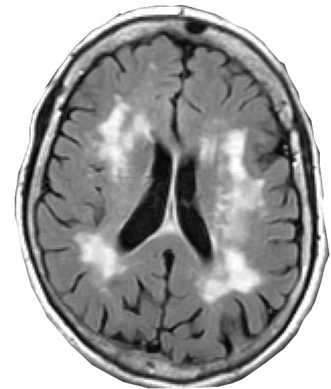
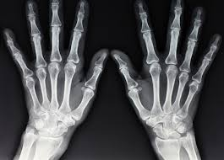
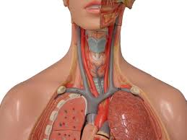
Background
Medical images are images acquired from humans or animals
Medical images are used for clinical diagnosis, treatment and patient management.
There are many methods of acquiring medical images. Each method has specific use, strengths or weaknesses
Medical Image analysis and computer vision provides a platform for developing computational techniques for converting the raw images to meaningful information.

Slide 4
Scientific Problem
Some of the challenges in the field of medical image analysis
Imaging equipment are very expensive
Image acquisition is very expensive
There are limited availability of medical image analysts in Nigeria
Limited collaboration efforts and ability to share expertise amongst clinical experts
The advancements in internet technology, data communication and reduction in hardware cost has led to the birth of Science Gateway
Science Gateway can help in solving medical image analysis problems by offering tools for
Creating of image repository
Making image analysis tools available
Making workflow available
Adapting some of the tools to make them intelligent
Science Gateway is in top gear in the developed world but very sluggish in Africa
In particular, there is no platform for image analysis in Africa

Slide 5
Scientific Problem
MIPAR was developed to address the challenges in the field of medical image analysis
However, MIPAR does not currently allow statistical analysis
Statistical analysis is required for guidance during diagnosis

Slide 6
Work Done During Hackfest
Extending MIPAR interface to allow for statistical analyses.
Write bash scripts for computing image volumes
Write R shell scripts for:
Performing Regression
Computing correlation
Comparing two groups within a dataset
Comparing two measurements within a dataset
Make the scripts available on MIPAR using the FutureGateway
Commence OAR cloning for LASU

Slide 7
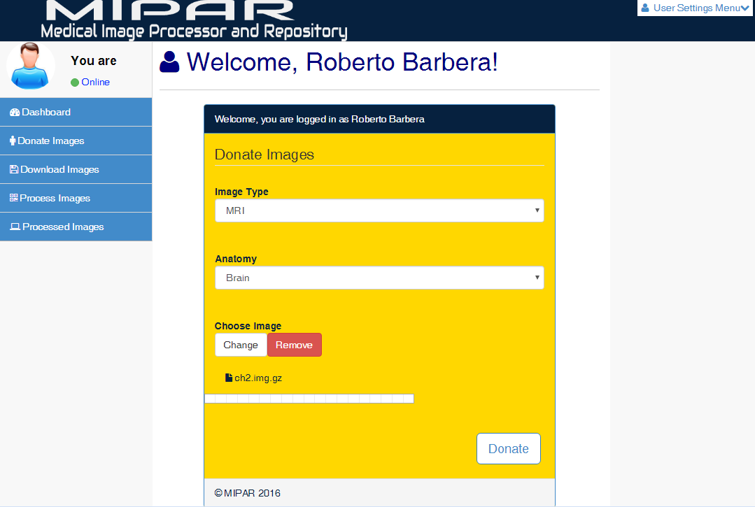
MIPAR – Before Lagos Hackfest

Slide 8
Results Achieved So Far

Slide 9
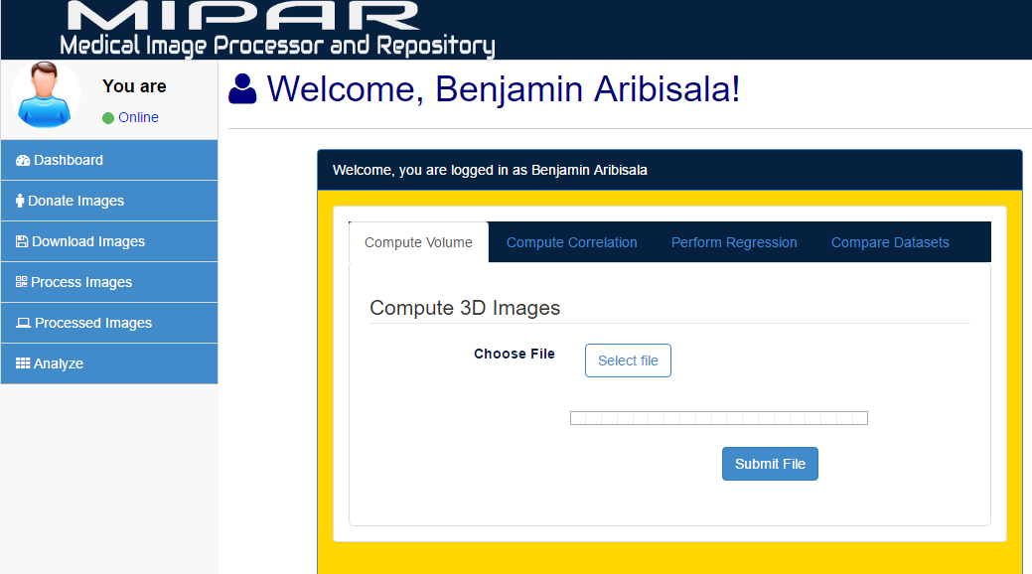
Results Achieved So Far

Slide 10
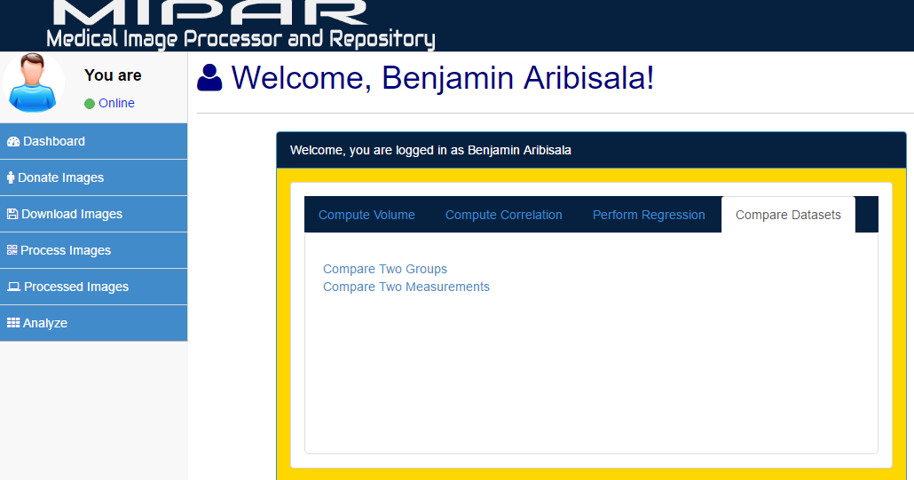
Results Achieved So Far

Slide 11
Future Plans
Completing LASU OAR in earnest

Slide 12
Summary and Conclusions
In summary, there is no such thing as monopoly in scientific research like any other field of research. Opportunity to meet various personalities during hackfest was worth it.
The exposure was excellent.
Hands-on by Mario and Bruce was spot-on.
It has been 10 solid days of increased exposure
The food was great
My horizon has improved, I now look to do even better
Finally, I look forward to having as many more of this training as can be made available in the nearest future.

Slide 13
Thank you!
sci-gaia.eu
info@sci-gaia.eu

