Slide 1
E-readiness survey: Know Your Customer – Plan the Future

Slide 2
Hello!
Stephan Mgaya
Email smgaya@ternet.or.tz, or smgayanath@gmail.com.

Slide 3
CONTENTS
Introduction.
Survey objectives and methodology.
Key findings.
Conclusion and Recommendation.

Slide 4
INTRODUCTION
1
Introduction on what is TERNET.

Slide 5
INTRODUCTION
Tanzania Education and Research Network (TERNET)
was formed in 2007 as a membership organization to serve higher education and research institutions in Tanzania where 52 member institutions adapted its constitution.
It was formally registered as a trustee on 11th April, 2008. It is a network aiming at providing a platform for enabling sharing of education and research resources.

Slide 6
INTRODUCTION
eReadiness is defined by the Center for International Development at Harvard University) as “the degree to which a community is prepared to participate in the Networked World”.
The value to a community of assessing its Readiness lies in evaluating its unique opportunities and challenges.
The 2014 e-readiness survey of Tanzanian academic and research institutions is the first major survey that Tanzania Education and Research Network (TERNET) took after its establishment in 2008.

Slide 7
INTRODUCTION
This survey was funded by International Network for the Availability of scientific Publications (INASP).
The survey has been measured using a framework of 10 indicators grouped in four categories:
Internet access.
networked campus.
networked learning.
institutional ICT strategy.

Slide 8
Objectives and Methodology
2
The following are e-readiness survey and methodology used.

Slide 9
Objectives
Diagnostic assessment on e-readiness to Tanzania’s Higher Education and Research Institutions (HERIs).
Identify critical issues that need to be addressed through TERNET services, especially allocating slots during trainings “capacity building” and prioritize the Direct Engineering Assistance.
Disseminate research findings to stakeholders in the Last Mile project as well as TERNET collaborators to assist in future plans.

Slide 10
Methodology
A questionnaire containing “hard facts” and perception questions was designed to contain three sections related to:
Awareness of TERNET and COTUL
Management facts for each visited institution
Technical part related to ICT and library systems.

Slide 11
Data collection
The questionnaires were sent to the campuses through email. Physical visits.
A total of 74 institutions was visited, 32 institutions responded.
The target was to visit all institutions in the country.

Slide 12
Data Analysis
Data analysis
All the hard facts and valid perceptions data was entered into the online database in the “Adobe-Forms Central” where summary report in a form of charts were generated. The same was exported to excel for further analysis part related to ICT and library systems.

Slide 13
Key Findings
3
Here are the key findings of the ereadiness survey

Slide 14
Key Findings
The first section of the questionnaire was about institutions awareness to TERNET and COTUL. The findings indicate that
63% respondents are aware of COTUL
94% are aware of TERNET.
note:
Since the questionnaire was not designed to capture active versus non-active membership, it is difficult to indicate
whether being aware is the same as membership to those entities.

Slide 15
Key Findings
The assessment framework developed to indicate issues in which TERNET will take into consideration as indicators for serving members. These issues were considered to be indicators in four categories captured and asked in different items in the survey tool. The categories were;
Internet access,
Networked campus,
Networked learning,
ICT strategic plans.

Slide 16
Key Findings-Internet Access
Internet availability
13% - TERNET as ISP, Majority use TTCL as ISP .
Internet affordability
2 Campuses capacity in volume -100GB, 2OOGB/Month,
30 Campuses with total of 143Mbps = 4.76Mb/s per institution
Internet speed and quality
Bandwidth allocated is inadequate
Campus network not well design and managed.

Slide 17
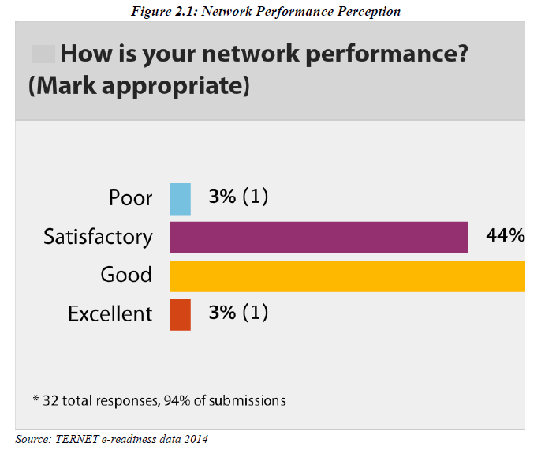
Key Findings
Overall Network Performance from Survey.

Slide 18
Networked Campus
Network environment and infrastructure
81% of respondents have Campus network (LAN) connecting all buildings and 75% have wireless network access.

Slide 19
Networked Campus
NOTE:
75% of respondents would like to re-structure their current networks

Slide 20
Networked Campus
Services
There already exist some services, but more could be done such as
how to extend online interaction of information systems like delivering lecturer remotely, e-library systems
etc.

Slide 21
Networked Learning
Enhancing education with ICT
integration of ICT into the curricula and use of e-learning still a challenge whoever some as Open University of Tanzania which has e-learning platform.
ICT in libraries
low usage of ICT in libraries, some institutions (very few) had online public access catalogue (OPAC) available off campus.
62% knows about COTUL.

Slide 22
Networked Learning
ICT in research and journals
84% of institutions have researchers and 81% have access to journals and online publications.
Capacity building
66% - attended trainings conducted by TERNET

Slide 23
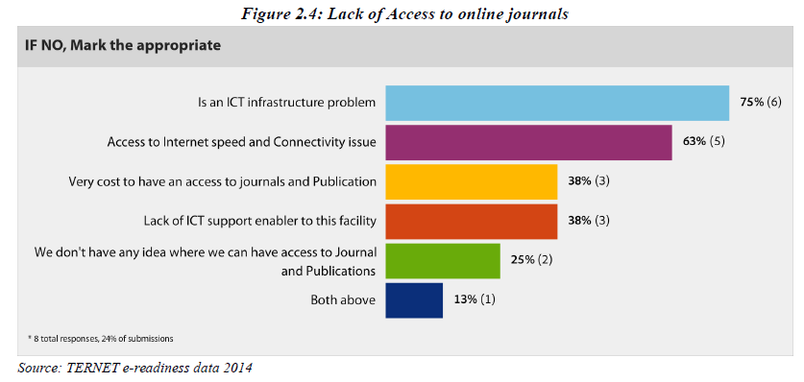
3.Networked Learning
(very few) had online public access
Catalogue (OPAC) available off campus

Slide 24
ICT STRATEGY
Only 59% have indicated to own an ICT policy, some of them outdated.
And as the case of missing the policy most institutions had no standards of network implementations.

Slide 25
Other observation
In management: Budget is an issue failed to deploy some services such as e_library, student’s systems, network monitoring.
In technical: need for capacity building.
Other systems : are already deployed in some institutions but no awareness to university members’staffs and other users to utilize those systems.

Slide 26
Conclusion
Out of the 32 respondents,
63% indicated awareness of COTUL.
81% have wired LAN, 75% have wireless network in campus.
75% would like to restructure their networks.
66% attended workshops and trainings offered by TERNET in collaboration with partners

Slide 27
Conclusion
Out of the 32 respondents,
81% of respondents have access to online publications. But, there is no defined procedures for handling ICT issues since only 59% have indicated owning an ICT policy.
The Internet availability and number of users are incomparable
a capacity of 4.76 Mb/s regardless the total number of users.

Slide 28
Thanks!
Any questions ?
Contacts
@smgayanath
smgaya@ternet.or.tz
smgayanath@gmail.com

