Slide 1
Towards a Regional Communication and Information Network for the West and Central African Research and Education Network (WACREN)
Presented at the
WACREN 2016 Conference
Shared Experiences, Best Practices and Collaboration
By Donna Oti, PhD
Notes:
It is indeed a privilege for me to have this opportunity to share ideas about how WACREN could harness the energies of NRENs to better inform audiences about the important work taking place and the tremendous potential for our future.
Discussions about RENs predominantly lie among technical professionals who are involved in building and maintaining infrastructure, which is appropriate at this stage since it would be impossible to realize the promise of REN without a solid ICT infrastructure in place and the technical competencies to maintain it.

Slide 2
Challenges
Beyond Technical Base
Race for Content
Notes:
As NRENs continue to mature and more services become available, the challenge at this juncture may be developing strategies to enable WACREN to engage potential stakeholders beyond its primary technical base. A challenge at a later stage will be the quest for content – ensuring that the infrastructure is not underutilized and supporting the storage of regional digital content from all disciplines and in varied formats accessible to research partners.

Slide 3
Overview of Presentation
Targeted Audiences
Communication Strategy
The Network Solution
Notes:
.
WACREN’s success depends on involving key stakeholders who will not only build REN infrastructure, but also the donors who will finance them, the diverse audiences who will use them, and the general public who will benefit.
Each member of WACREN must play a greater role is securing funds for its NREN, attracting users, and educating publics about its value.
Next I will discuss briefly considerations for developing a communication strategy then end with a proposed solution to address the need to target messages to key audiences

Slide 4
Targeted Audiences
Potential Funders
National Governments
Local Donors
Alumni
Public Awareness
Influencers
General public
End Users
University campuses
Primary, secondary, and Tertiary education
Research Institutions
Notes:
Sustainable financing requires national government support. An increasing amount of the funding for NRENs should derive from public sources. NREN advocates must persuade regional governments to allocate appropriate funding, but also explore opportunities to attract donors from other local sources.
A communication strategy which targets key government officials may also benefit from raising public awareness. The more the general public knows about the capabilities of NRENs, the more likely they are to advocate for their funding. In addition to the need for funding, WACREN needs to attract users from diverse audiences. As NRENs gradually move from connectivity to provision of applications and services, the need for users becomes paramount.

Slide 5
Communication Strategy
Traditional Media
New Media
Notes:
Centralized (Wire Services)
Mass Broadcast
Feature Articles
Trade Publications
Decentralized (Influencers)
Communities of Practices
Visual/10 second rule
Shareable

Slide 6
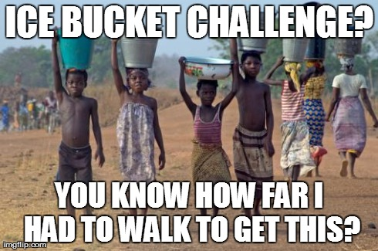
Communication Strategy
Notes:
Communication campaigns succeed more often when they motivate their audience(s) to act in addition to gain knowledge. By focusing on what the organization wants its audience to do, communication strategists have a more effective measure of success. Successful campaigns, particularly social media campaigns, define an impactful act that audiences can engage in. The act should be more than click, comment and share.
For example, the Ice Bucket Challenge raised more than US$115 million for ALS research from 1.4 million donors within the first year of implementation. That number is five times the US$23 million raised the previous year . The Ice Bucket Challenge encouraged people to participate in both a social media activity and donate money.

Slide 7
The University of Jos, Nigeria Advancement Office
Access to lists of philanthropists
Ability to organize donor drives
Possibilities of soliciting alumni support
Notes:
Many may argue that there are real barriers to gaining donor support from mass audiences for NRENs in the region. However, there may be other opportunities for more targeted approaches in getting audiences to act in meaningful and supportive ways.

Slide 8
The Network Solution
GARNET
RITER
GabonREN
TogoREN
WACREN
NigerREN
snREN
MaliREN
RIC
Notes:
The Network Solution
A WACREN Communication Network offers a unique opportunity to shift a large part of the responsibility for communication locally to the WACREN member countries. This will be achieved in part through modeling successful practices employed by campus news networks . Similarly, the proposed Communication network will bring together a multidisciplinary cohort of scholars united in a desire to utilize NRENs to improve collaboration, connection, and communication.
Specifically, the Network will focus on the following strategic goals to: (1) share resources to better inform audiences about the role and potential of NRENs; (2) document research innovation facilitated by or that could be facilitated by NRENs; (3) build sustainable student media with wider audiences accessible through RENs; (4) improve teaching and learning in communication arts and science fields; and (5) strengthen partnerships with key stakeholders.

Slide 9
The Network Solution
WACREN
NREN
Communication Strategy
Audience
Purpose
Policy
Goal
Implementation
Assessment
WACREN website
Maintaining WACREN website
Ensuring updated content
Training
Guidelines for member REN
Ensuring access to applications/services
Networking with local partners
Student Media
Advancement Offices
Media Influencers
Target Audiences
Creating and Sharing Content
Report on NREN activities
Engage audiences on social media
Features on NREN users
Implementing Campaigns
Localization
Feedback to WACREN

Slide 10
The Network Solution
Share resources to better inform audiences
Document research innovation
Build sustainable media
Improve teaching and learning
Strengthen partnerships with key stakeholders.

Slide 11
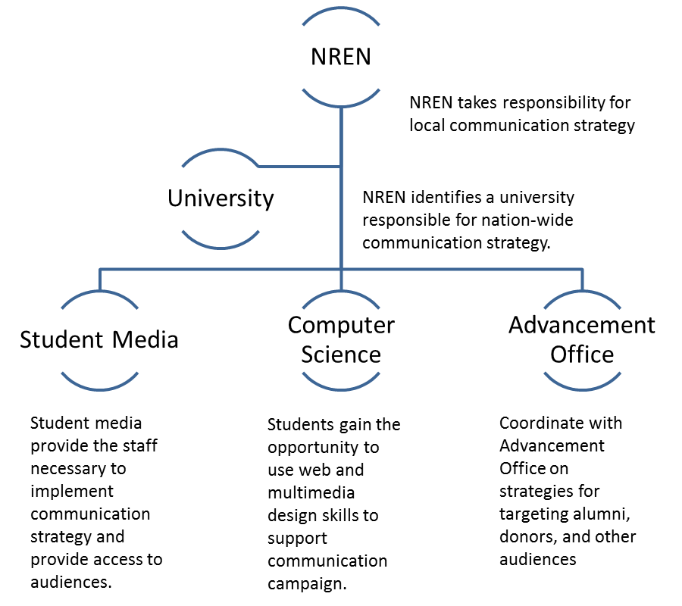
Model for a NREN Communication Network
Notes:
Each country with an NREN would identify one of the universities with the top student media program to coordinate Network activities. The network can begin modestly with one communication manager and grow as WACREN develops an appropriate framework. The communication manager, under WACREN and university guidance, could form a committee which includes students from communication, computer science and related disciplines, as well as personnel from advancement offices.

Slide 12
The Network Solution – Long Term Goals
Report news and write articles for WACREN media platform/website, social media
Write stories about NREN for student media
Implement social media campaigns
Develop multimedia Public Service Announcements
Produce documentaries of NREN activities – supported research, teaching and learning initiatives, etc.
Work with Advancement Office to engage larger audiences – potential donors, alumni, etc.

Slide 13
Summary and Conclusion
The Network Solution
Aligns with WACREN’s philosophy.
Challenges NRENs to take responsibility for gathering and disseminating news
Holds capacity to help create content to store in multimedia formats
Helps chronicle the history, development and aspirations of the REN community
Supports the creation of a wealth of content for RENs digital archives.
Nurtures the technical expertise to support as teaching and learning initiatives by developing the talent to create multi-media learning objects
Notes:
Working together, WACREN and NRENs can significantly increase public knowledge about the state and promise of RENs. Collaborating on a communication strategy aligns with WACREN’s philosophy. Today WACREN makes it easy to share technical expertise, talent and experiences. This same principle could be used to support information sharing. To an extent this is already happening on the WACREN website, through TANDEM, and at conferences such as WACREN 2016. Nevertheless, to build a strong network WACREN needs to harness the potential of its 11 NRENs, challenging each to take responsibility for gathering and disseminating news and information. The network can start quite modestly by identifying one person in each country to create concise, visual, sharable content. It could grow exponentially by liaising with news organizations, the university community, and other key stakeholders.
The network also holds tremendous capacity to help create content to store in multimedia formats. First by chronicling the history, development and aspirations of the REN community on a regular basis, the network can create a wealth of content for RENs digital archives. Second, as teaching and learning initiatives increase the need for the creation and use of multi-media learning objects – the producer from the network, now skilled in creating concise, visual and sharable content – can work across disciplines to teach users how to produce high quality visual content.
In sum, this paper proposes a three phase strategy to: 1) customize a communication strategy to meet the needs of the WACREN community; 2) develop a communication campaign to engage current stakeholders and build wider constituencies; and 3) develop a news and information network to sustain WACREN goals for communication. The author envisions these activities being supported by a wider teaching and learning initiative for academic staff and students in mass communication, digital content development, computer science, and related disciplines. Interest in NRENs have been heightened primarily among academic audiences by public relations and social media campaigns (GEANT, 2015; Taylor 7 Abbott, 2015). Still the need exists, particularly in the early stages of WACREN, to build constituencies—through a planned communication strategy—beyond the core technical audiences.

